Slide 1
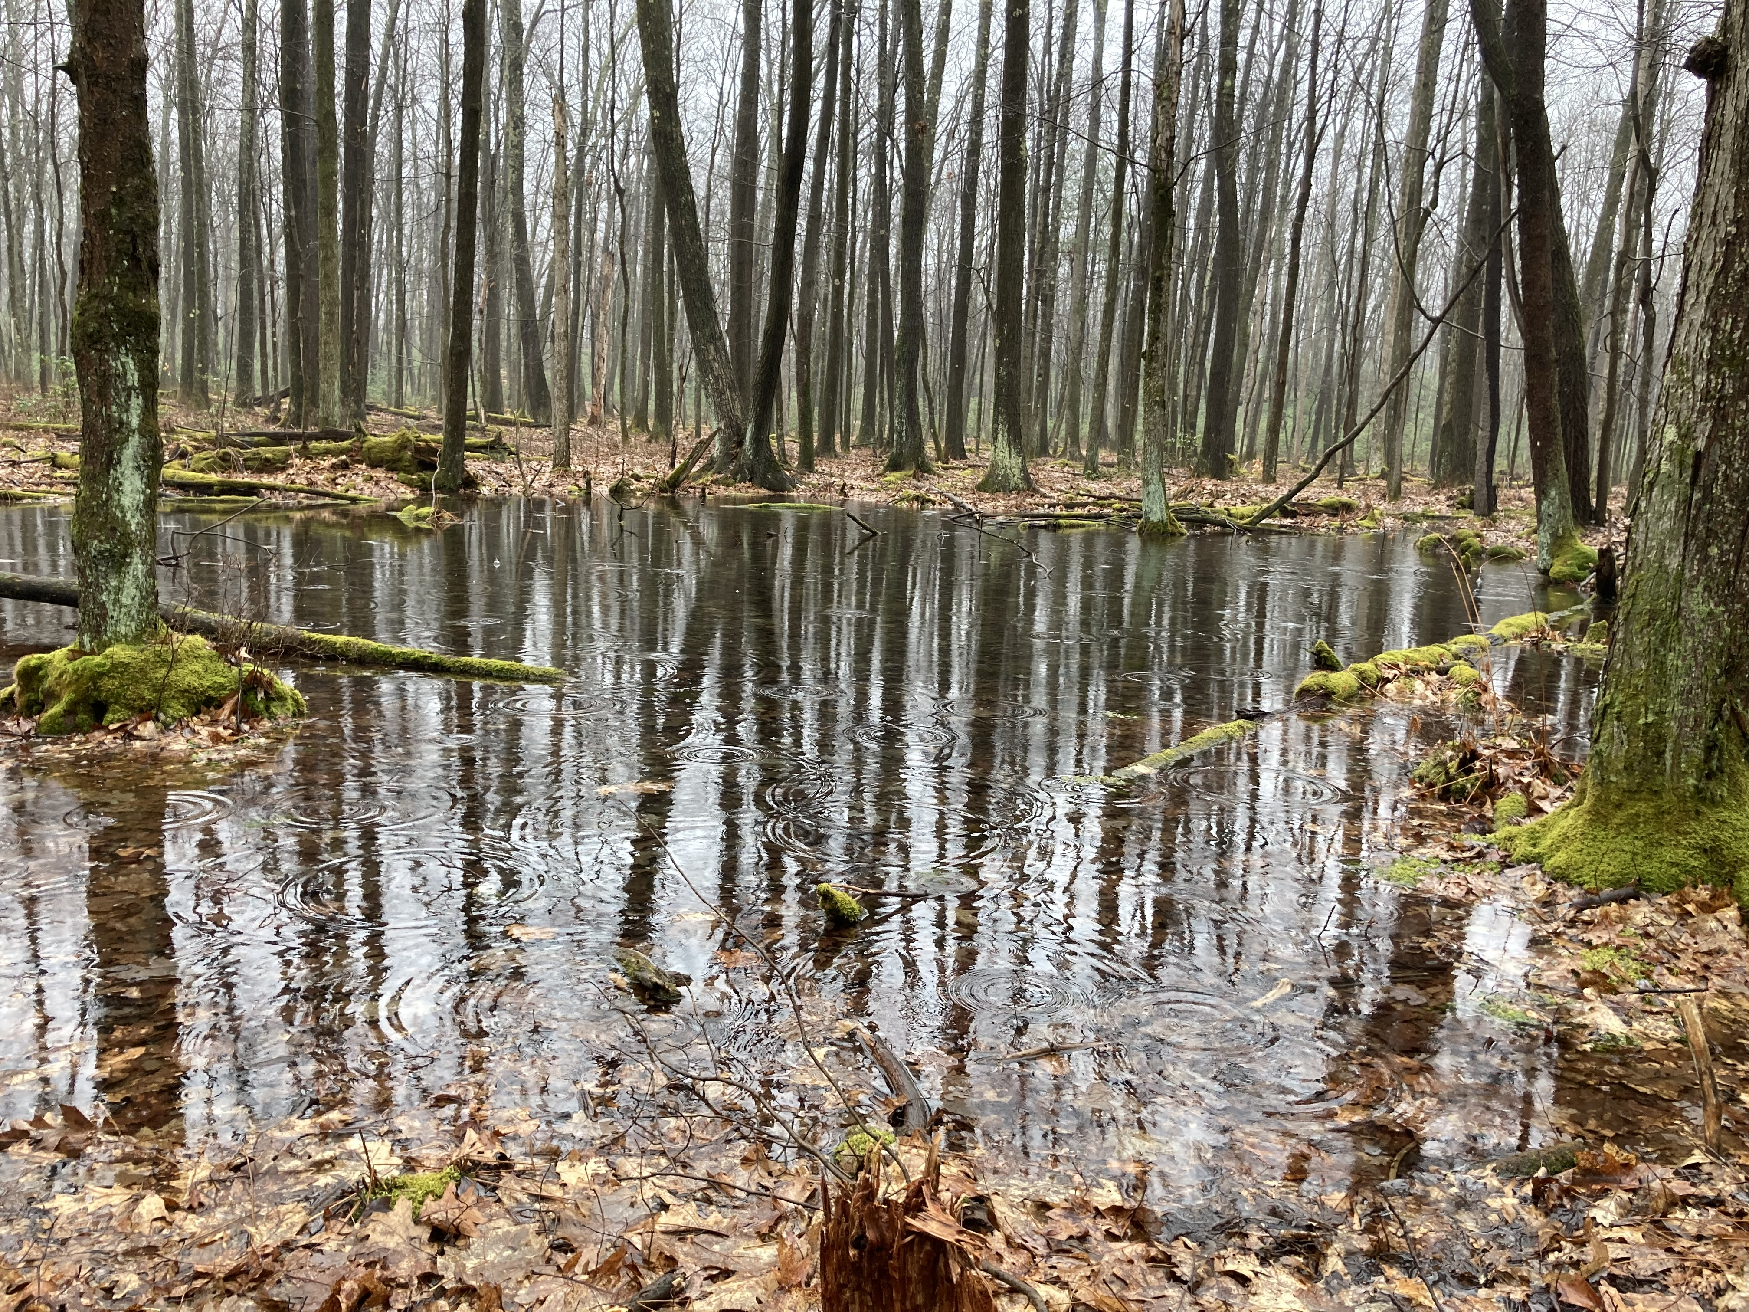



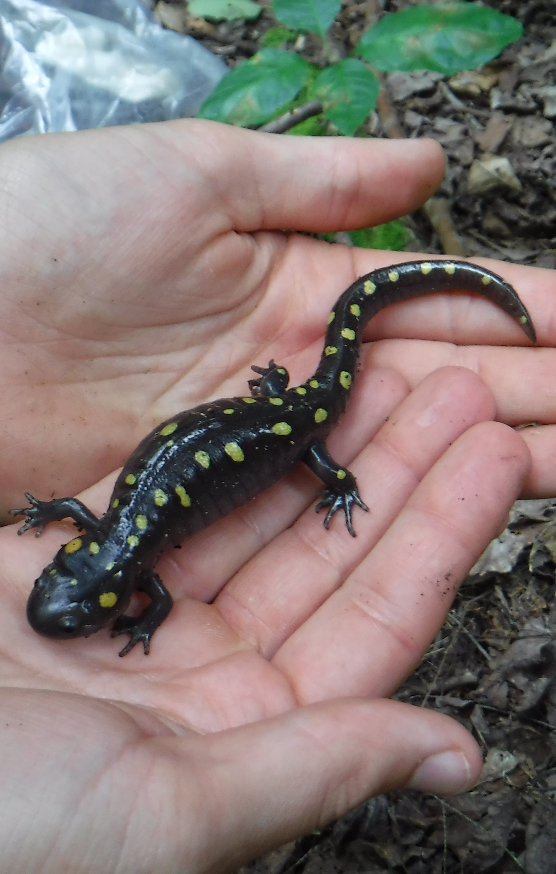

Vernal Pool Tour
Come experience a vernal pool migration (hopefully!). Learn more about vernal pools, protection of these unique environments, and the critters that use them. This is a kid friendly event. Space will be limited to 30 people per event so please call to reserve a spot.
March 27, 2026, 8PM:
Clear Creek State Park
&
April 17, 2026, 8PM:
Clear Creek State Park
For more information and to RSVP, please contact Dana Hannibal with the Jefferson County Conservation District at 814-849-7463 or dana@jeffersonconservation.com.

