Slide 1
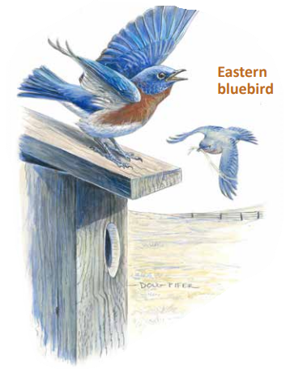
Bluebird Nesting Box Event When: March 21, 2026 Where: Jefferson County Conservation District 1514 Route 28, Brookville, PA Time: 10-11:30am
REGISTRAION CLOSED
Learn about Bluebirds and build a nesting box with the Jefferson County Conservation District and PA Game Commission! Please bring a hammer and power drill, if available.
Only 20 boxes are available. Please call or email Dana Hannibal to RSVP at 814-849-7463, dana@jeffersonconservation.com.

Slide 2
Bluebird Nesting Box Event When: March 21, 2026 Where: Jefferson County Conservation District 1514 Route 28, Brookville, PA Time: 10-11:30am
Learn about Bluebirds and build a nesting box with the Jefferson County Conservation District and PA Game Commission! Please bring a hammer and power drill, if available.
Only 20 boxes are available. Please call or email Dana Hannibal to RSVP at 814-849-7463, dana@jeffersonconservation.com.

