Slide 1
DGLVR Projects 2025
Grant Funds Awarded: $712,500.65
Total Project Value: $848,374.11

Slide 2
Swamp Run Rd Knox Township
Grant Funded: $45,660.98
Total Project Value: $52,475.20

Slide 3
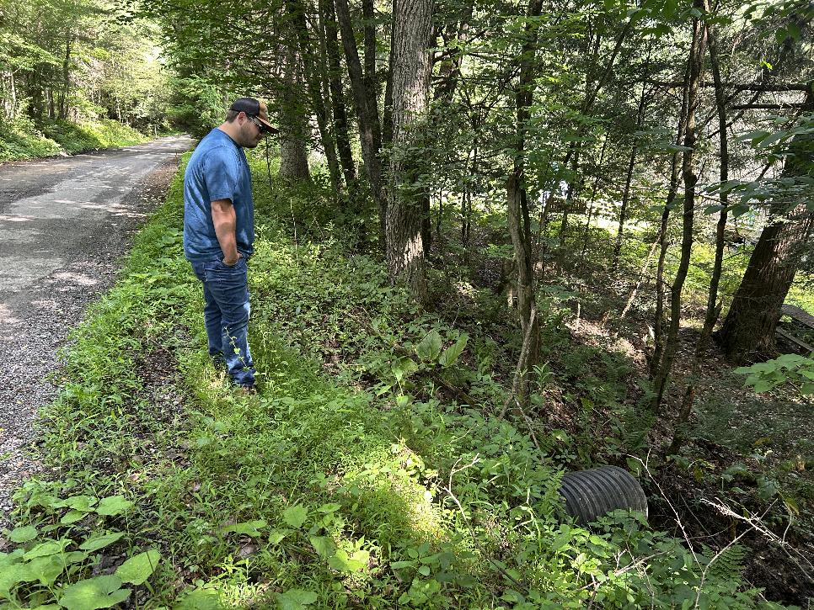
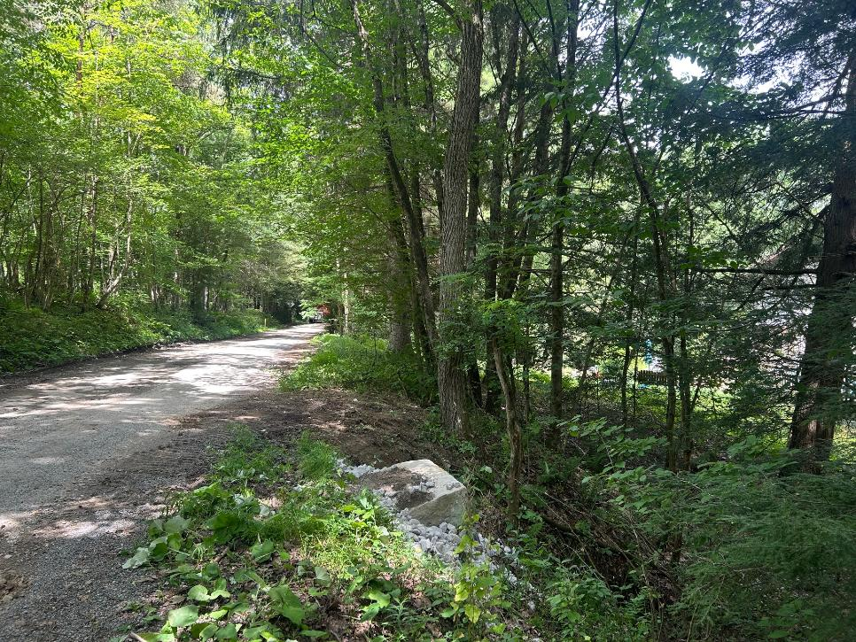
Before
After

Slide 4
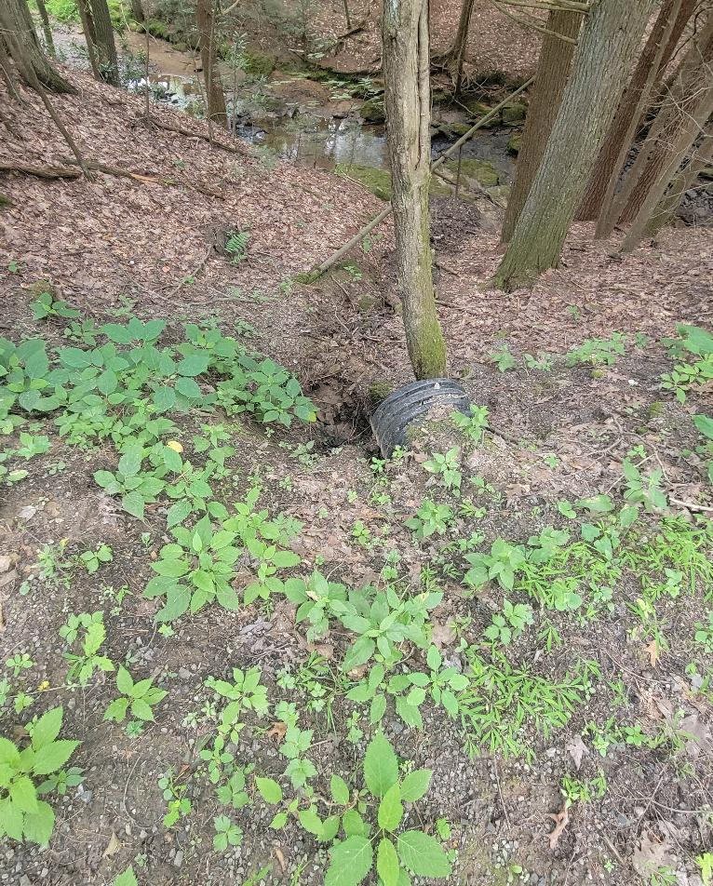
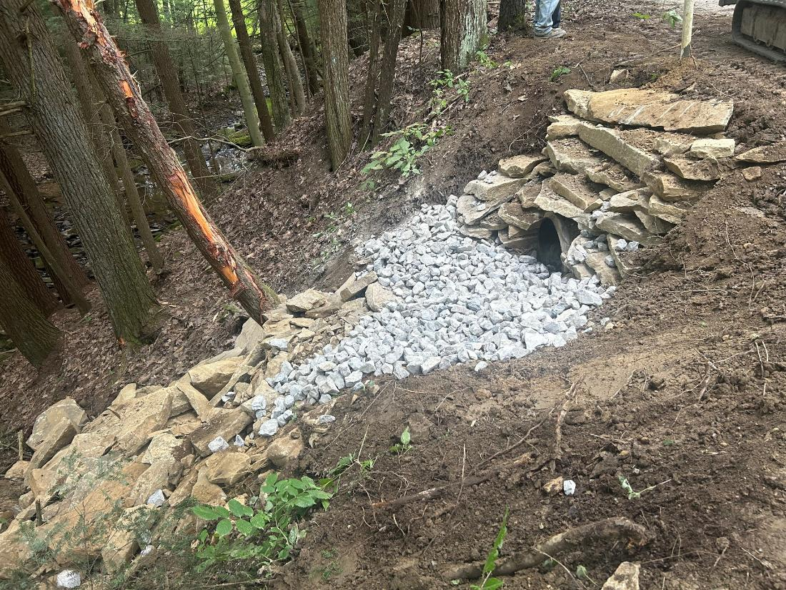
Before
During Construction

Slide 5
Witch Hollow Rd
Knox Township
Grant Funded: $61,543.00
Total Project Value: $62,524.88

Slide 6
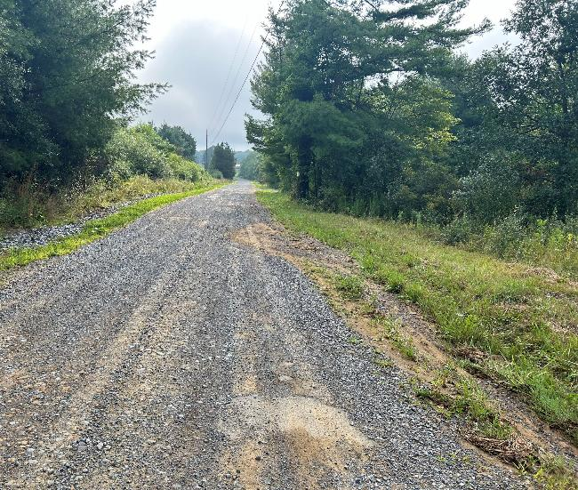
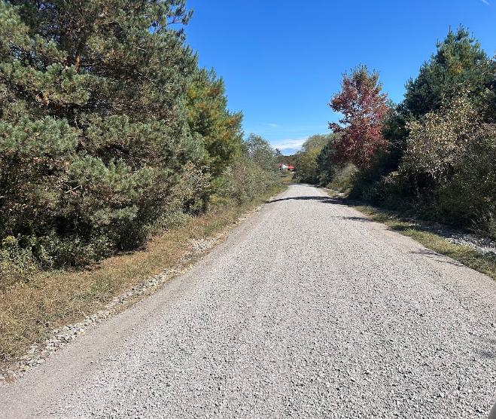
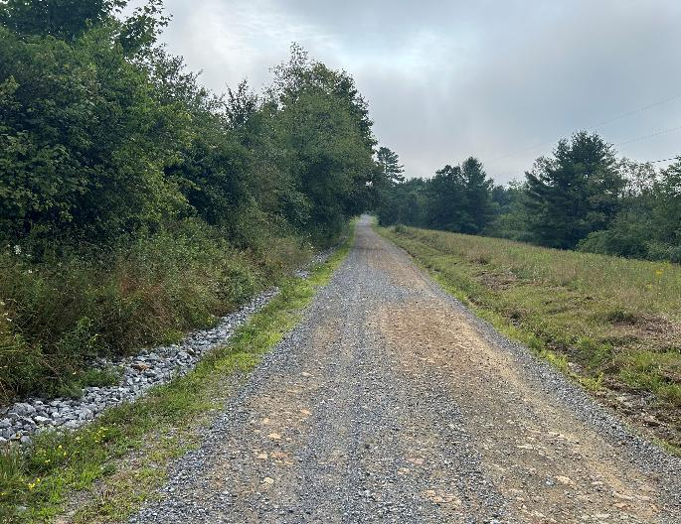
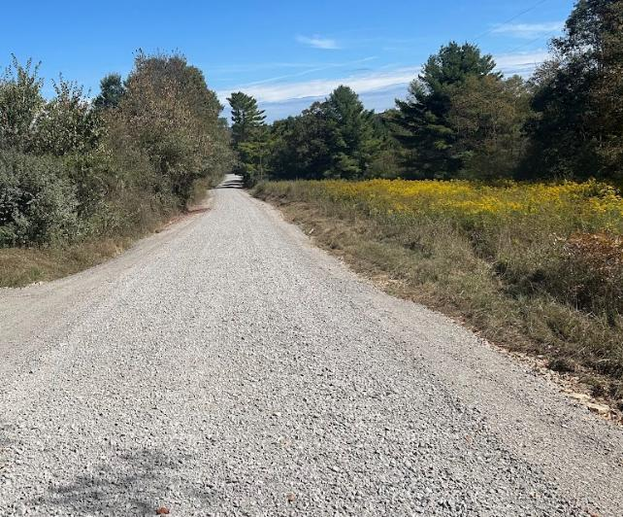
Before
After
Before
After

Slide 7
London Rd
Oliver Township
Grant Funded: $56,482.17
Total Project Value: $65,854.97

Slide 8
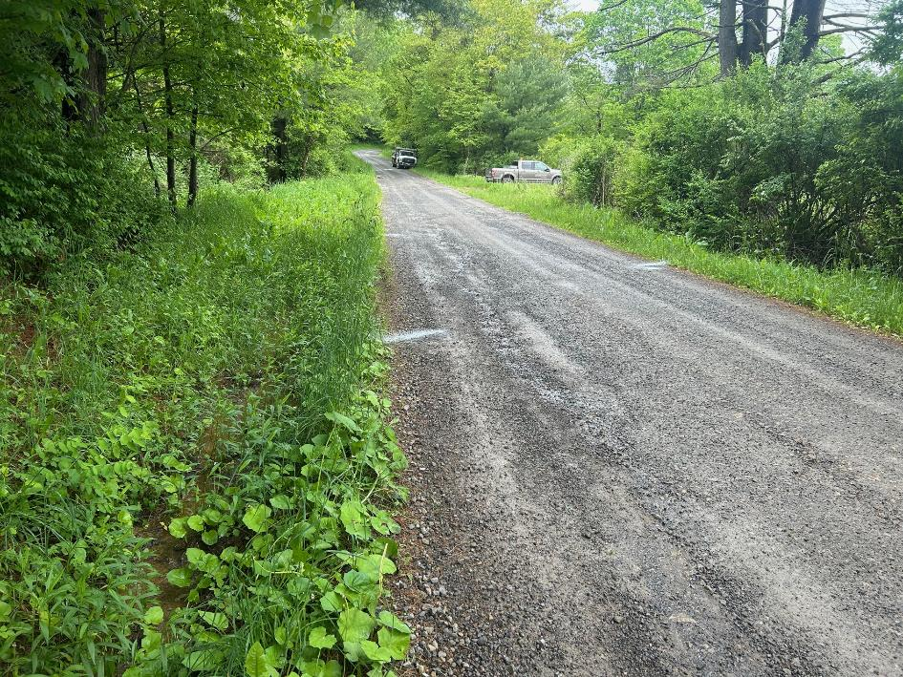
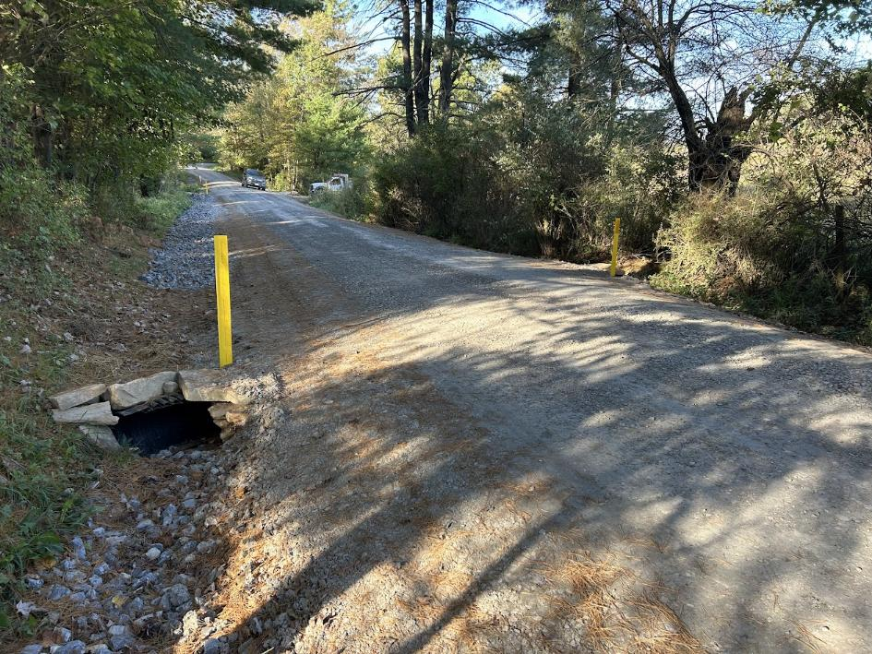
Before
After

Slide 9
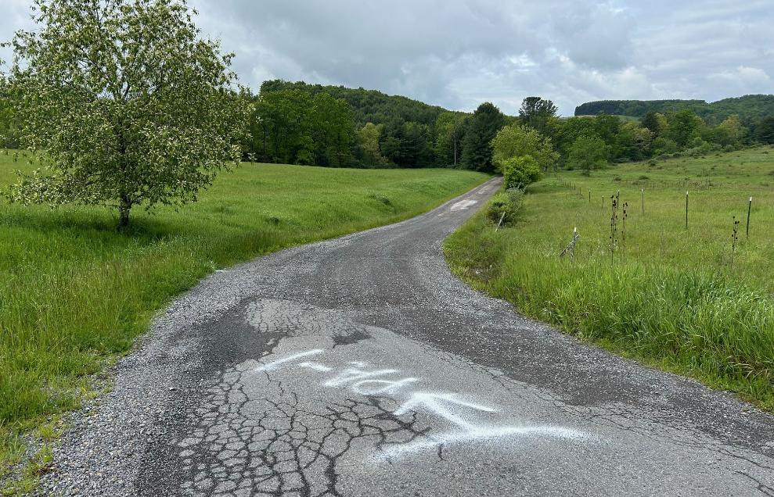
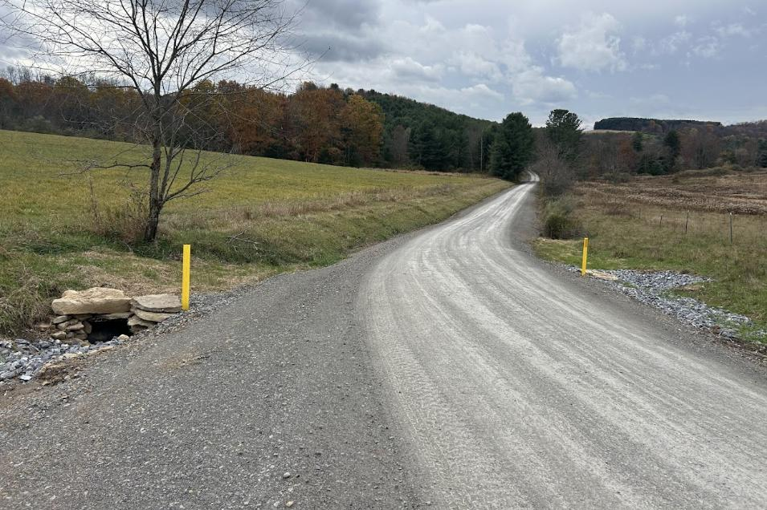
Before
After

Slide 10
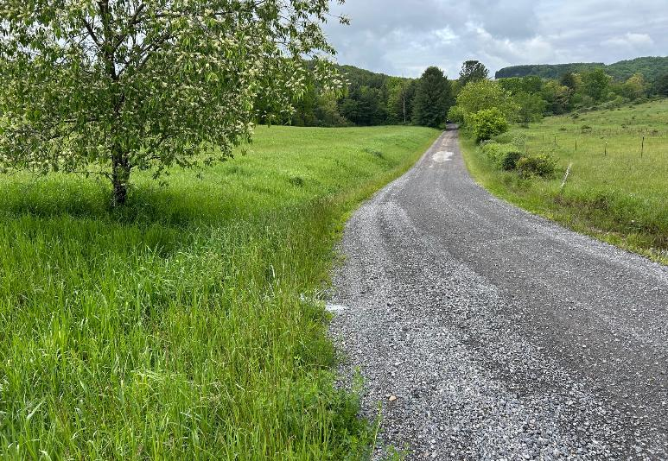
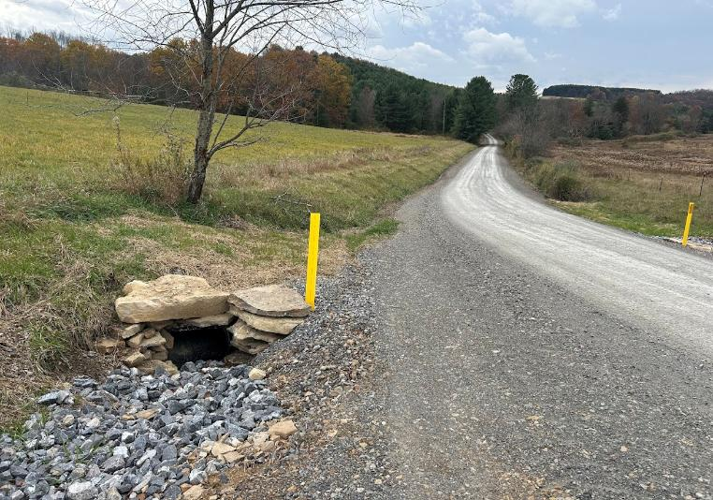
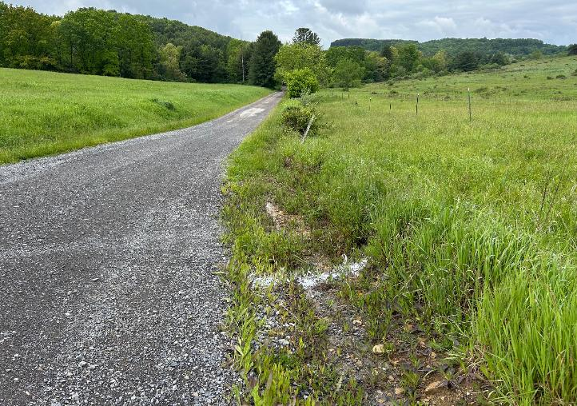
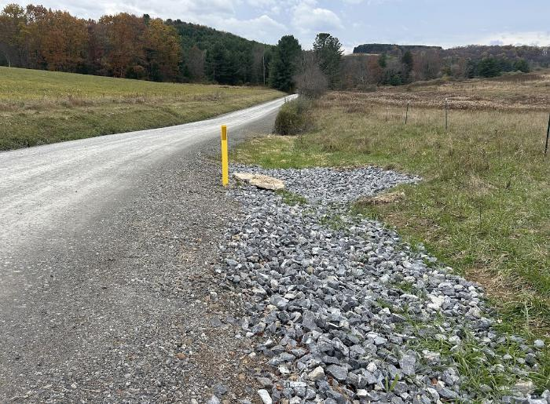
Inlet Before
Inlet After
Outlet Before
Outlet After

Slide 11
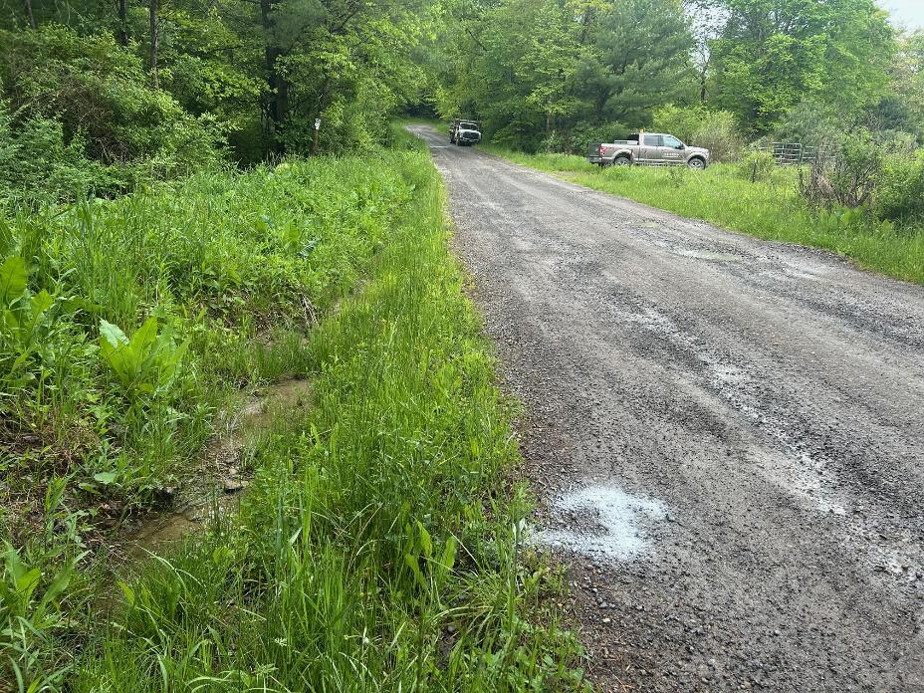
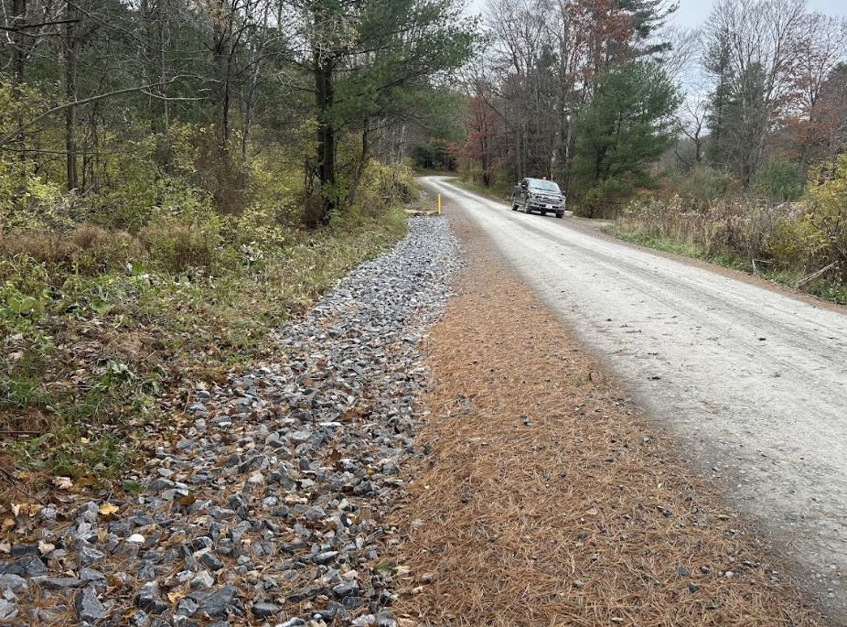
Before
After

Slide 12
Jimtown Rd
Polk Township
Grant Funded: $93,627.60
Total Project Value: $118,677.60

Slide 13
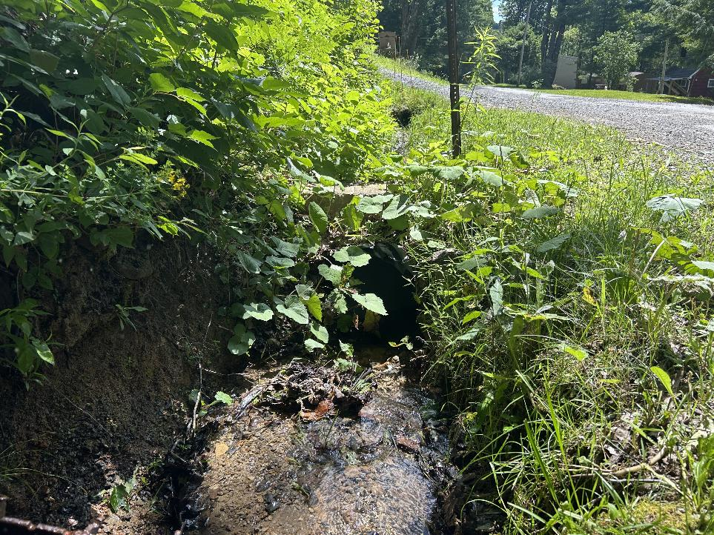
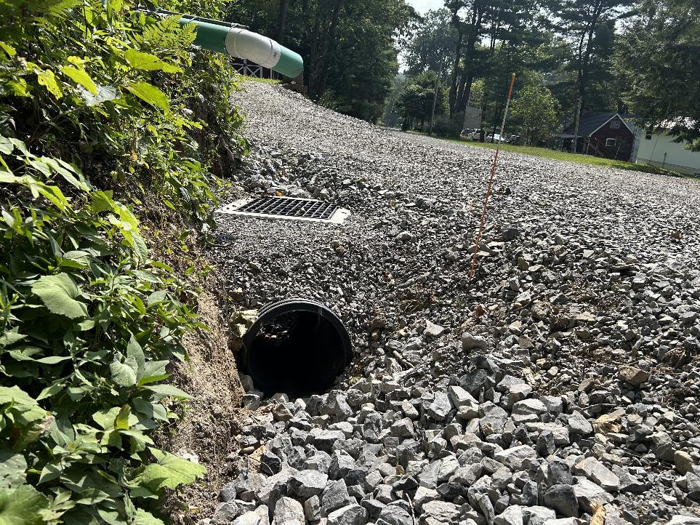
Before
After

Slide 14
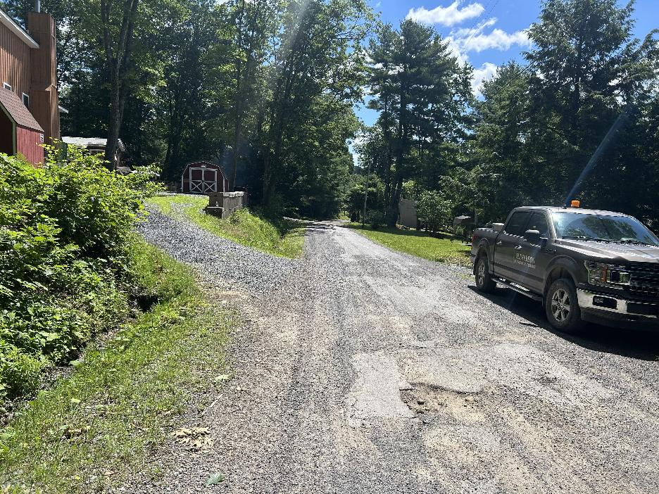
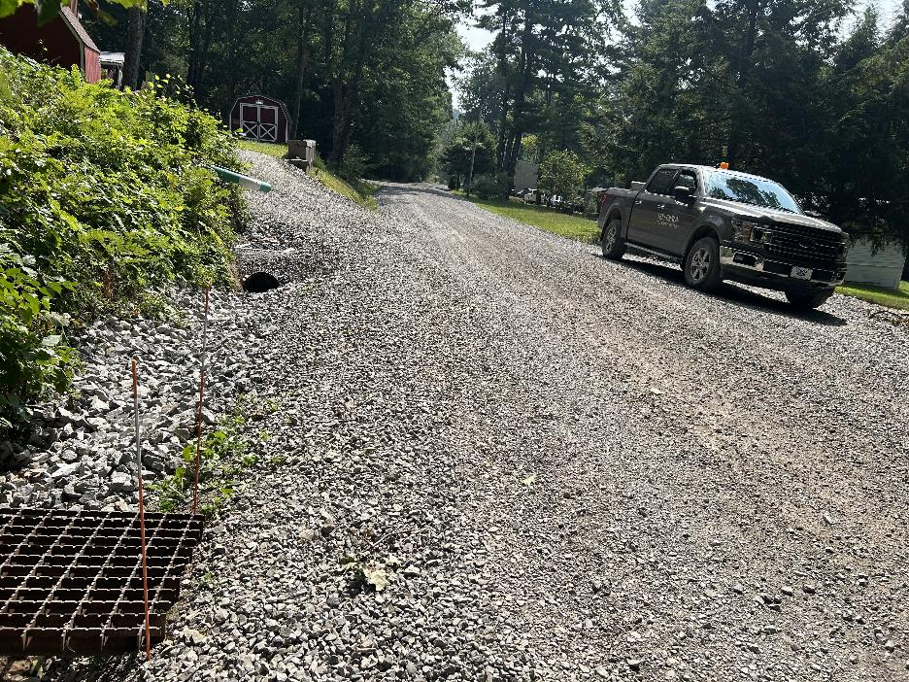
Before
After

Slide 15
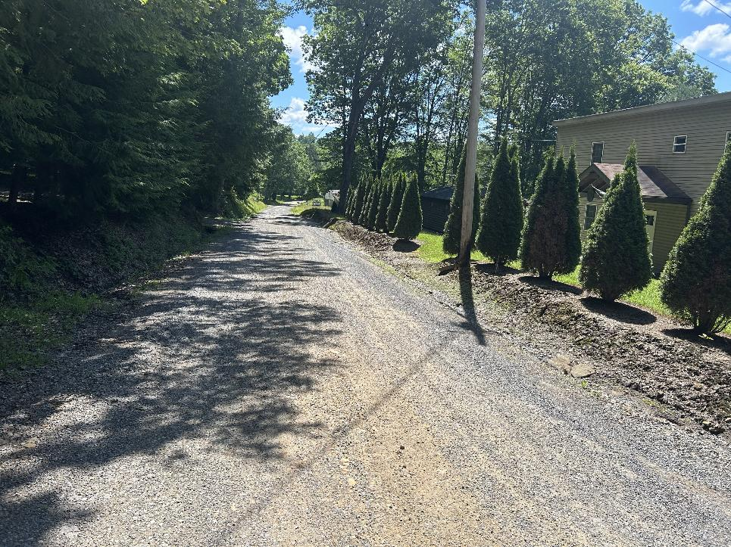
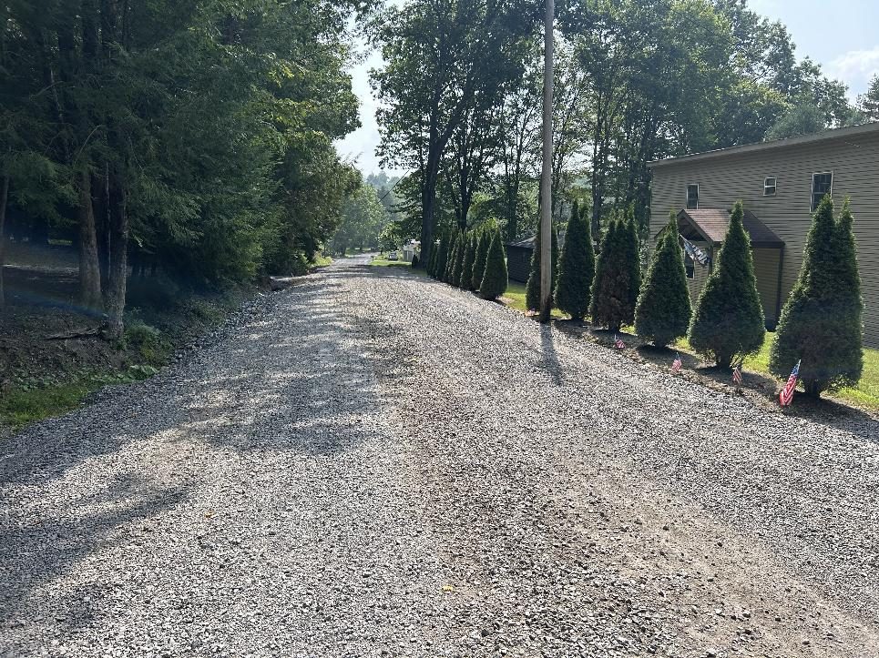
Before
After

Slide 16
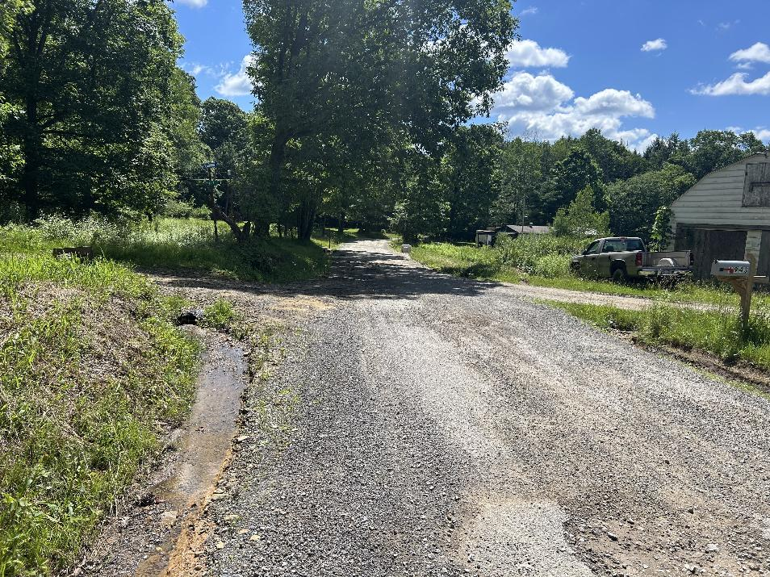
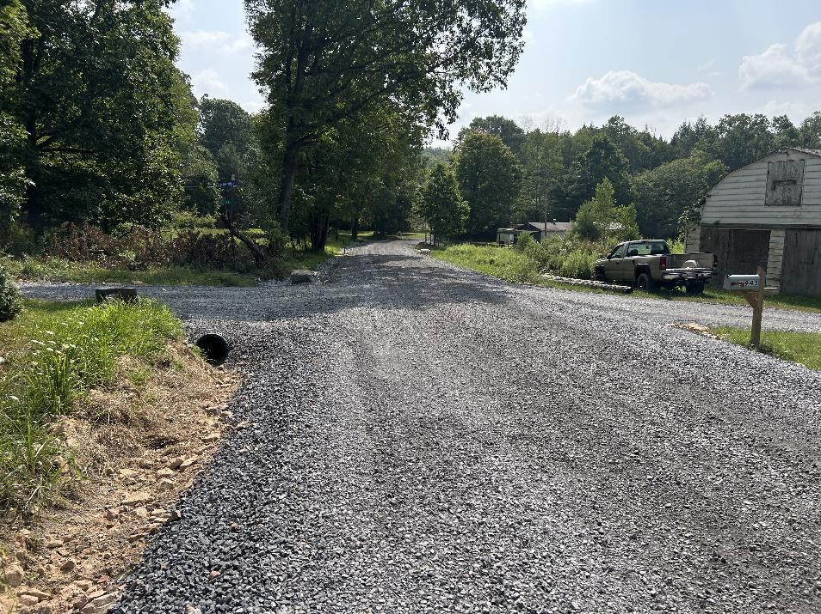
Before
After

Slide 17
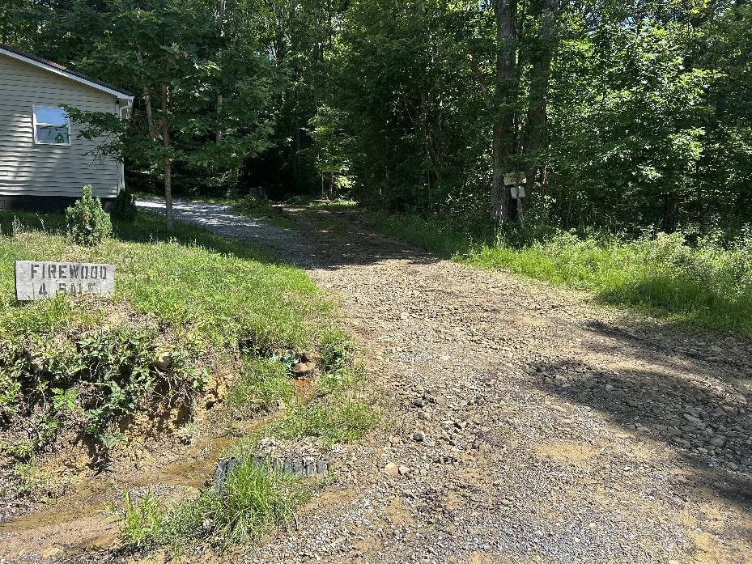
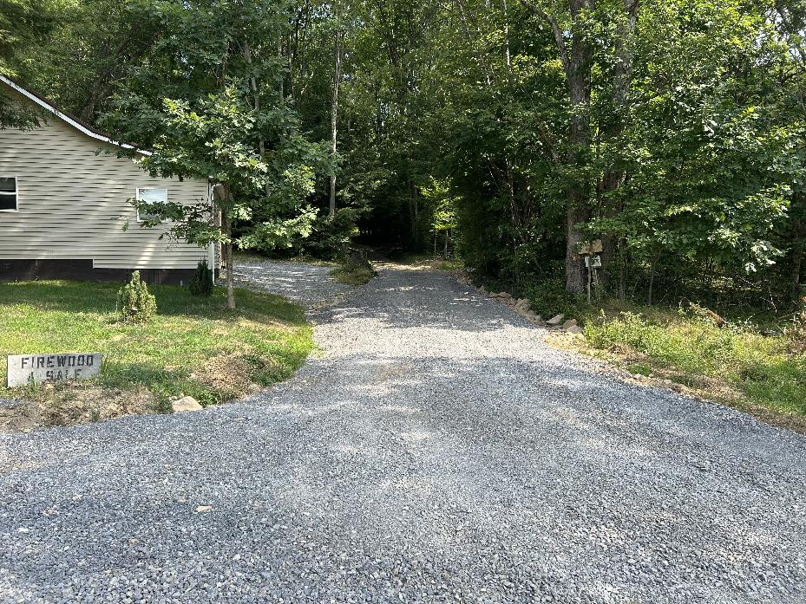
Before
After

Slide 18
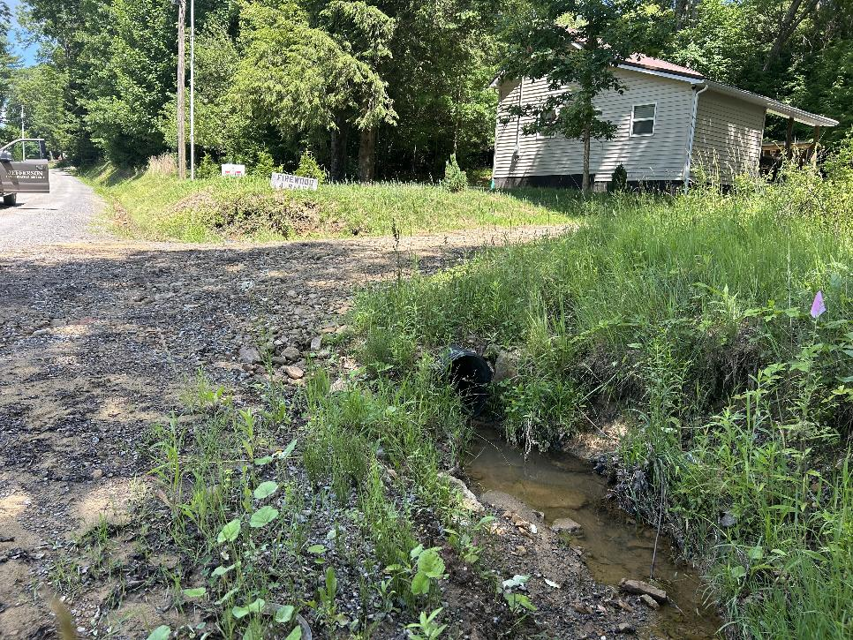
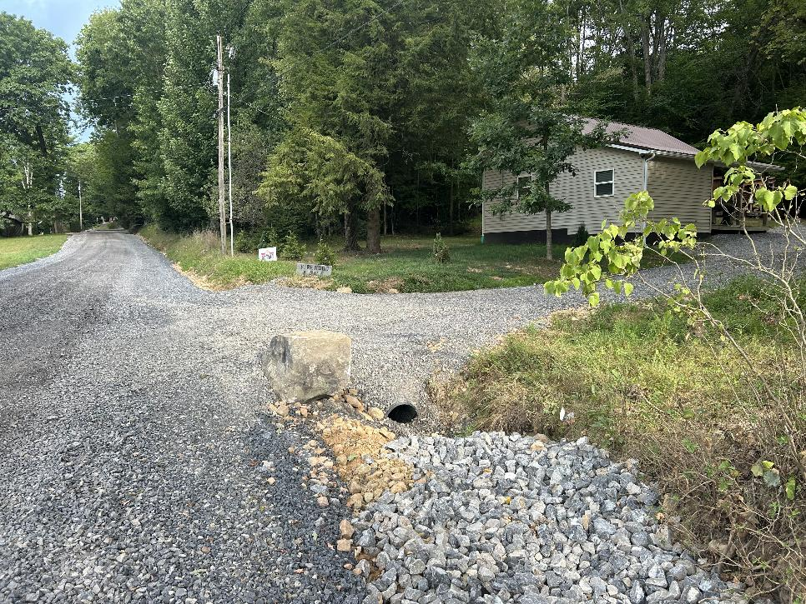
Before
After

Slide 19
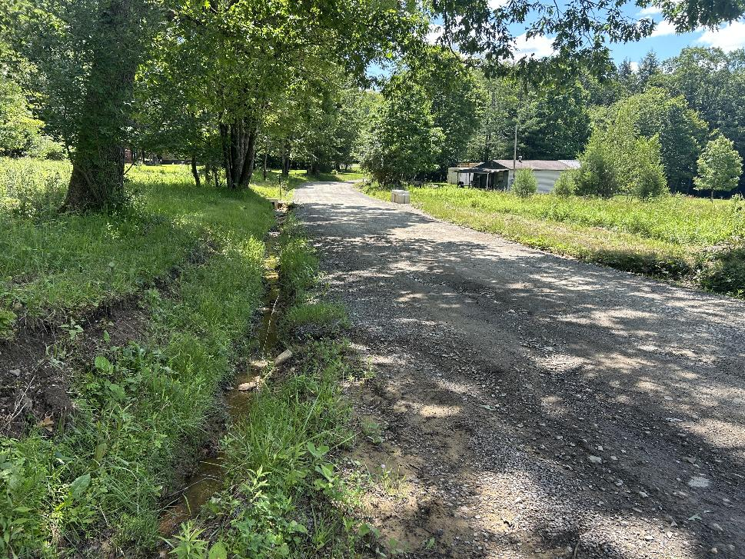
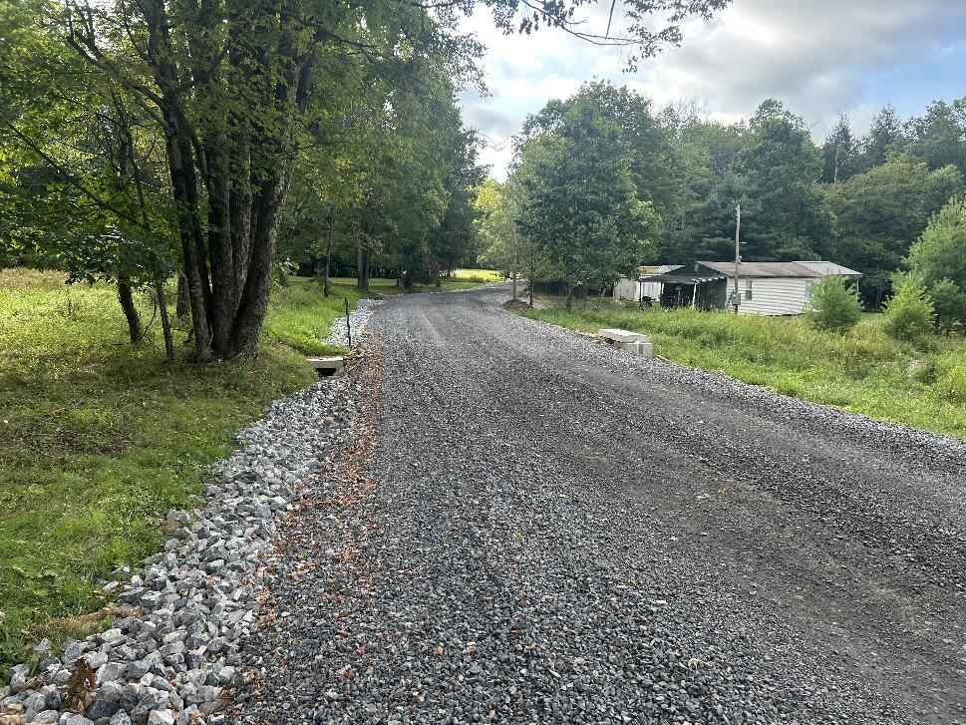
Before
After

Slide 20
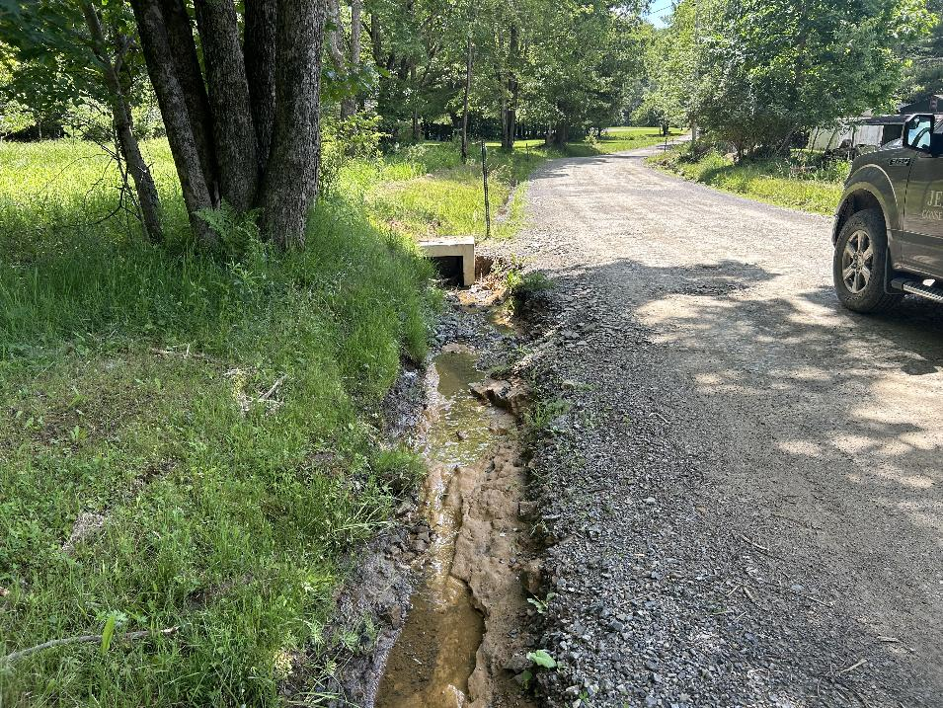
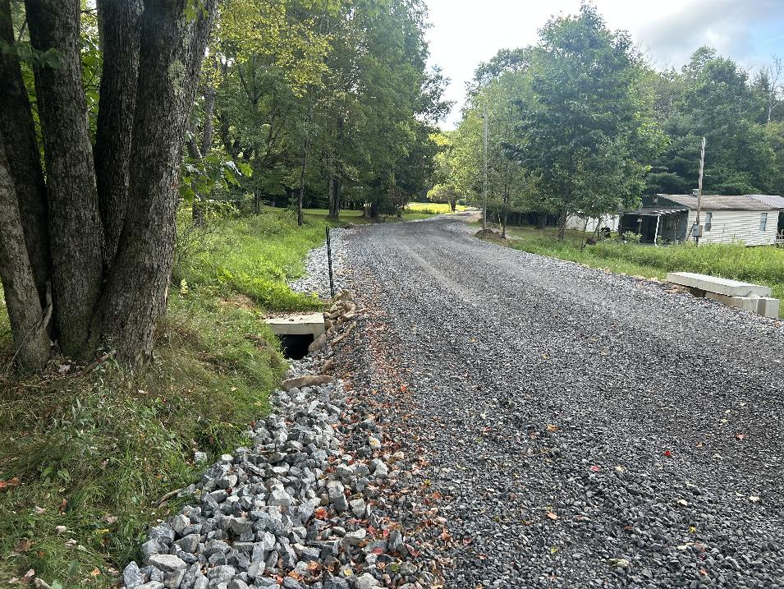
Before
After

Slide 21
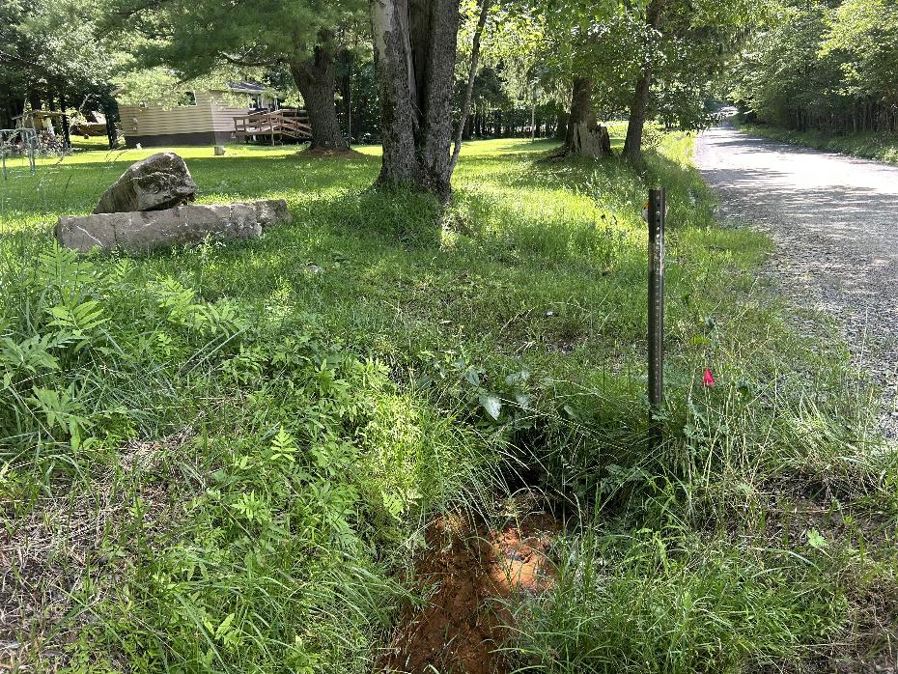
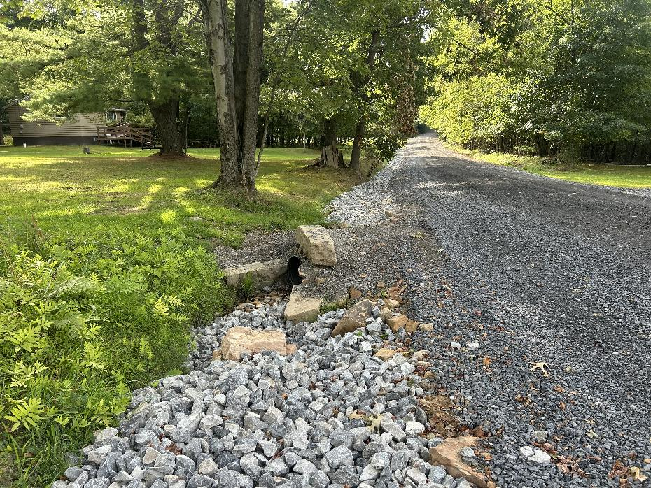
Before
After

Slide 22
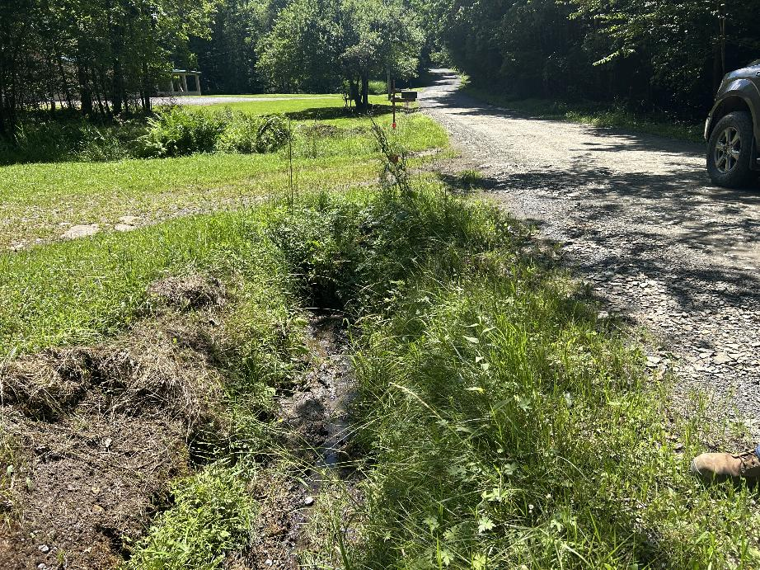
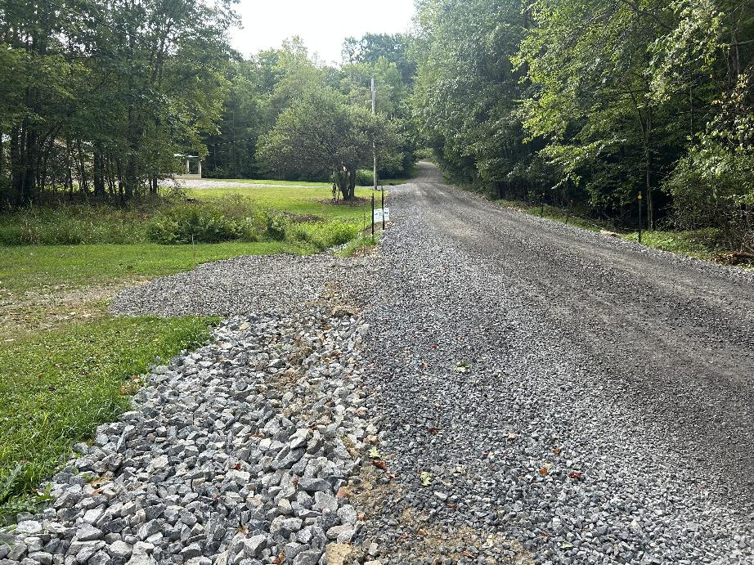
Before
After

Slide 23
Minich Rd
Ringgold Township
Grant Funded: $23,853.53
Total Project Value: $30,626.33

Slide 24
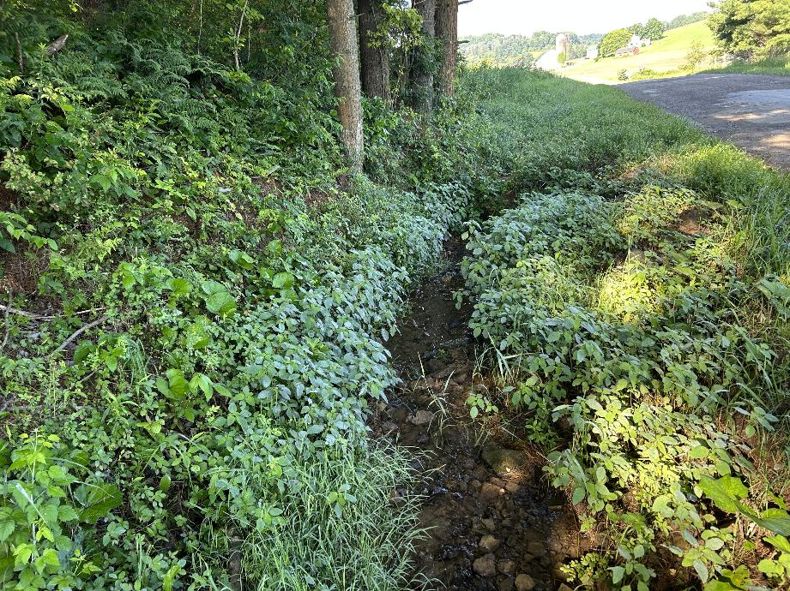
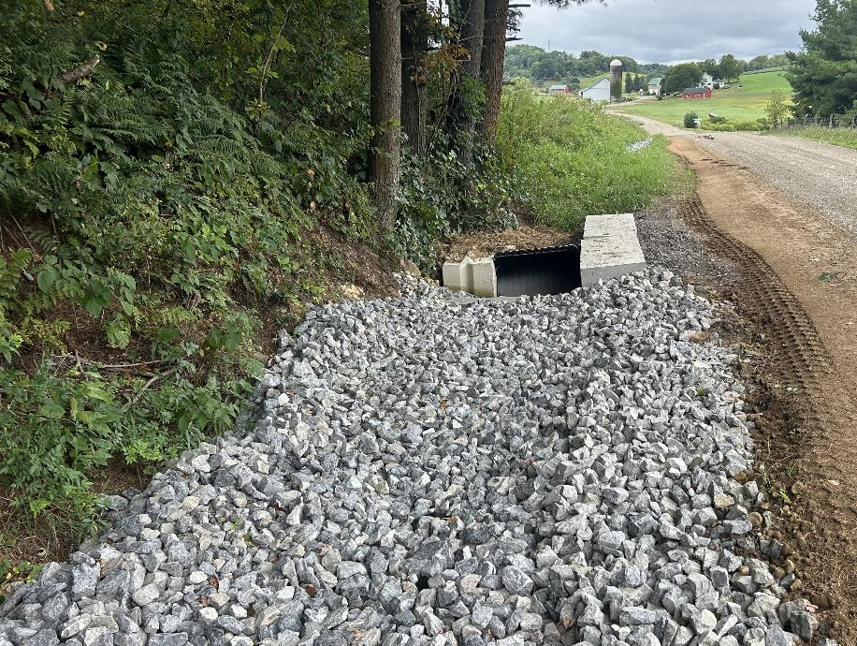
Before
After

Slide 25
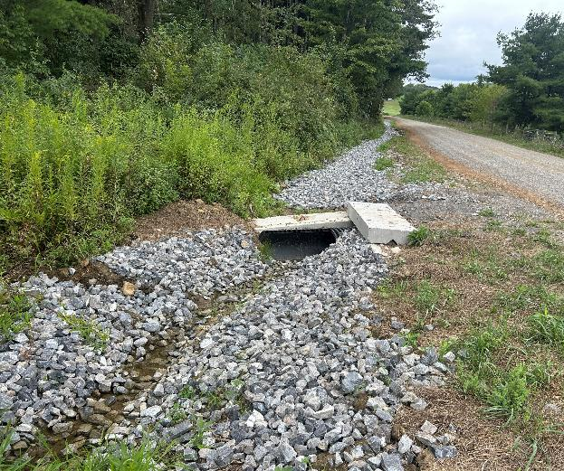
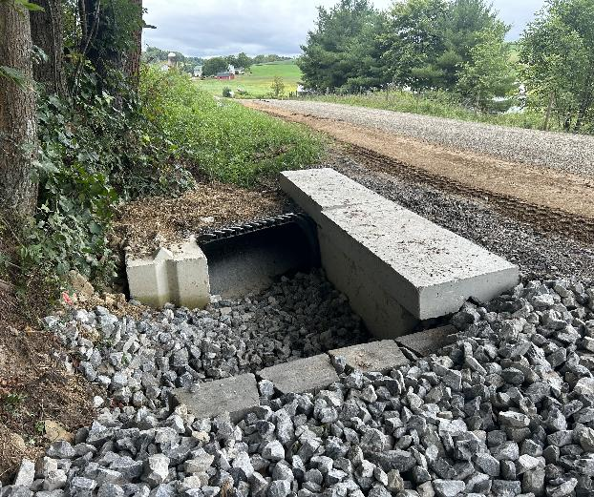
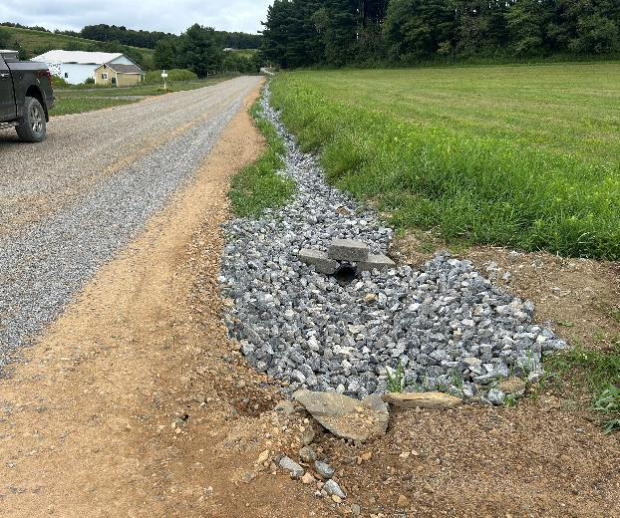
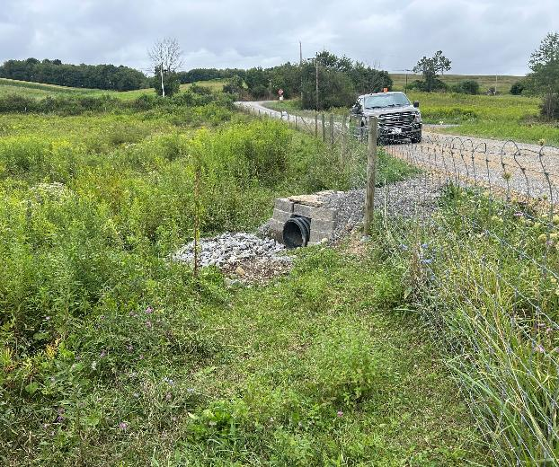
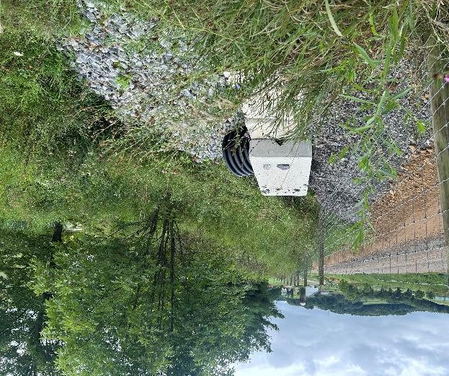
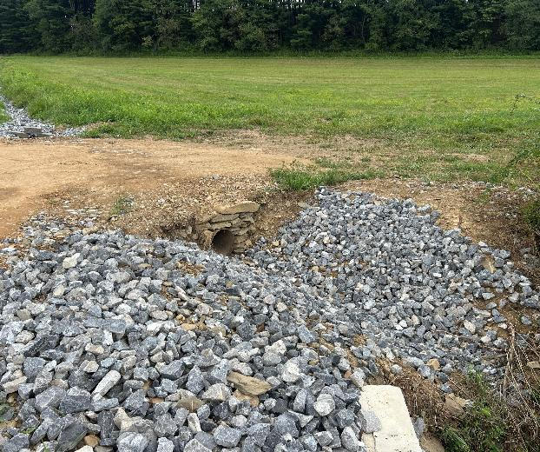
Pipe 1 Inlet
Pipe 2 Inlet
Underdrain Outlet
Pipe 1 Outlet
Pipe 2 Outlet
Field Access Pipe Outlet

Slide 26
Sherry Hollow Rd
Ringgold Township
Grant Funded: $19,386.69
Total Project Value: $37,684.63

Slide 27
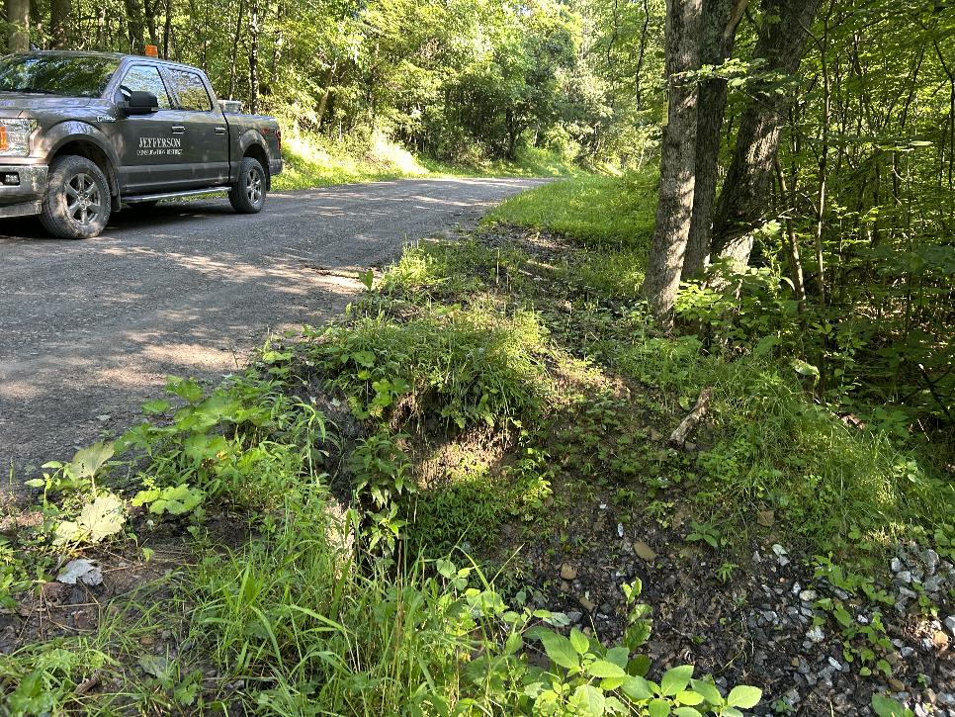
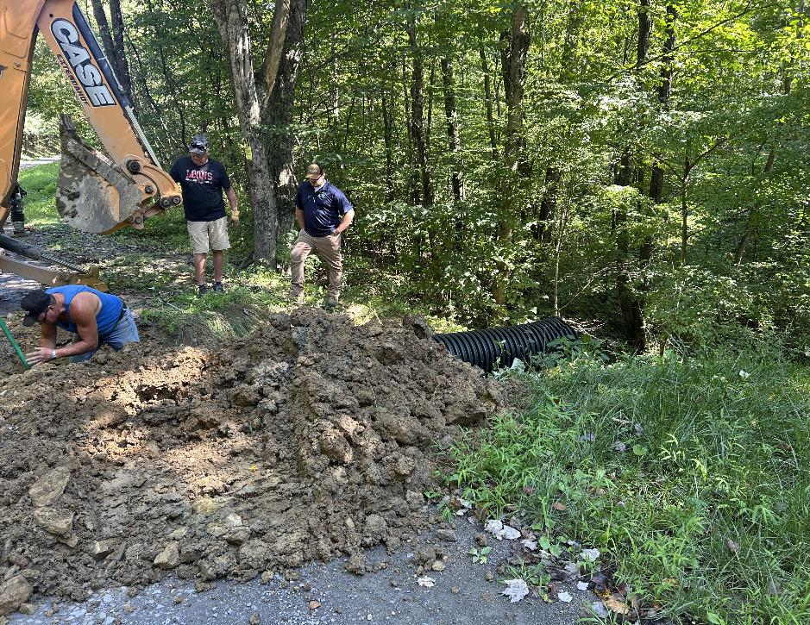
Before
During Construction

Slide 28
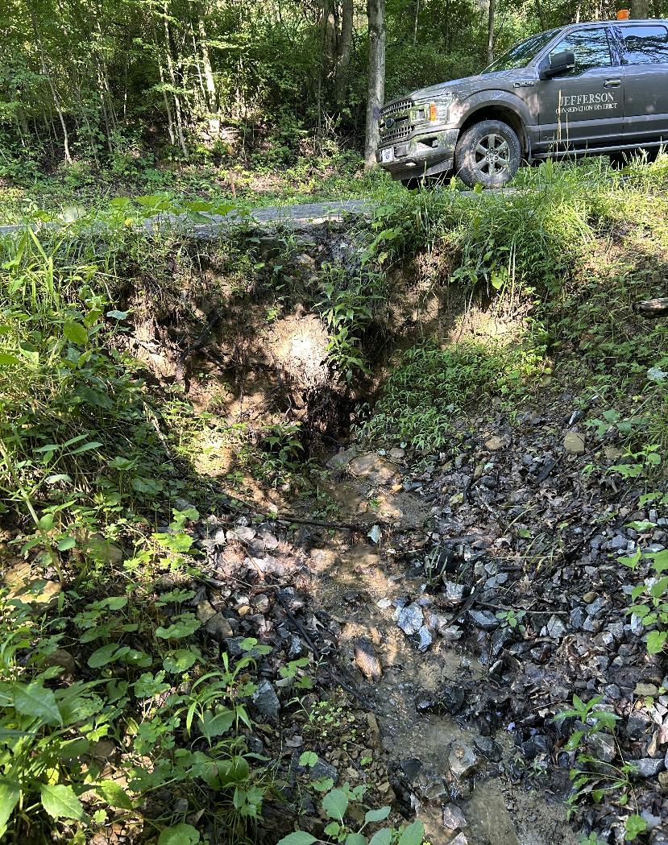
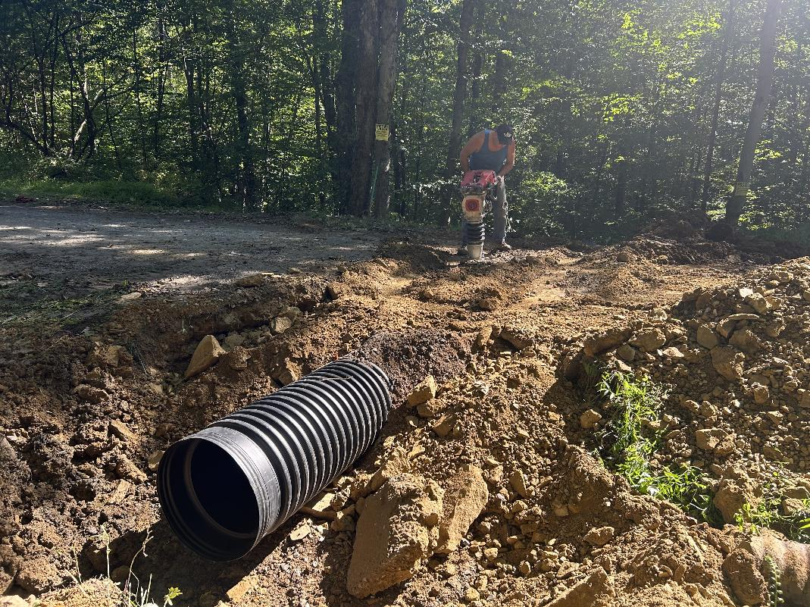
Before
During Construction

Slide 29
Gilbert Road
Warsaw Township
Grant Funded: $214,268.28
Total Project Value: $254,502.20

Slide 30


Before
After

Slide 31
Cathers Run Rd
Barnett Township
Grant Funded: $164,917.40
Total Project Value: $176,017.40

Slide 32


Before
After

Slide 33


Before
After

Slide 34


Before
After

Slide 35


Before
After

Slide 36


Before
After

Slide 37


Before
After

Slide 38
Brown Rd
Young Township
Grant Funded: $32,761.00
Total Project Value: $50,010.90

Slide 39


Before
After

Slide 40


Before
After

Slide 41


Before
After

