Slide 1
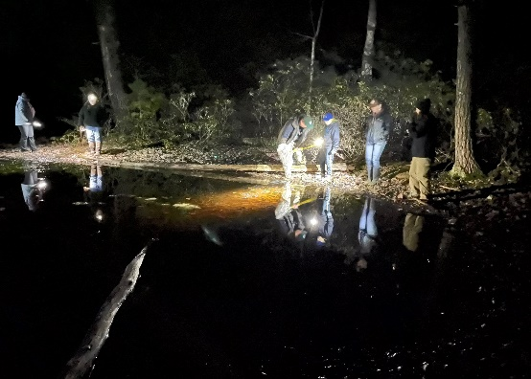
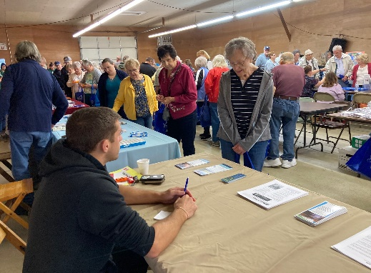
The District is governed by a board of directors consisting of a representative of Jefferson County Commissioners, three farmer members, and three public members. Associate directors assist the board in its mission.
Individuals are recommended for board membership by nominating organizations having interests in natural resources conservation. County Commissioners appoint the directors who, in turn, appoint associate directors. All serve on a voluntary basis.
Protecting our Resources for Future Generations
The District is funded by annual appropriations from the State and the County. The remainder is generated through delegation agreements for other state and local programs and special projects.
The District is authorized to accept donations and bequests, subject to the approval of the State Conservation Commission.
The District’s Environmental Education Program is funded in part, by the sale of bird seed. Quality bird seed can be purchased at the District office.
Financial Resources
Directors:
Chairman – Tom McFarland
Vice-Chairman – Herb Bullers
Secretary/Treasurer – Allen Campbell
Porter Duvall
Theresa Shick
Terry Shields
Sam Farcus
Associate Directors:
Laura Lynn Yohe
Jerry Chamberlin
Tom Kundrich
Dennis Day
Deb Wilson
Bruce Snyder
Staff:
District Manager – Shaun Wessell
Administrative Assistant – Christine Hughes
ACT/Nutrient Mgmt Spec – Megan Whitlatch
Resource Technician – Carl Johnson
District Technician – Dana Hannibal
Watershed Specialist – Evan DeLong
Conservation Technician – Becky Gaston
District Team
Jefferson
County Conservation District
1514 Route 28
Brookville, PA 15825
(814) 849-7463
www.jeffersonconservation.com

Slide 2
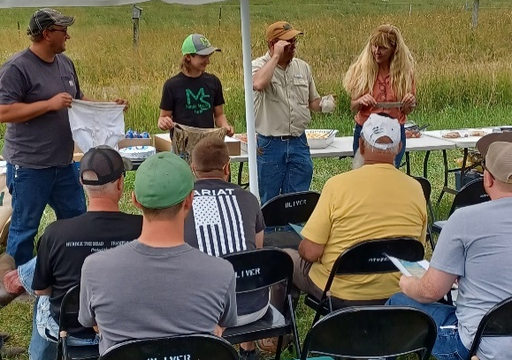
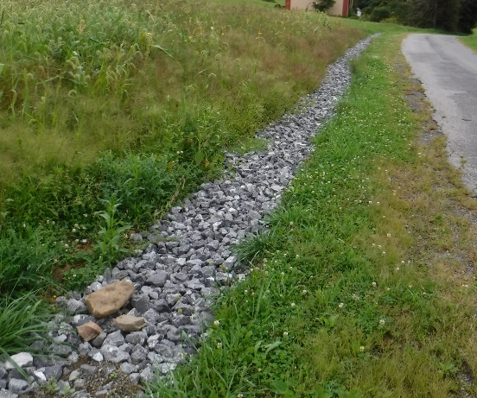
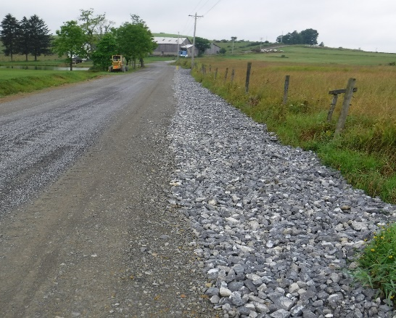
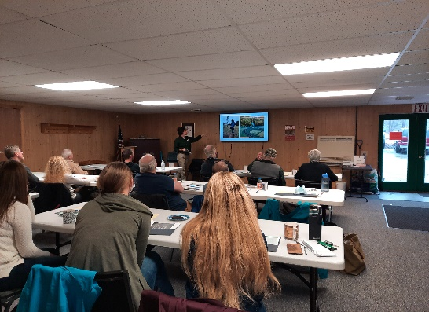
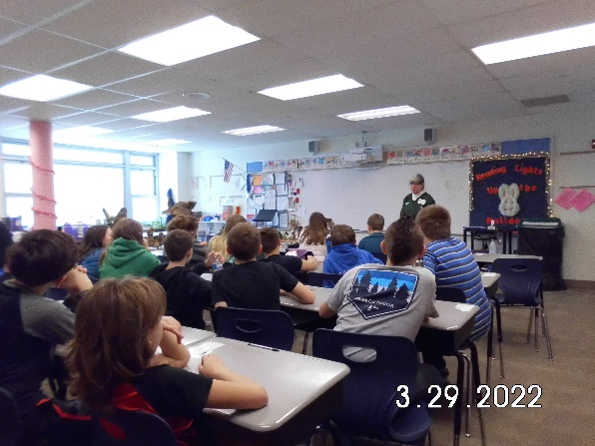
Programs & Services
Reviews of project plans, issue permits, and inspect earthmoving projects to assure that erosion and sedimentation controls are properly installed and maintained;
Participate in the Dirt, Gravel and Low Volume Road Program;
Assist in development of projects designed to reduce or eliminate pollution from abandoned mines;
Educate developers, engineers, contractors and other professionals to implement best management practices to protect water quality;
Assist landowners in resolution of complaints arising from earthmoving projects;
Conduct annual Envirothons: a program in which students learn about our natural environment through competitive events;
Offer technical assistance on farms where manure and fertilizer are applied, to ensure environmental standards are being met;
Assist farmers in developing farm plans required by the state to address soil and manure management.
Review Stormwater Management Plans to assure compliance with local ordinances and the Jefferson County Act 167 Plan;
Provide volunteer organizations technical assistance & assist with funding acquisition.
Moore Grazing Field Day
The Conservation District’s educational activities target farmers, municipal officials, homeowners, teachers and students, along with many other audiences.
Activities range from participating in large community events, to hosting professional workshops and technical training sessions, to going out in the field to provide one-on-one assistance.
Jefferson County Conservation District
In 1945, Pennsylvania state legislators recognized the need to support grassroots conservation efforts. As a result, the Conservation District Law was passed, and county conservation districts were created. Today, there is a conservation district established in every PA County except Philadelphia.
Established in 1946 by the Jefferson County Board of Commissioners, the District operates under the direction of the State Conservation Commission, which was created by the General Assembly to provide for the conservation of soil, water and related resources of the Commonwealth.
2023 marks the 77th year that the District has coordinated local, state, and federal resources to provide technical assistance to individuals, volunteer organizations and local governments.
6th Grade Mini-Envirothon

