Slide 1
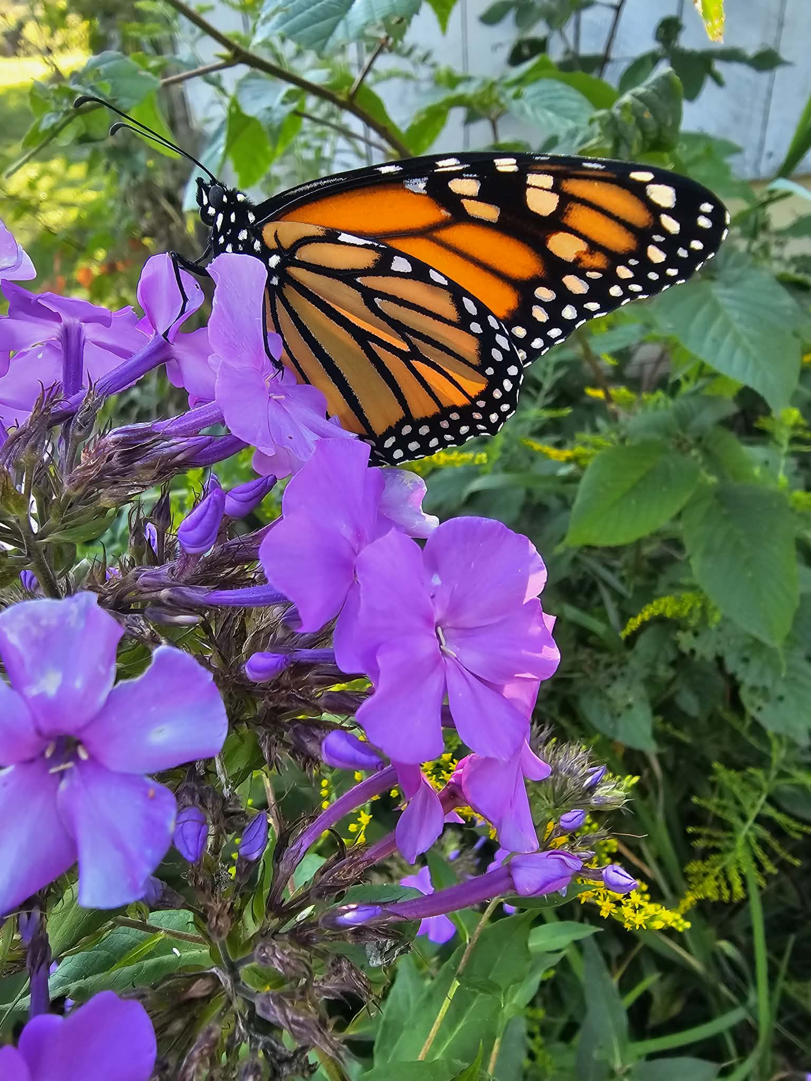
Jefferson County Conservation District
2025 Annual Report

Slide 2
Table of Contents
Cover
Table of Contents
Background
Board of Directors/Mission/Vision
Staff / Cooperating Agencies
State Delegated Programs (DGLVR)
Chapter 102: E&S
Chapter 105
Nutrient Management Program
Agricultural Technical Assistance
Agriculture Conservation Assistance Program (ACAP)
Outreach & Education
Outreach & Education Continued
Outreach & Education Continued
Outreach & Education Continued
Outreach & Education Continued
Tri-County Envirothon
Special Projects
Growing Greener Grant: Rattlesnake Creek
Redbank Creek Watershed Trust: Conifer West
Redbank Creek Watershed Trust: Conifer East
Redbank Creek Watershed Trust: Little Sandy
Contact Information

Slide 3
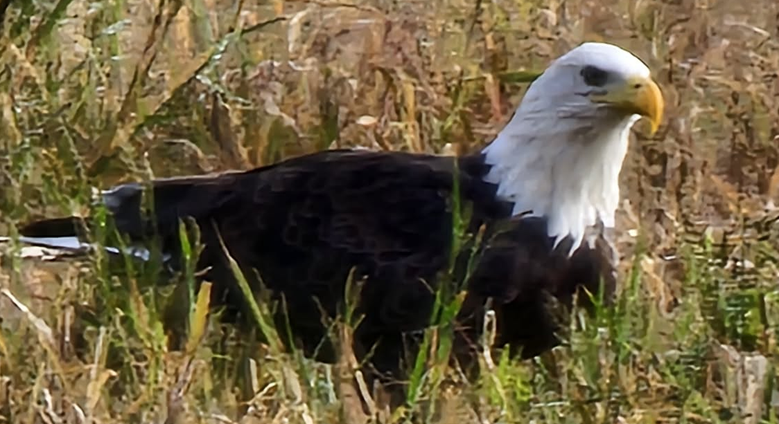
A Conservation District is a legal subdivision of State Government, responsible under law for conservation work within its boundaries, just as Townships and Counties are responsible for roads and other services and school districts are responsible for education. Conservation Districts were created in PA in 1945 in response to the dust bowl of the 1930s.
Conservation Districts were created to improve soil and water conservation. District program areas include erosion and sediment control on earthmoving activities, farm conservation planning, nutrient and manure management planning, environmental education, river cleanups, abandoned mine drainage abatement, and environmentally sensitive maintenance of dirt and gravel roads.
The goal of Districts’ activities is to make all citizens aware of the inter-relationship between human activities and the natural environment.
Districts are managed by citizens who know local problems. In Pennsylvania, a
District’s governing Board is comprised of six appointed Directors (3 Farmer Directors and 3 Public Directors) and one County Commissioner Director.
Districts employ staff to assist Directors in carrying out their responsibilities and objectives.
The Jefferson County Conservation District is a nonprofit entity established by the Jefferson County Commissioners under Pennsylvania’s Conservation District Law. Much of the District’s effectiveness is due to its ability to coordinate local, state, and federal government resources to solve local environmental problems. District employees act as a liaison between all levels of government, environmental agencies, and the general public.
It is the responsibility of the Conservation District Directors to plan and develop the District’s programs. Directors work through District staff to develop programs that address the natural resource conservation needs of the county. Conservation programs dealing with agriculture, past mining, stormwater, wetland protection, environmental education, and earthmoving are all high priority for the JCCD.
Funding for District operations is obtained from a multitude of sources, mostly State and Federal grants. About 9% of the District’s operating budget came from the County Commissioners’ general fund, which makes District programs a good local investment.
Background
What is a Conservation District

Slide 4
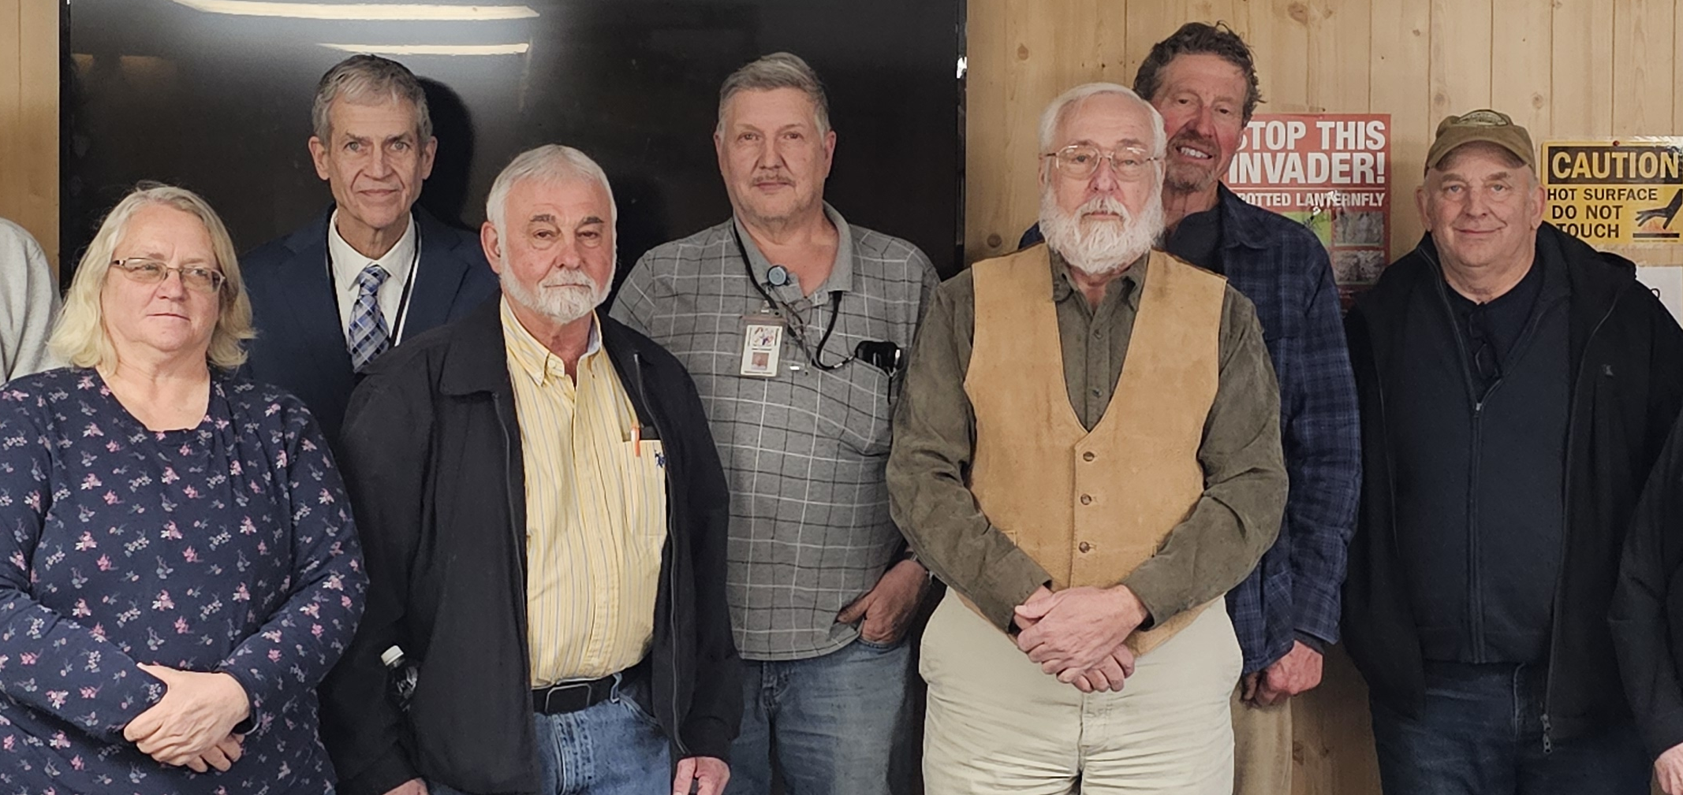

Meet the Board of Directors
Meet Jefferson County Conservation Districts Board of Directors
(Left to Right)
Theresa Shick-Farmer Director
Mark Humes- Commissioner Director
Sam Farcus-Vice Chairman-Public Director
Allen Campbell, Secretary/Treasurer- Public Director
Tom McFarland, Chairman- Public Director
Terry Shields- Farmer Director
Mark Pifer- Farmer Director
Our Vision
The Jefferson County Conservation District enables residents, businesses and industries to optimize environmental systems interactions throughout the county through subject expertise, education, project management, and research.
Our Mission
To preserve natural resources and protect/promote the health, safety and general welfare of the people of Jefferson County and to provide technical services to improve resource management for the benefit of all.

Slide 5





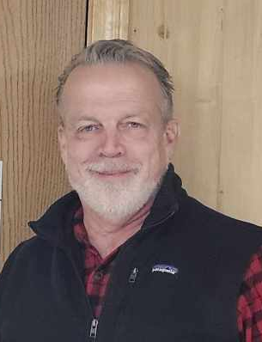
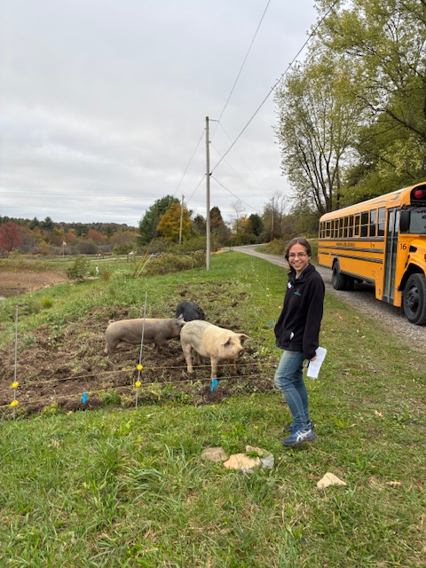

Staff
Shaun Wessell,
District Manager
Christine Hughes,
Administrative Assistant
Dana Hannibal,
District Technician
Megan Whitlatch,
ACT/Nutrient Management Technician
Laryssa Remmick,
Resource Technician
Bruce Snyder,
Conservation Technician
Cooperating Agencies
Farm Service Agency
Penn State Cooperative Extension
PA Department of Conservation and Natural Resources
Natural Resource Conservation Service
PA Fish & Boat Commission
PA Game Commission
PA Department of Environmental Protection
PA Department of Transportation
Jefferson County Solid Waste Authority
Jefferson County Department of Development
Western Pennsylvania Coalition for Abandoned Mine Reclamation
Ben Smith,
Watershed Specialist

Slide 6

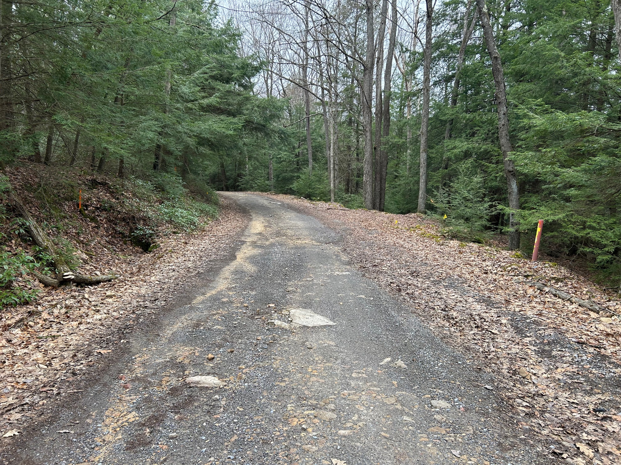
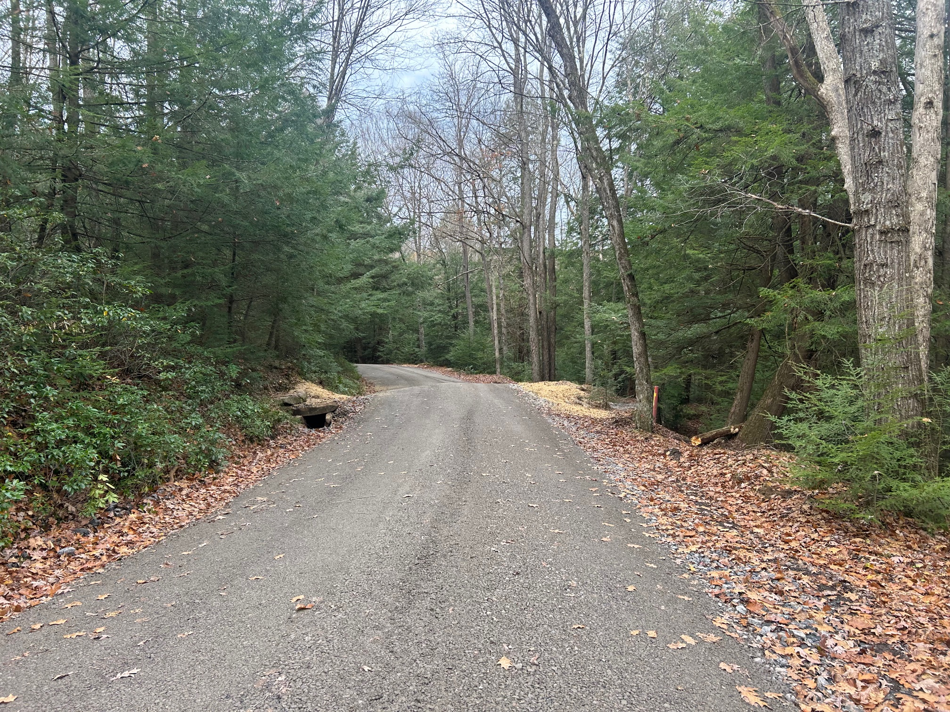
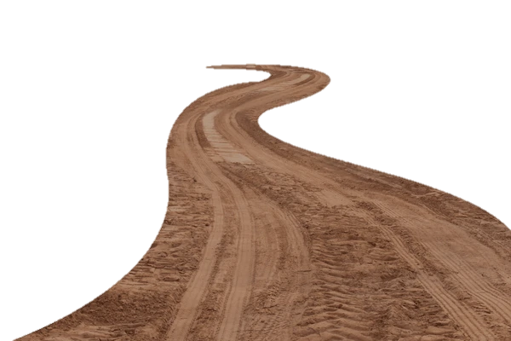
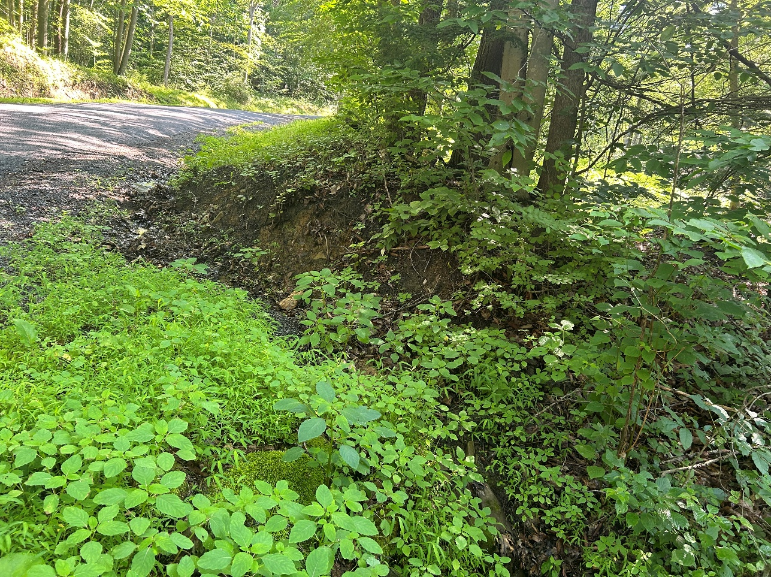
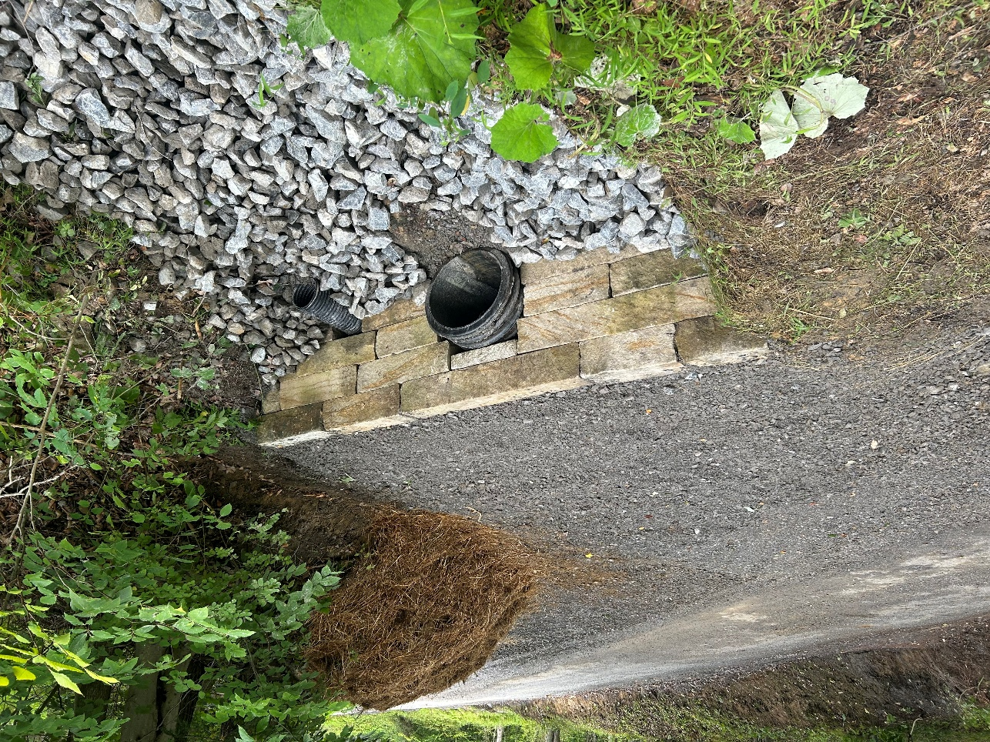
State Delegated Programs
Dirt, Gravel, and Low Volume Road Program
Pennsylvania's Dirt, Gravel and Low Volume Road (DGLVR) Maintenance Program provides funding to eliminate stream pollution caused by runoff and sediment from the State's comprehensive network of unpaved and low volume public roads. The Program was enacted into law in April 1997 as Section 9106 of the PA Vehicle Code, with annual funding for "environmentally sensitive road maintenance" for unpaved roads. The goal of the Program is to create a more environmentally and economically sustainable low volume road network through education, outreach, and project funding. Beginning in 2014-2015, a portion of the Program’s funding was directed towards paved or sealed low volume roads with 500 vehicles per day or less.
Before
After
Cathers Run Road, Barnett Township
In 2025, JCCD was able to provide $669,739.65
in DGLVR funds to 7 different Municipalities. Laryssa Remmick, Resource Technician, oversaw the completion of the Dirt, Gravel & Low Volume Road Projects.
Before
After
Brown Road, Young Township

Slide 7
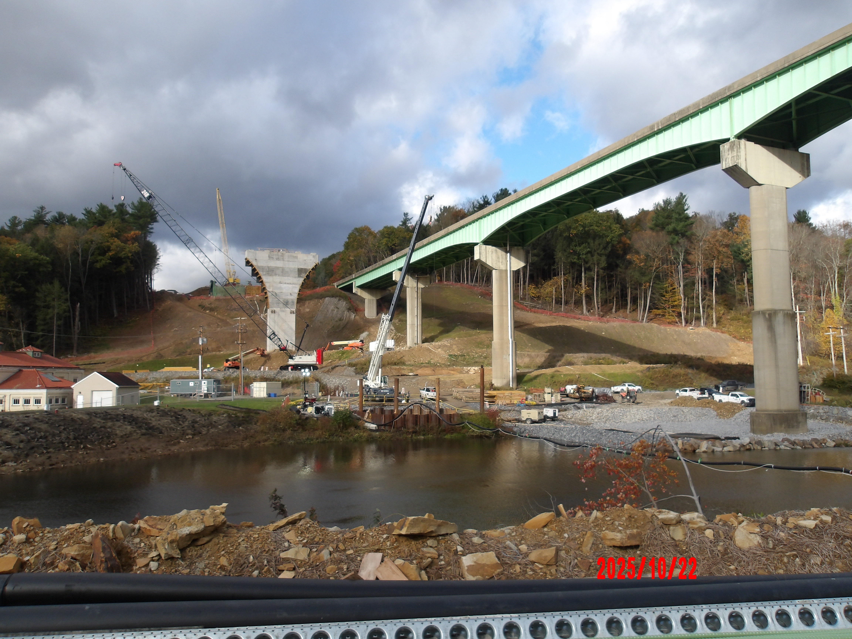
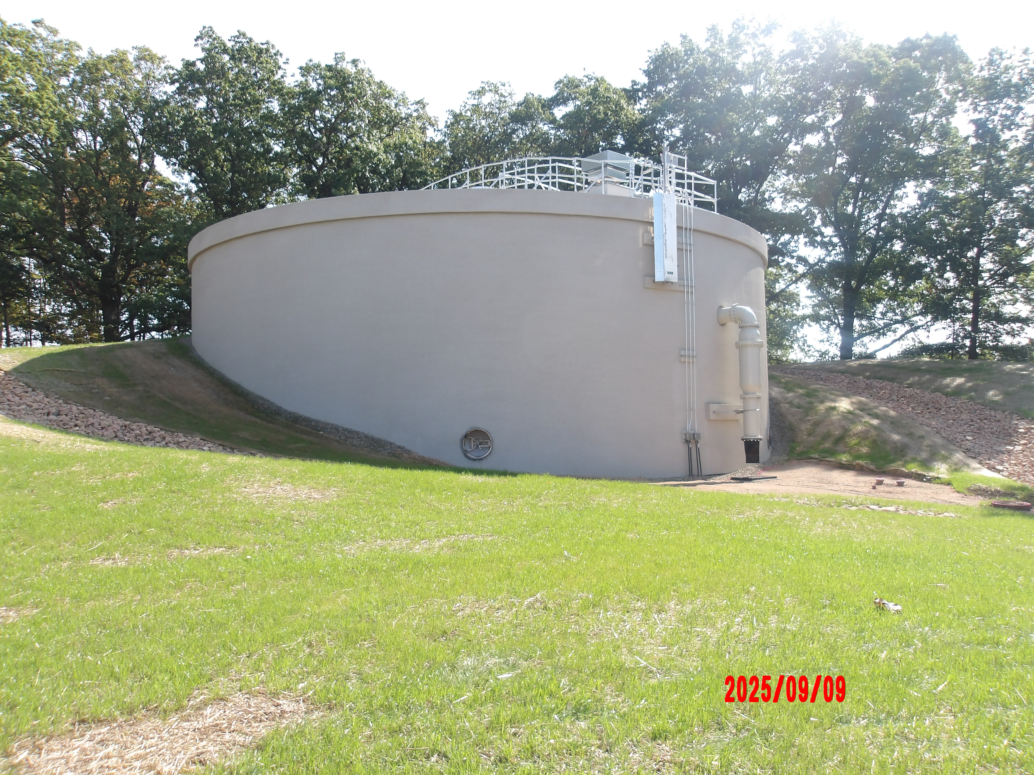
Product overview
Chapter 102: Erosion & Sediment Control Program
Pa. Code Title 25 Chapter 102 was created to require persons proposing or conducting earth disturbance activities to develop, implement, and maintain BMPs to minimize the potential for accelerated erosion and sedimentation during construction and plan for post construction stormwater management. Through a delegation agreement with the Department of Environmental Protection, JCCD reviews Erosion and Sediment Control Plans (E&S Plans). Each E&S plan is reviewed for technical adequacy under Chapter 102 requirements.
A federal regulation that works in conjunction with the state E&S program is the National Pollution Discharge Elimination System (NPDES) Program. This regulation requires earthmoving activities disturbing one acre or more to obtain an NPDES permit which is reviewed by the District.
North Fork I80 Bridge Project, Brookville Borough & Pine Creek Township
PAWC West Storage Tanks, Punxsutawney Borough
In 2025, 30 Erosion and Sediment Control Plans were reviewed and approved and 2 new NPDES Permits and 2 ESCGP Permits were authorized by Dana Hannibal, District Technician.
Dana Hannibal and Bruce Snyder, Conservation Technician, conducted 117 construction site inspections while providing a total of 417 technical assistance contacts.

Slide 8
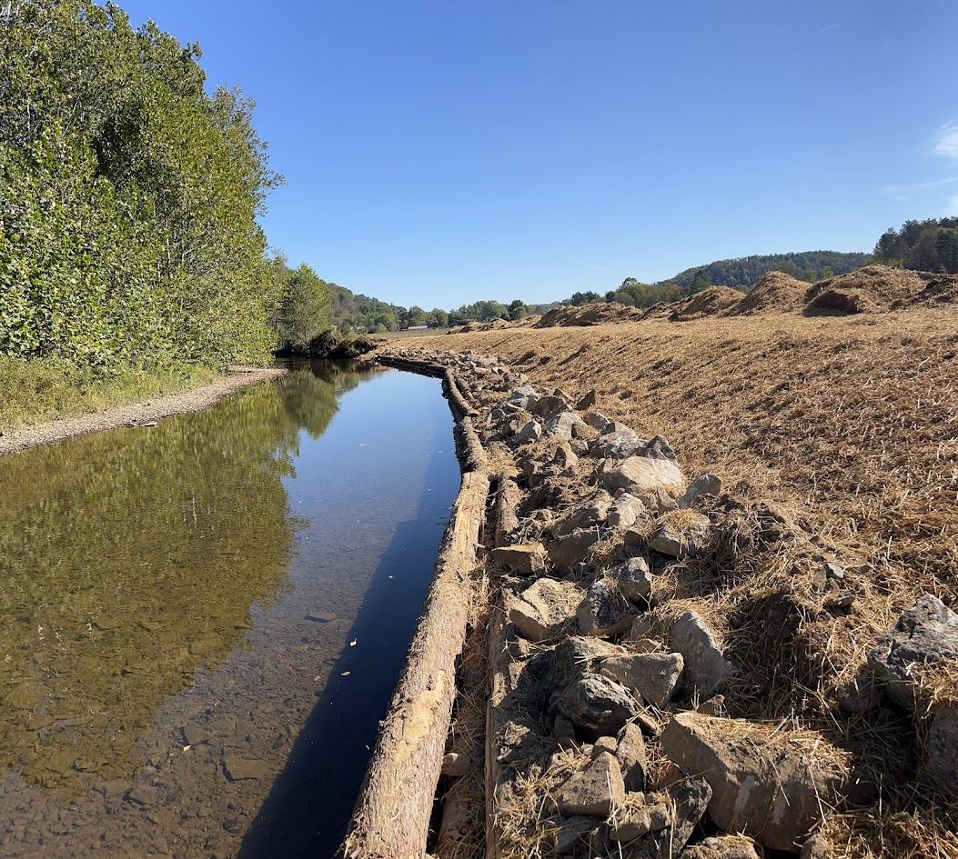


Chapter 105: Dam Safety and Encroachments Act
This state delegated program provides oversight of work in and around streams, wetlands and other bodies of water that has a potential to impact water quality, increase flooding or degrade riparian habitat.
The District acknowledges PA DEP General Permits, which authorize certain types of work including: Fish Habitat Enhancement; Small Docks & Boat Ramps; Streambank Stabilization; Utility Line or Minor Road Crossings of streams or wetlands.
In 2025, 12 General Permits for water obstructions and encroachments were acknowledged. 10 Chapter 105 related complaints were investigated.
The District provided 216 technical assistance contacts concerning permitting and other requirements associated with Chapter 105 regulations.
GP1 Shirey Streambank
Dana Hannibal presented on “Conservation District: Laws and Regulations to the Penn State DuBois Wildlife Technology Program students.

Slide 9



Nutrient Management Program
The Nutrient Management Act (Act 38) requires Concentrated Animal Operations (CAOs) to have and implement a Nutrient Management Plan (a more in-depth version of an MMP). A CAO is an agricultural operation with 8 or more animal equivalent units (AEUs) where the animal density exceeds two AEUs per acre suitable for the application of manure on an annualized basis. (An AEU is equivalent to 1,000 lbs. of animal weight on an annualized basis). Operations that are not CAOs may voluntarily have a NMP developed.
The goal of the program is to maximize use of nutrients on the farm, and to protect soil and water quality.
The State Conservation Commission has oversight of the Nutrient Management Program and the District is delegated to administer Act 38 in Jefferson County.
The District is responsible for reviewing and approving new and amended NMPs, conducting status reviews, investigating complaints, maintaining certification, and providing education and outreach within the community.
In 2025, the District completed:
4 NMP status reviews
1 NMP review & approval
2 complaint investigations
3 PACD Ag Plan Reimbursement applications

Slide 10

Agricultural Technical Assistance
PA REAP: The PA Resource Enhancement And Protection (REAP) Program is a state tax credit program administered by the PA State Conservation Commission in which farmers can apply for conservation best management practices (BMPs) they implement on their farm. The District assists farmers through the application process.
Farm Plans: State required farm plans, including Manure Management Plans (MMPs) & Agricultural Erosion and Sedimentation Control Plans (Ag E&S Plans) are developed upon request. Nutrient Management Plans for non-CAOs are also developed upon request.
Soil Sampling: The district provided free soil sampling services to area farmers
Agriculture Newsletters are developed on a quarterly basis and provide information on a variety of ag conservation topics, financial assistance opportunities, and upcoming events farmers may be interested in.
In 2025:
REAP application assistance was provided for 5 farmers
implementing conservation best management practices.
8 Manure Management Plans, 2 NRCS 590 Nutrient Management Plans, and 3 Ag E&S Plans were developed.
137 soil sample test kits were distributed, with district staff taking 95 of these samples for area farmers.
4 Agricultural Newsletters were developed and distributed to ~200 farmers on our mailing list.

Slide 11
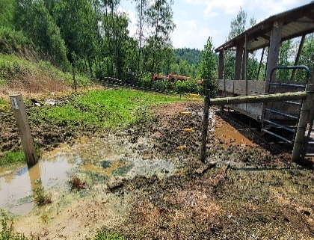
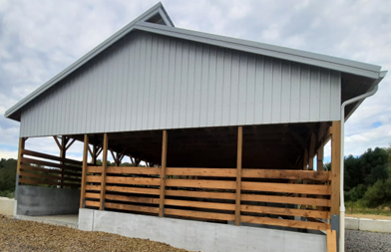
Agriculture Conservation Assistance Program (ACAP)
The Agriculture Conservation Assistance program (ACAP) awards grants to Pennsylvania farmers to install best management practices (BMPs) on their farms that reduce pollution from entering streams and waterways. The program is an opportunity for farmers to install soil and water conservation practices that have shared environmental and farm management goals.
The ACAP was created through the Clean Streams Fund to reduce non-point source pollution in the streams and surface waters of the Commonwealth. The State Conservation Commission is providing funding to many Pennsylvania Conservation Districts.
In 2025, 3 projects involving roofed heavy use area protections/manure storages were constructed.
Snyder Project
Before
After

Slide 12
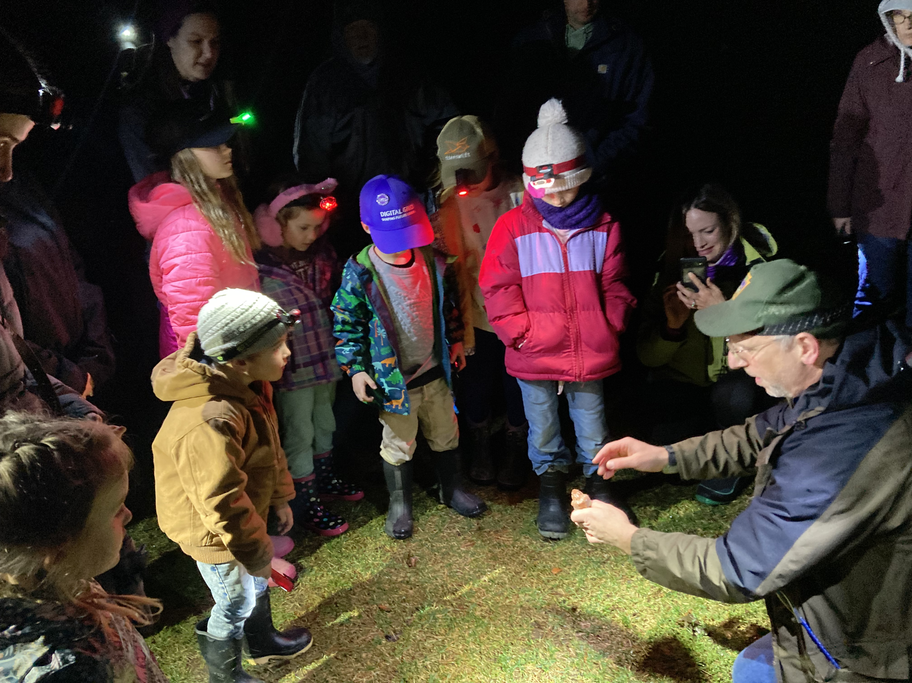
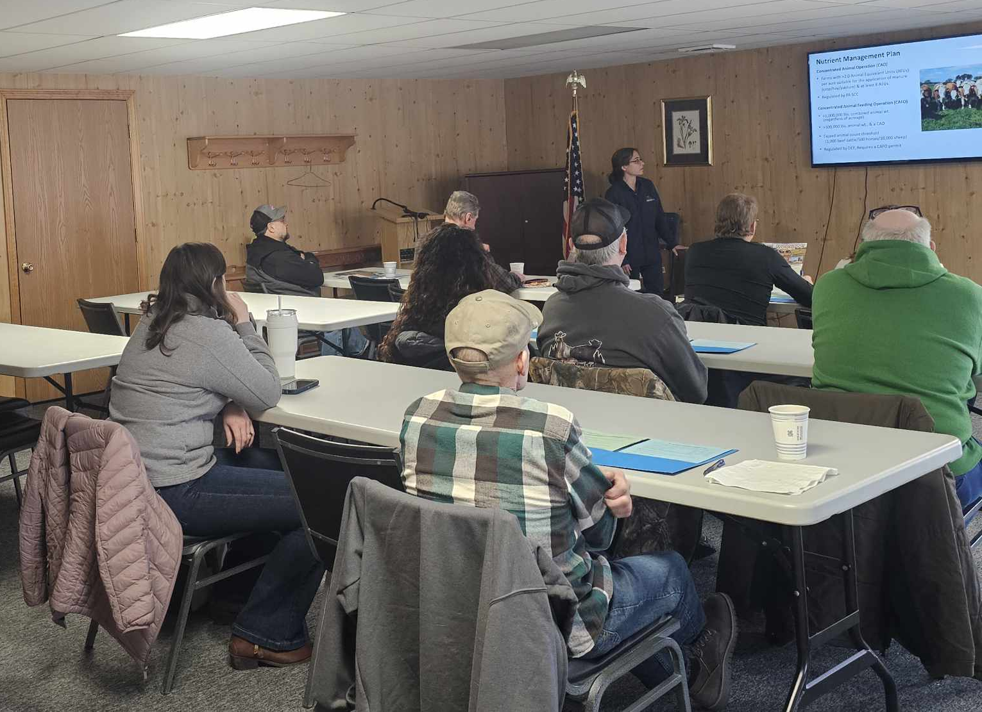
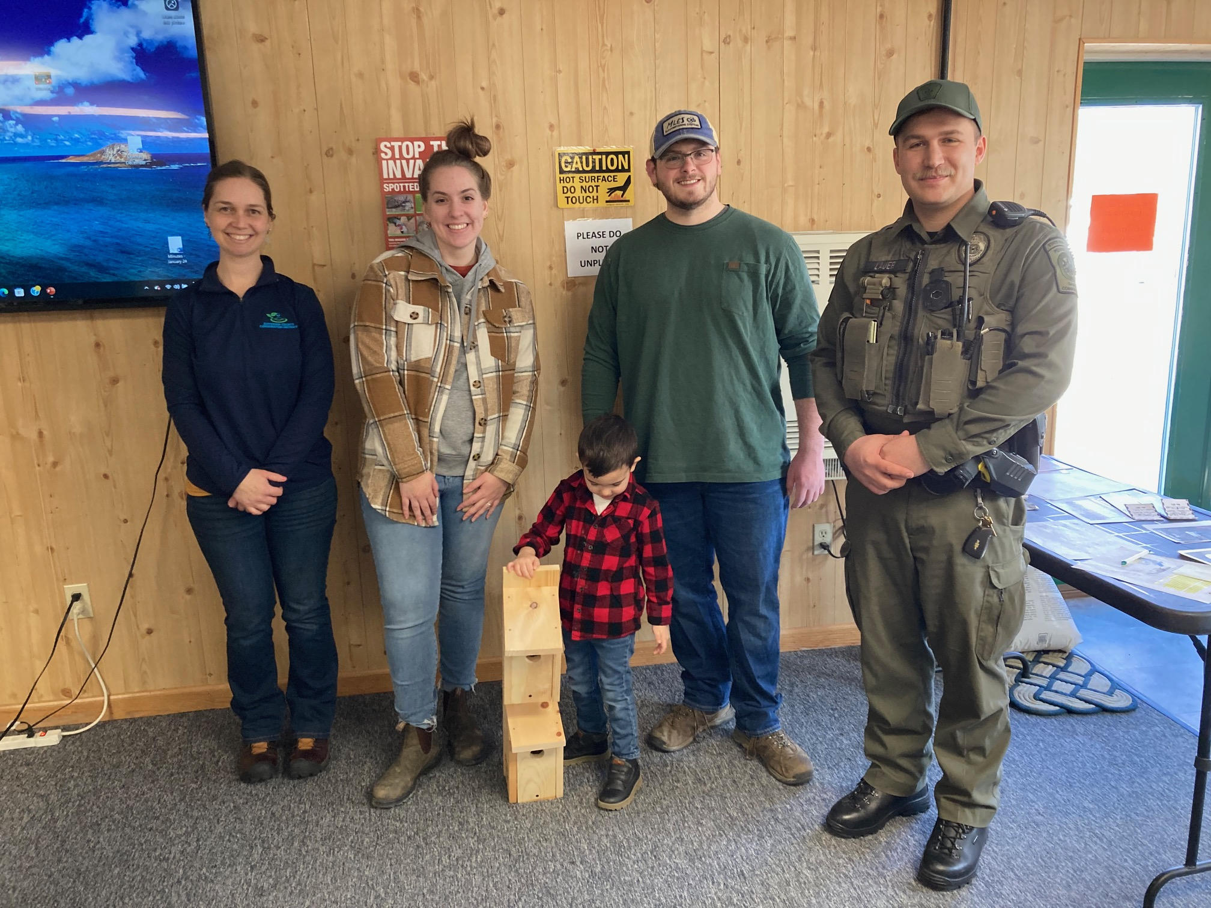
Outreach & Education
Vernal Pool Tours
The fourth annual vernal pool tours were held with DCNR. This event allowed people to experience an amphibian migration to a vernal pool habitat. Approximately 20 people attended.
Farmer Workshop
The District held a Farmer Workshop on February 21, 2025. Topics of discussion included Improving Soil Health on the Farm, Overview & Recent Changes to the Manure Management Guidelines, Updates on Funding Programs, and Farm Pond Management. The workshop was funded through a PACD NPS mini-grant.
Blue Bird Box Workshop
A blue bird box building event was held with the Game Commission to learn about Bluebirds and build a box that would encourage nesting. free boxes were provided by the Game Commission.

Slide 13
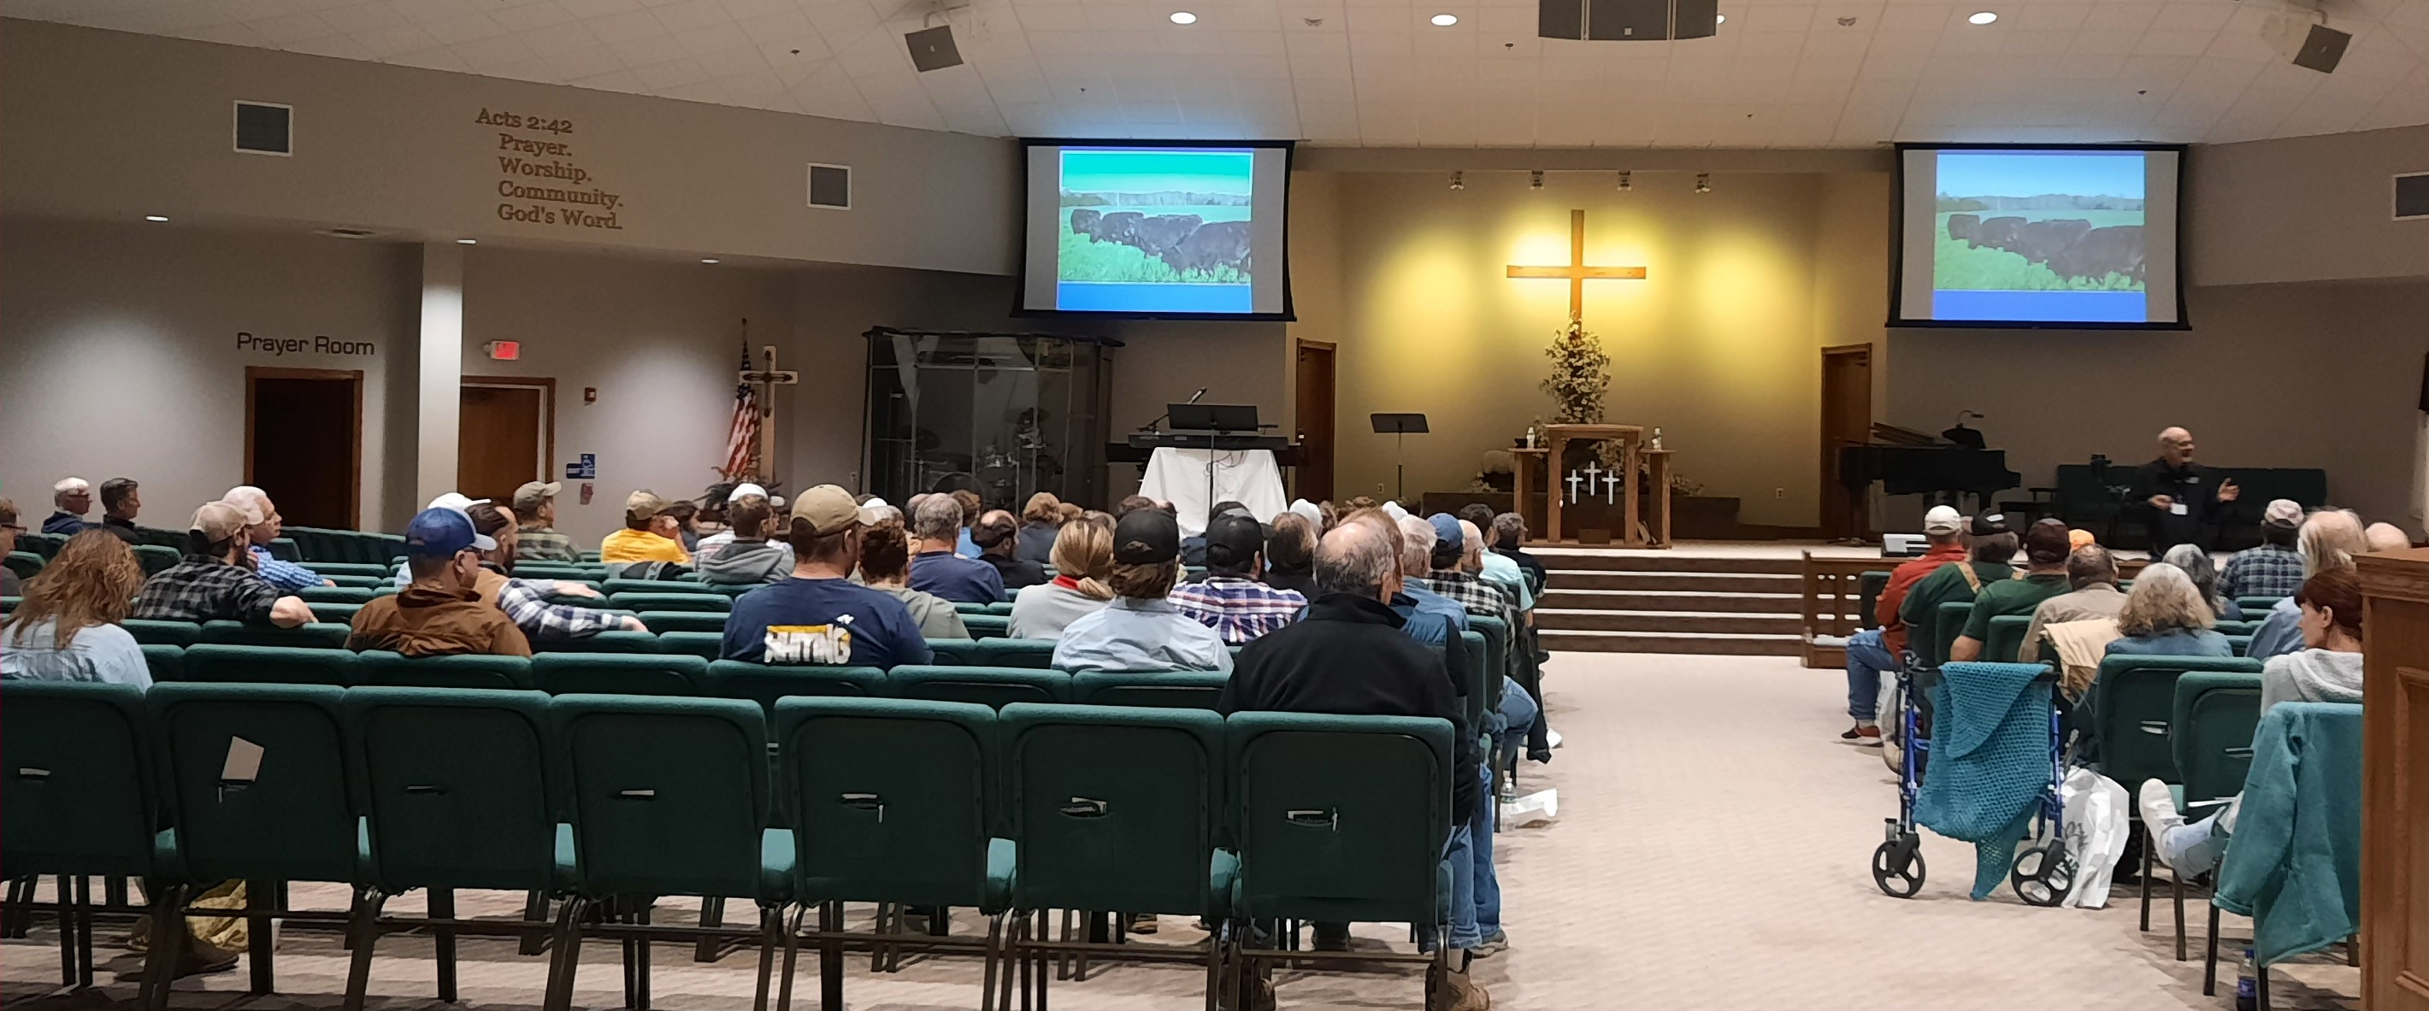
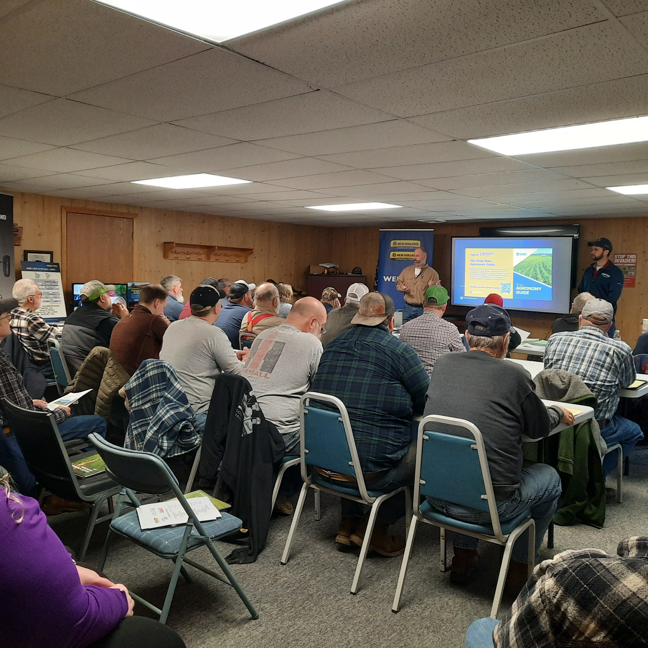


Continued Outreach & Education
Western PA Grazing Conference
The 27th Annual Western PA Grazing Conference was held on March 13, 2025 at the Trinity Point Church of God in Clarion, PA. This conference promotes sustainable grazing practices to farmers throughout PA and surrounding states. The keynote speakers this year were Dr. Matt Poore of NCSU & Triple Creek Ranch, VA, and Eli Mack of Mack Farms, PA. Over 170 people were in attendance. The District helps coordinate this conference every year as a member of the Western PA Grazing Conference Committee (Members include NRCS, Jefferson, Clarion, and Clearfield Conservation Districts, Penn State Extension, NW & SW Project Grass, and local farmers). Grand support was provided by the PA Grazing Lands Coalition.
Hay Production Workshop
A Hay Production Workshop was held in collaboration with Penn State Extension at the District office on March 5th. Penn State educators discussed topics including soil fertility, weed control, and marketing your hay. Approximately 45 farmers were in attendance. Financial support for the workshop was provided by PA DEP.

Slide 14
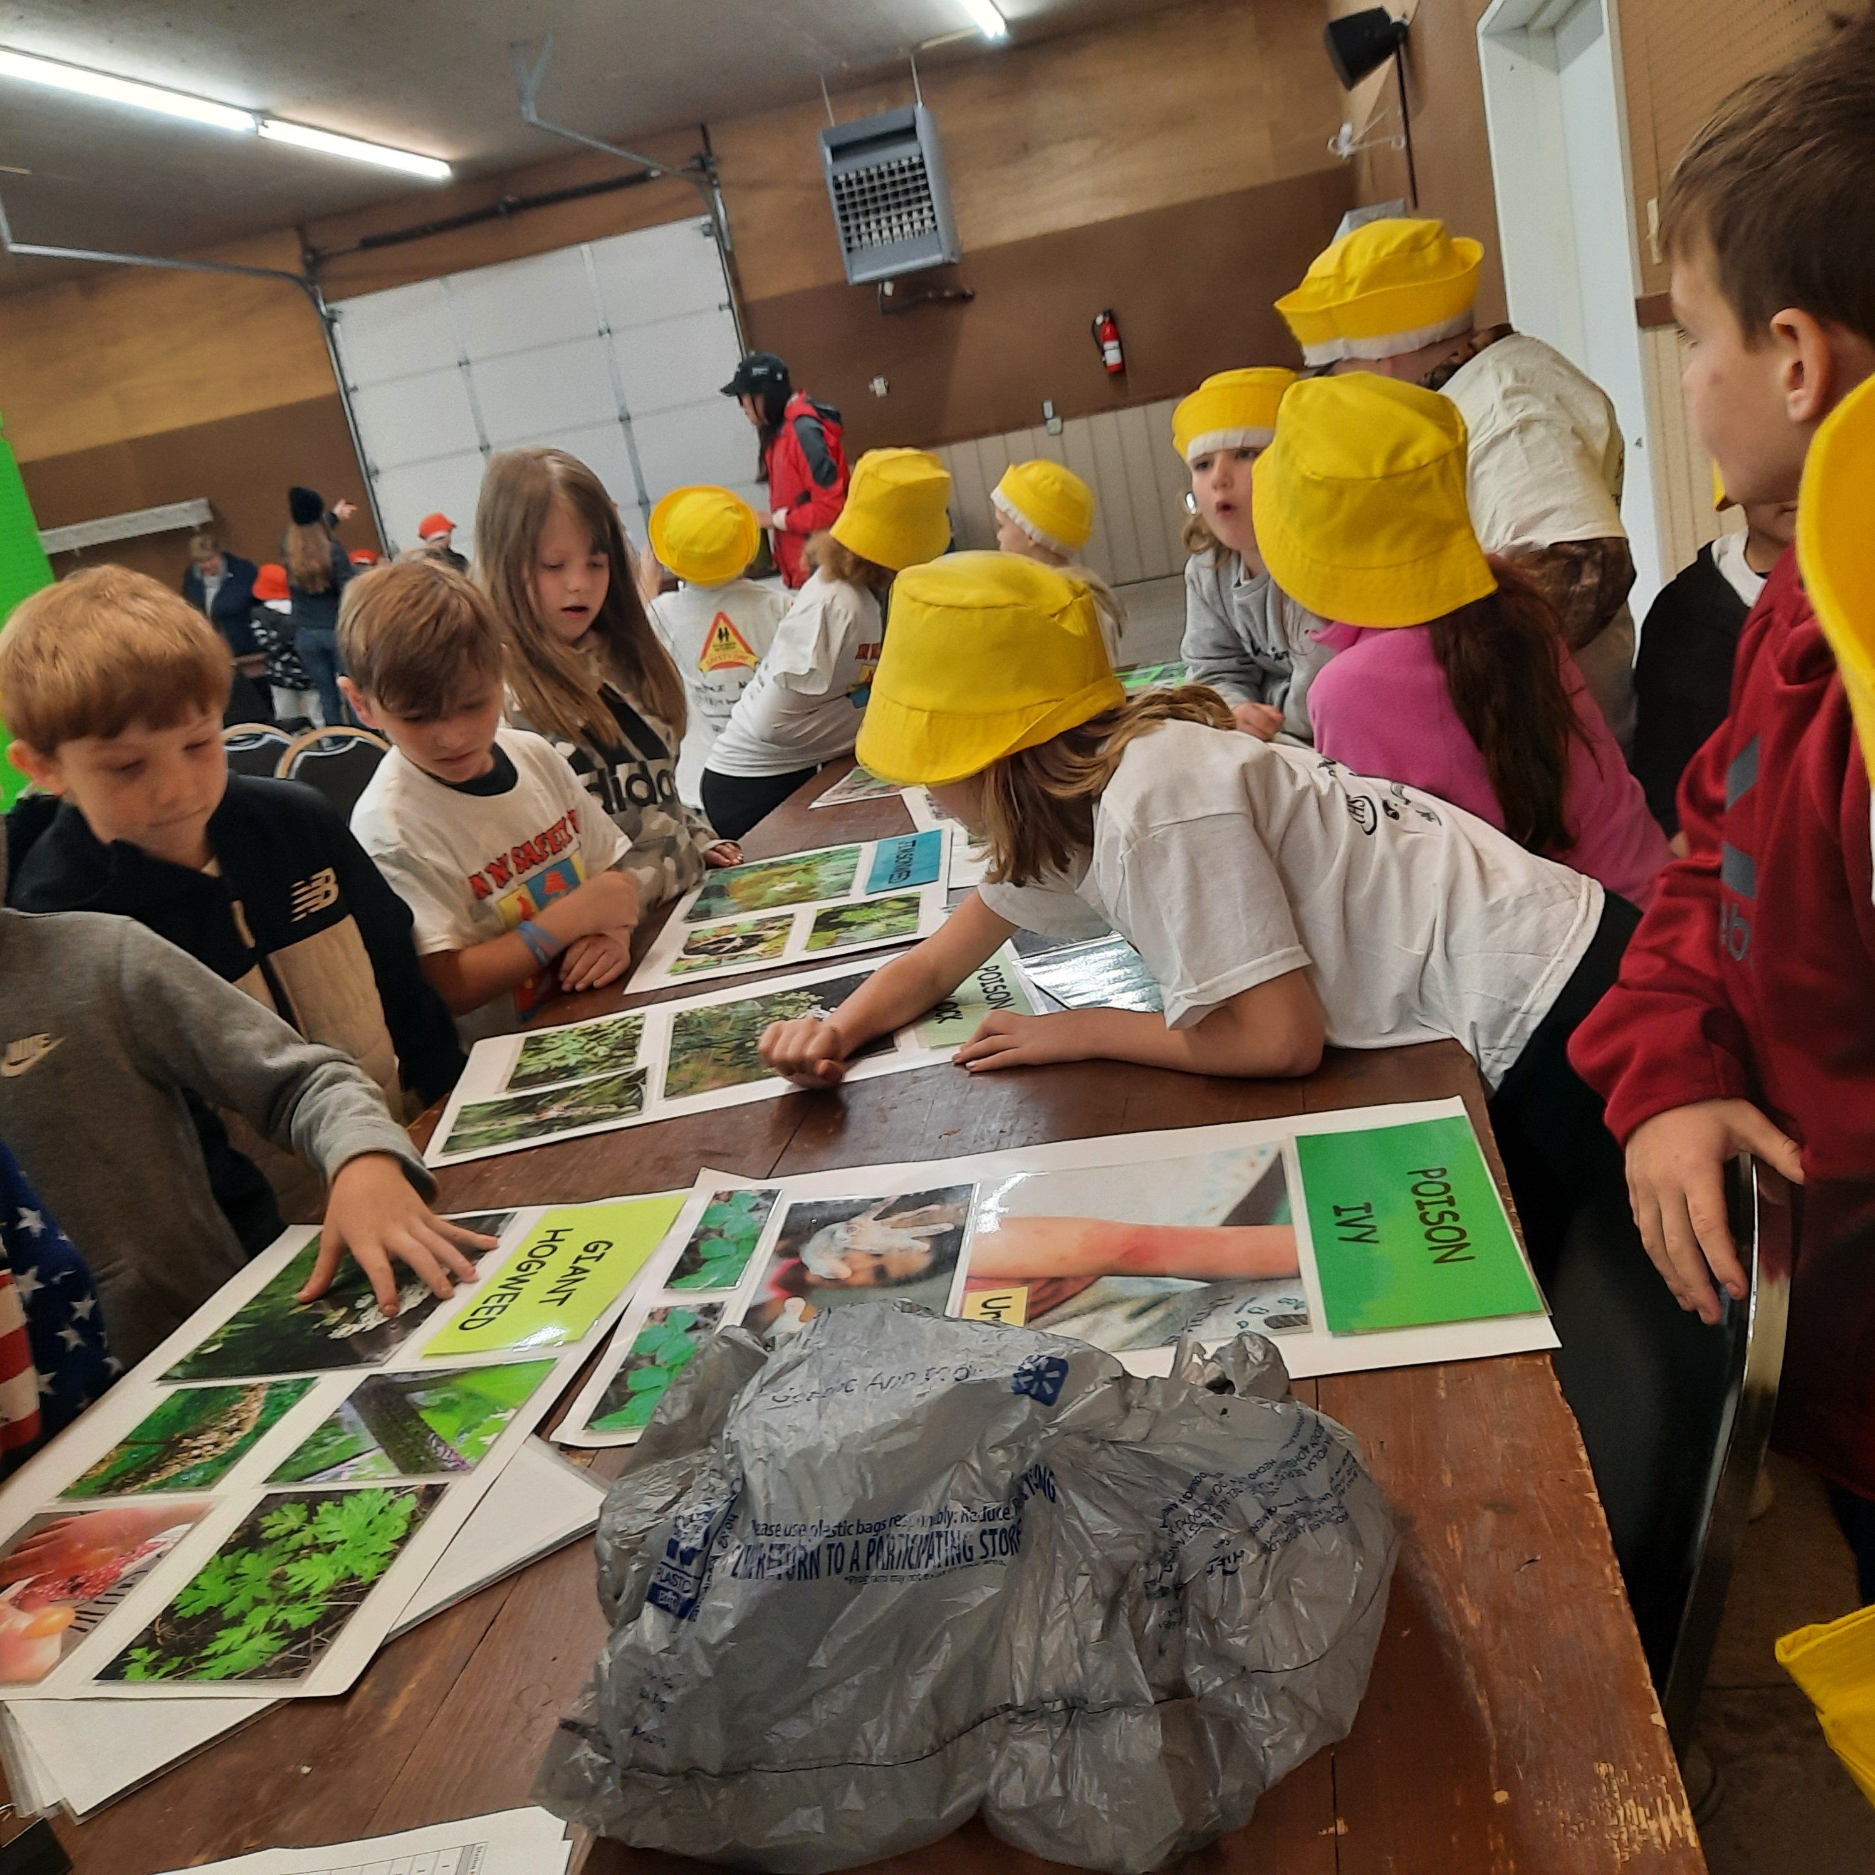
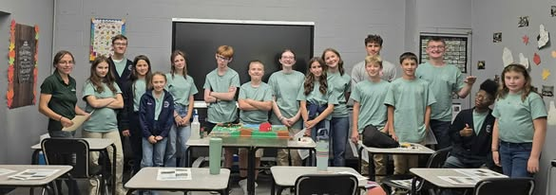
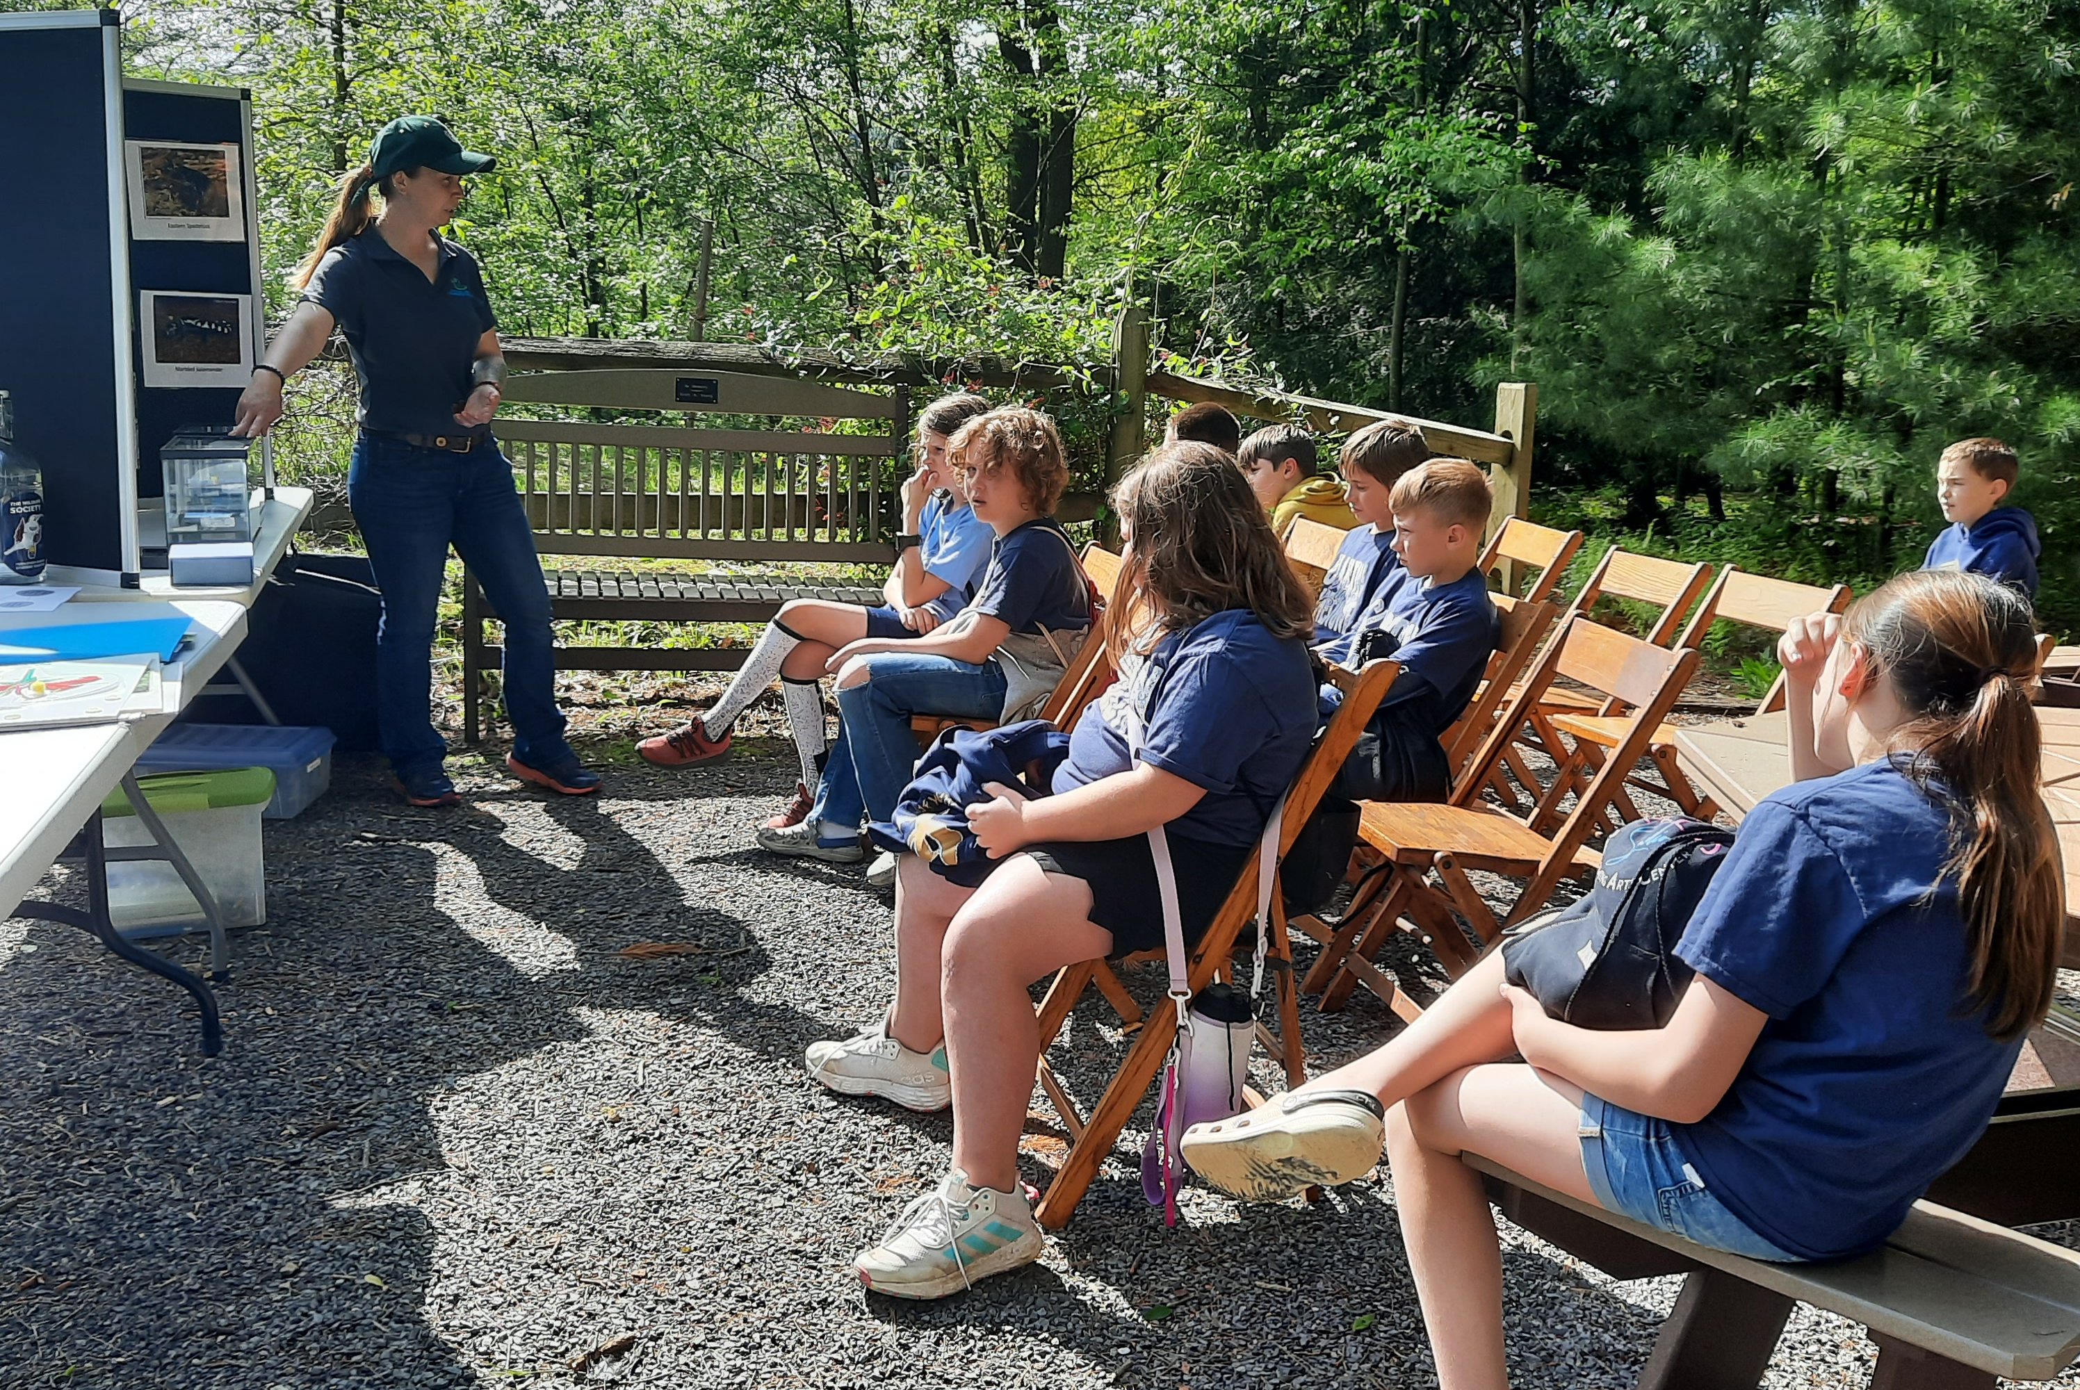





Continued Outreach & Education
Ag Safety Days
The 2025 Ag Safety Days, hosted by the Penn State Extension, was held on May 8th & 9th, 2025. Over 300 second grade students from area schools including Brookville, Punxsutawney, and C.G. Johnson listened to presentations on various safety topics. Conservation District staff presented information on Poisonous Plants. Other stations included Firearms Safety, Electric Safety, Animal Safety, and many others.
Punxsutawney Christian School
JCCD visited the ag class at Punxsutawney Christian School to discuss sources of non-point source pollution on the farm using the Enviroscape, and conservation practices that can be implemented to protect water quality.
4th Grade Heritage Park
The JCCD assisted with two stations, pond critters, and native plant-pollinator ecology to Hickory Grove 4th Grade students.

Slide 15
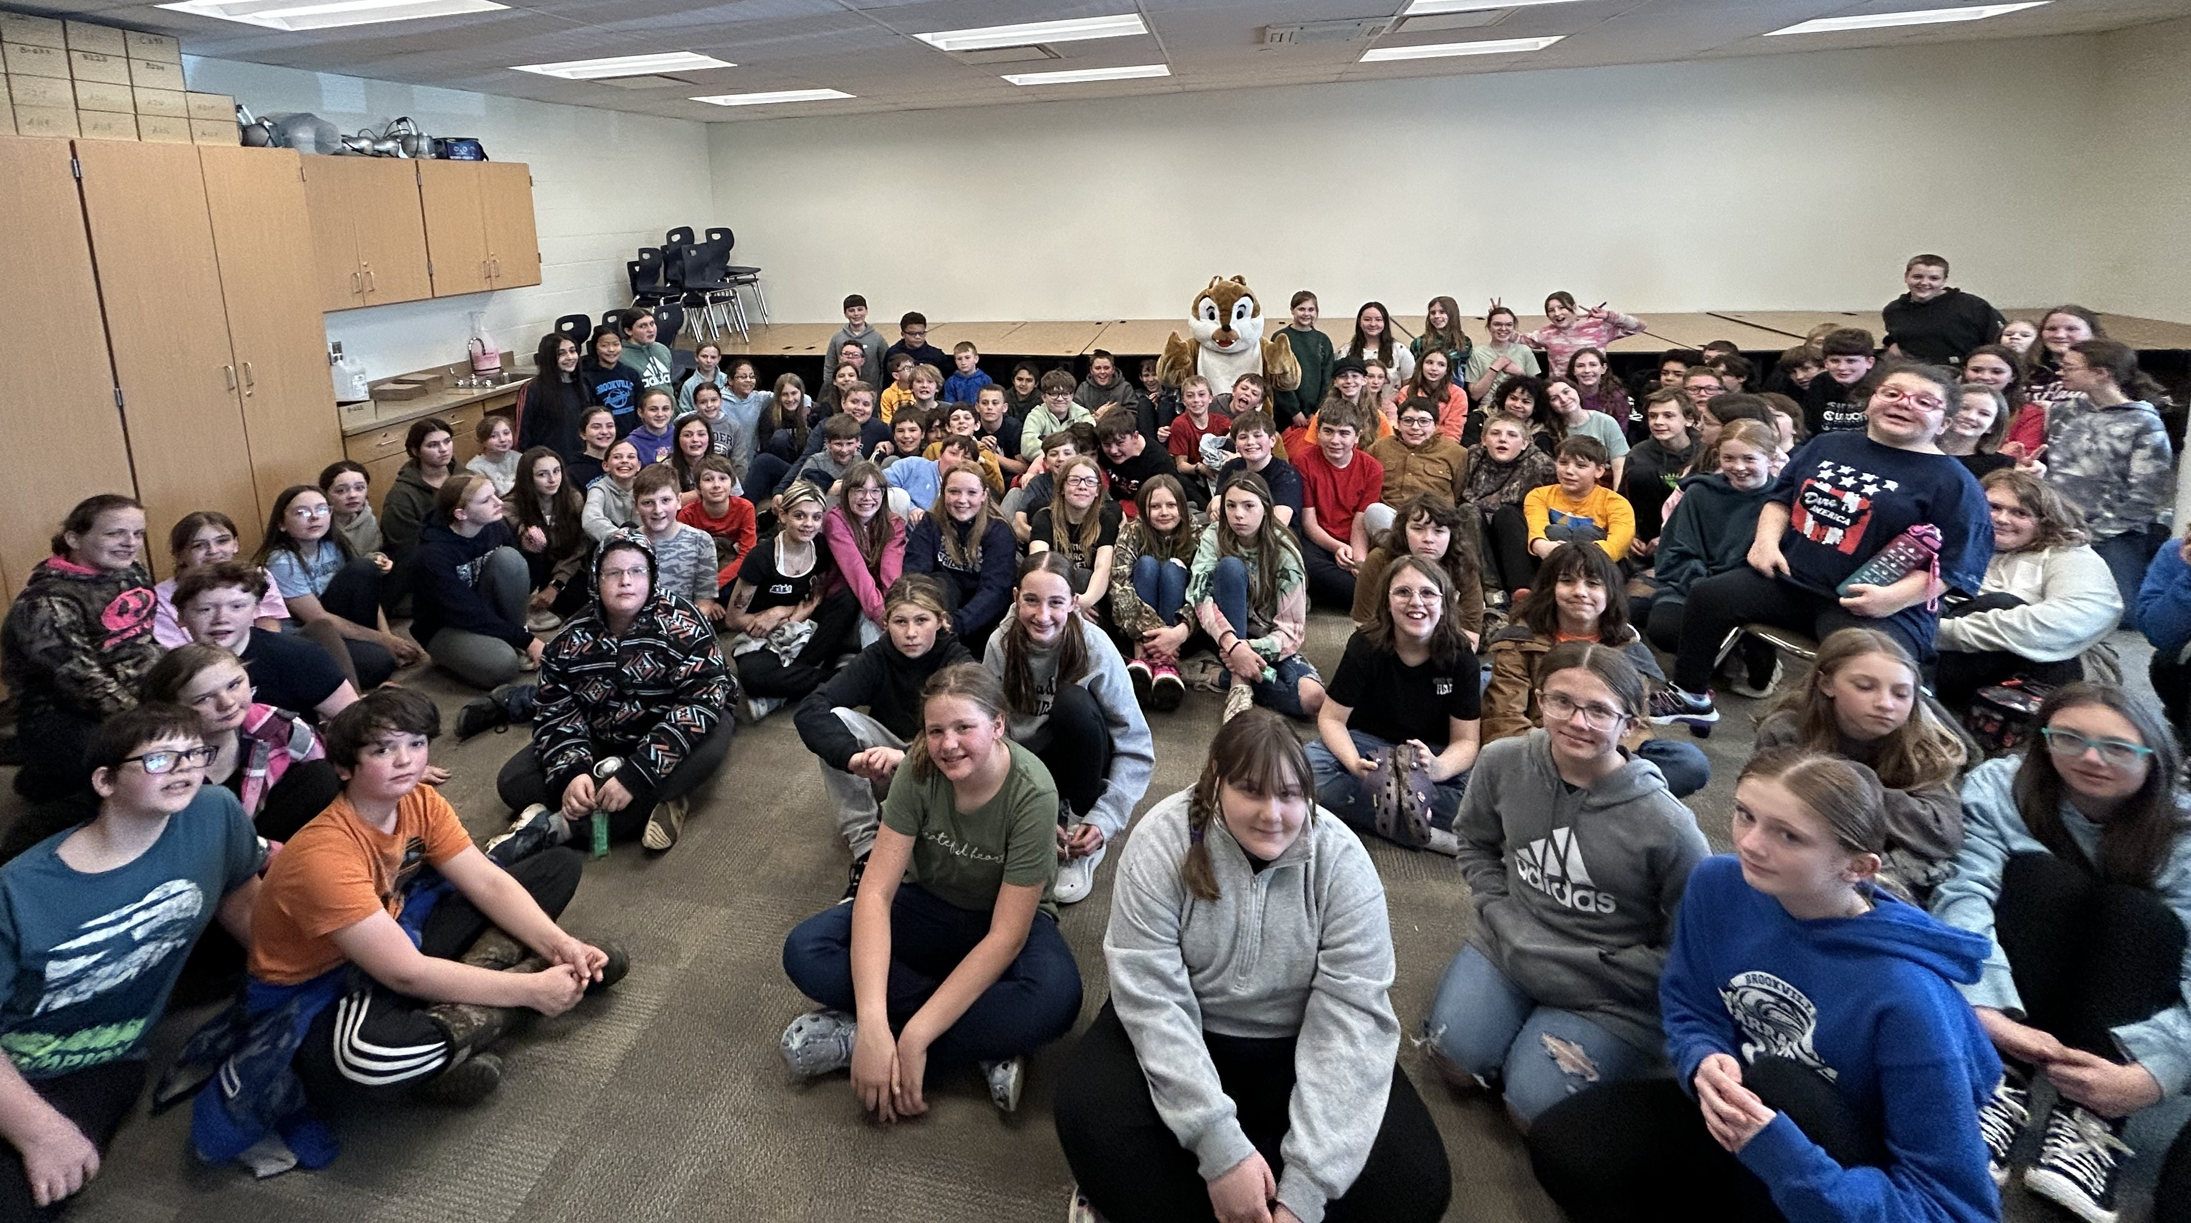
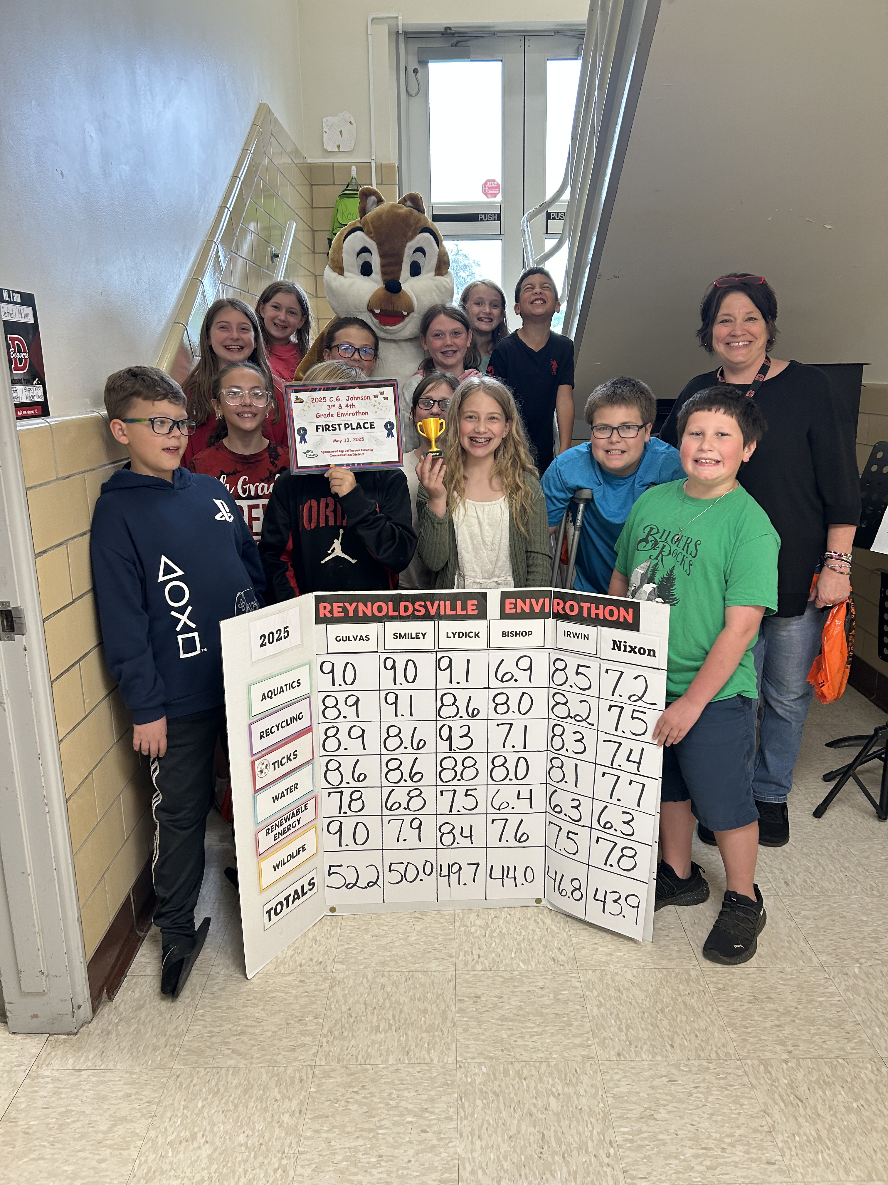
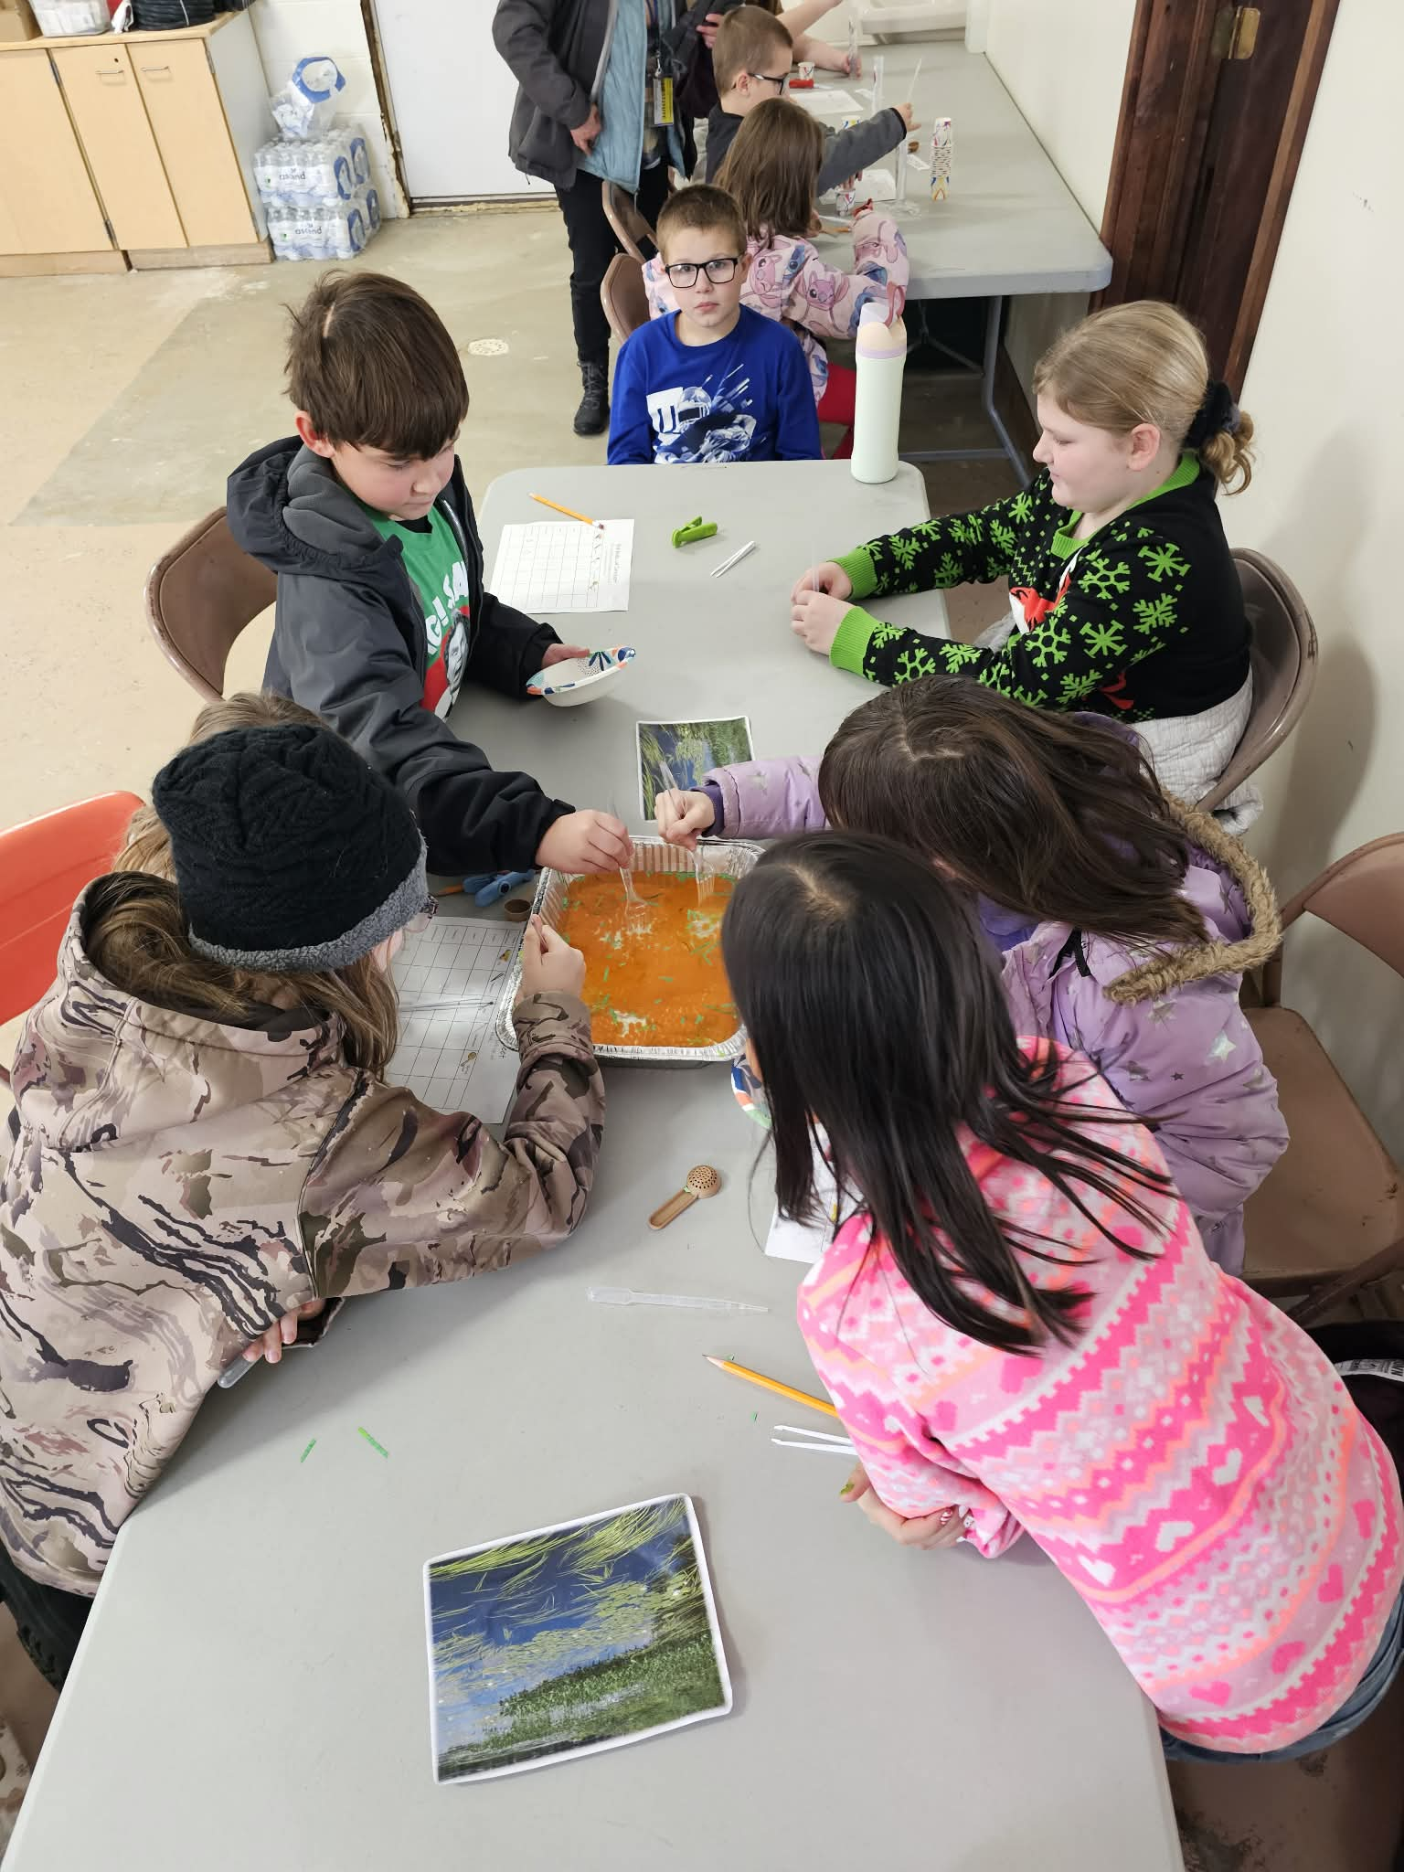


6th Grade Brookville Envirothon
4th Grade Reynoldsville Envirothon
CL Beak Lab

Slide 16
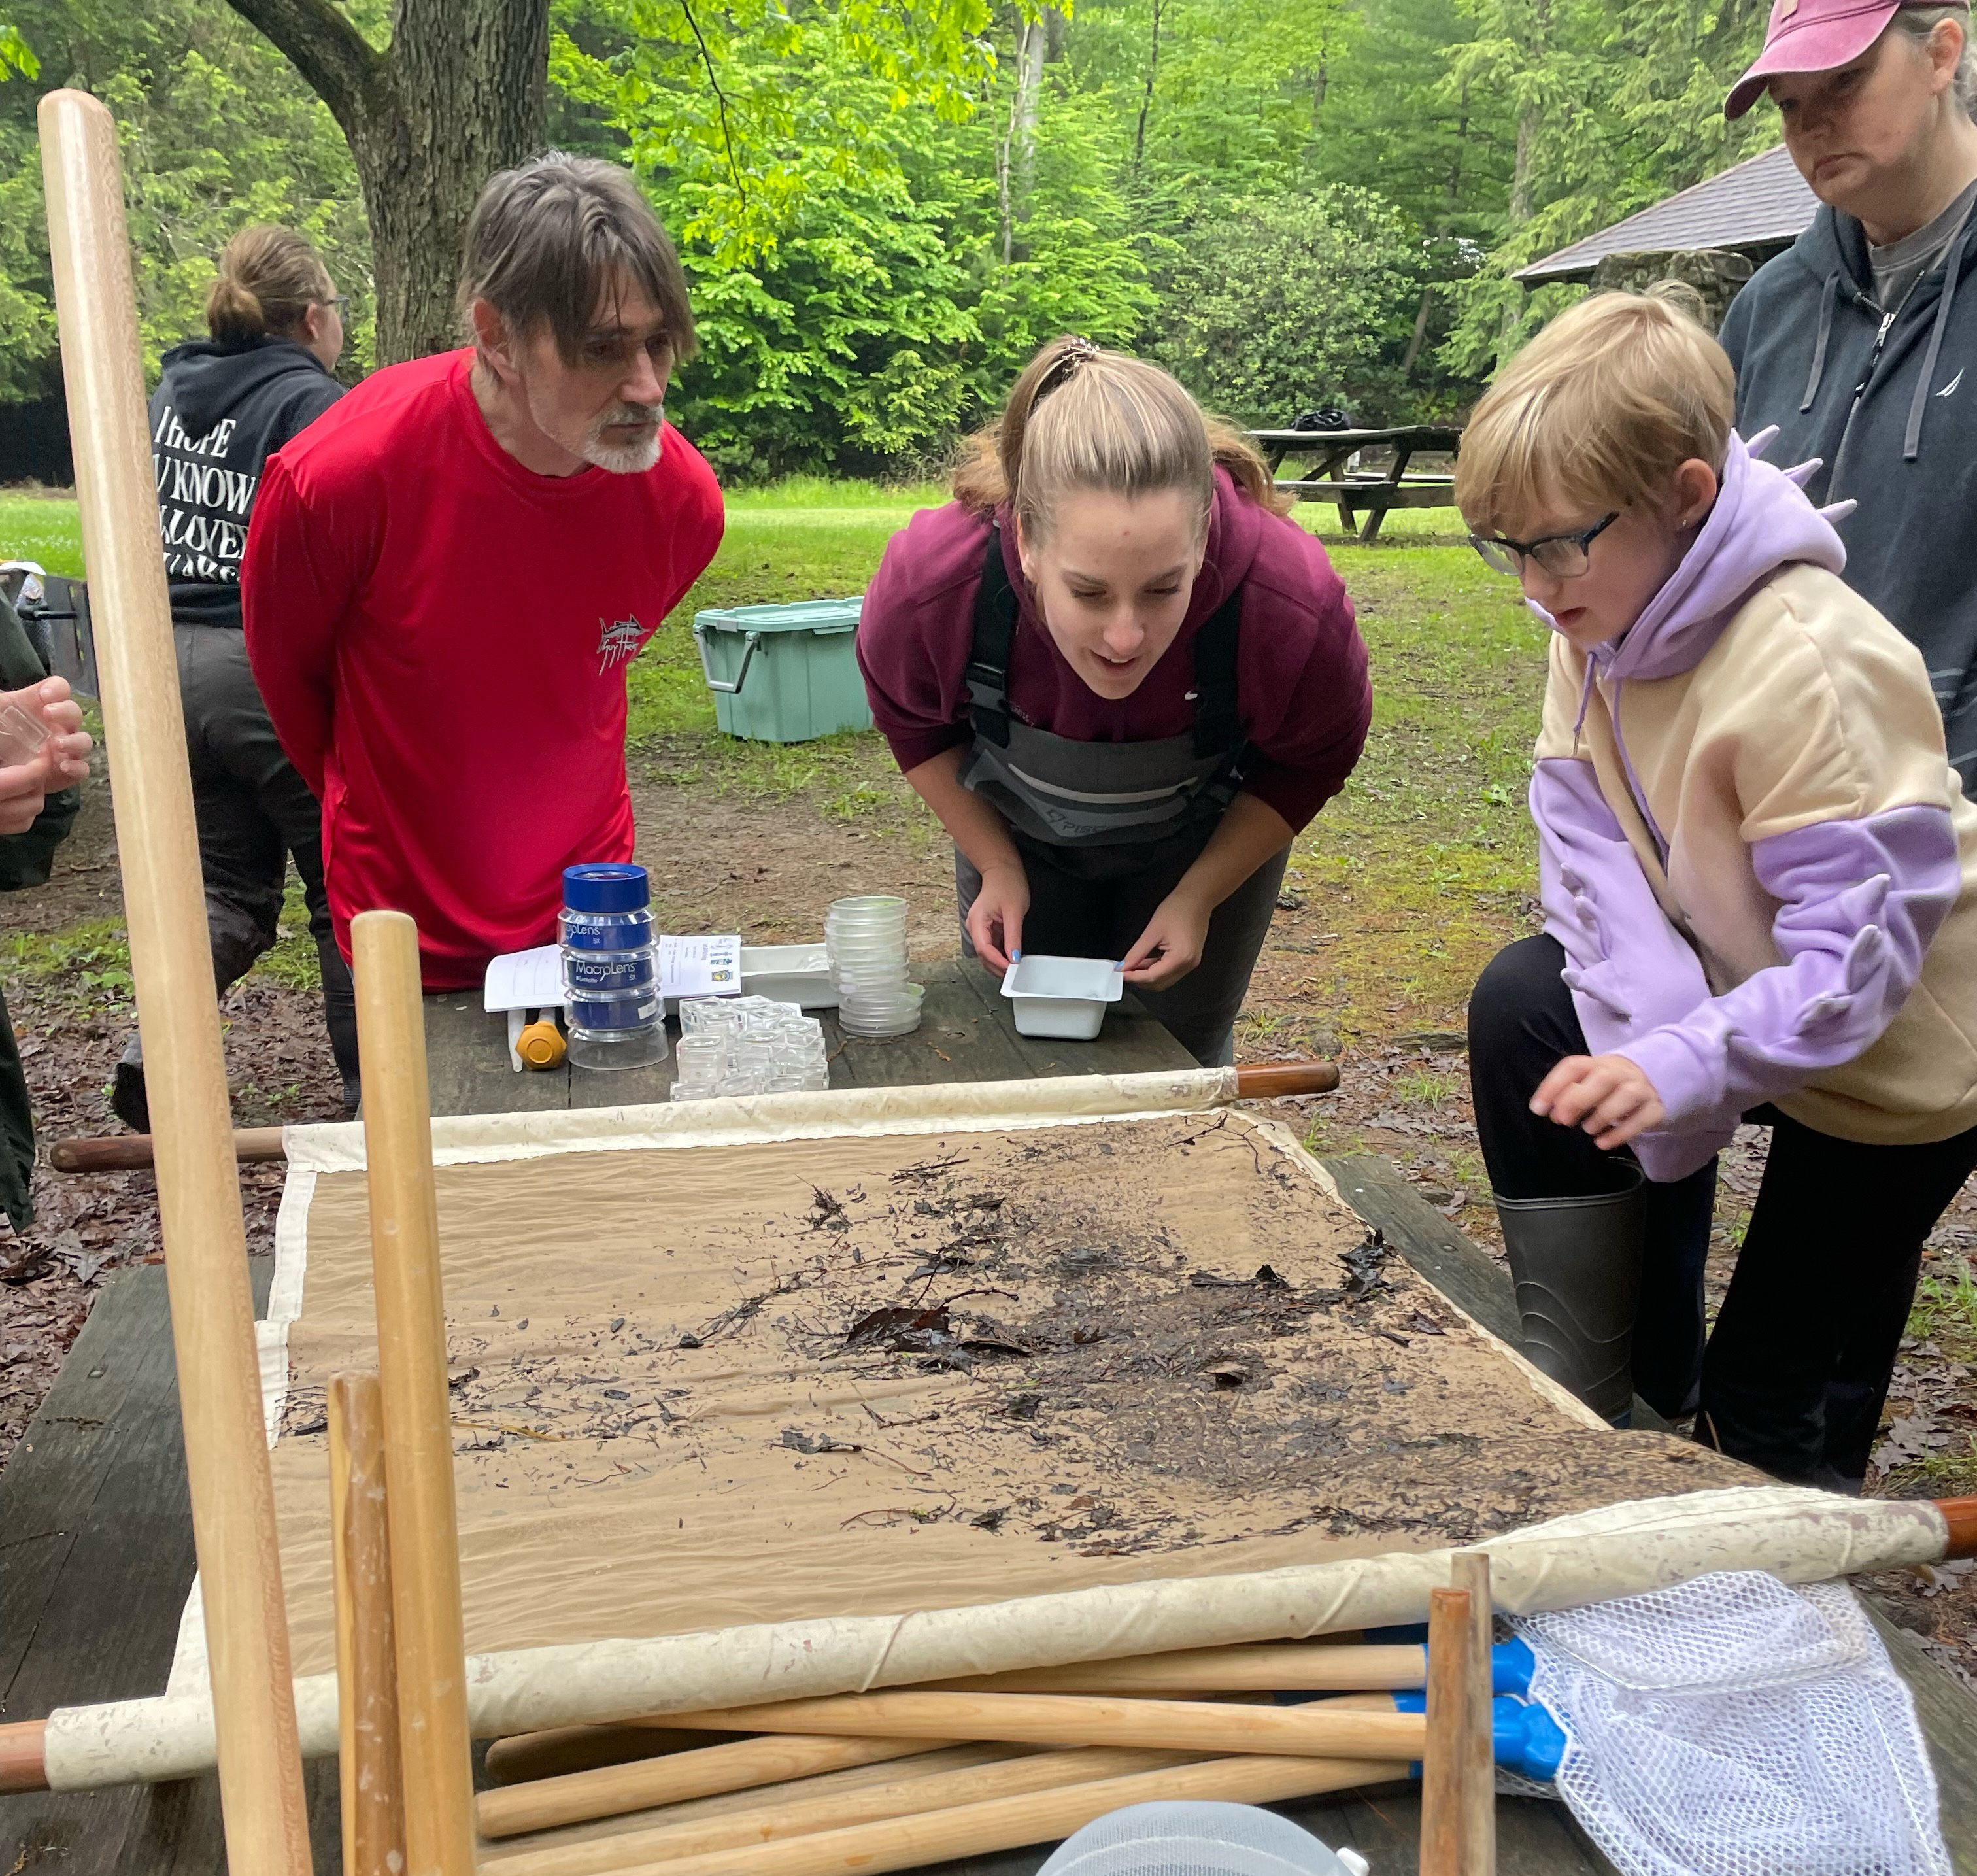
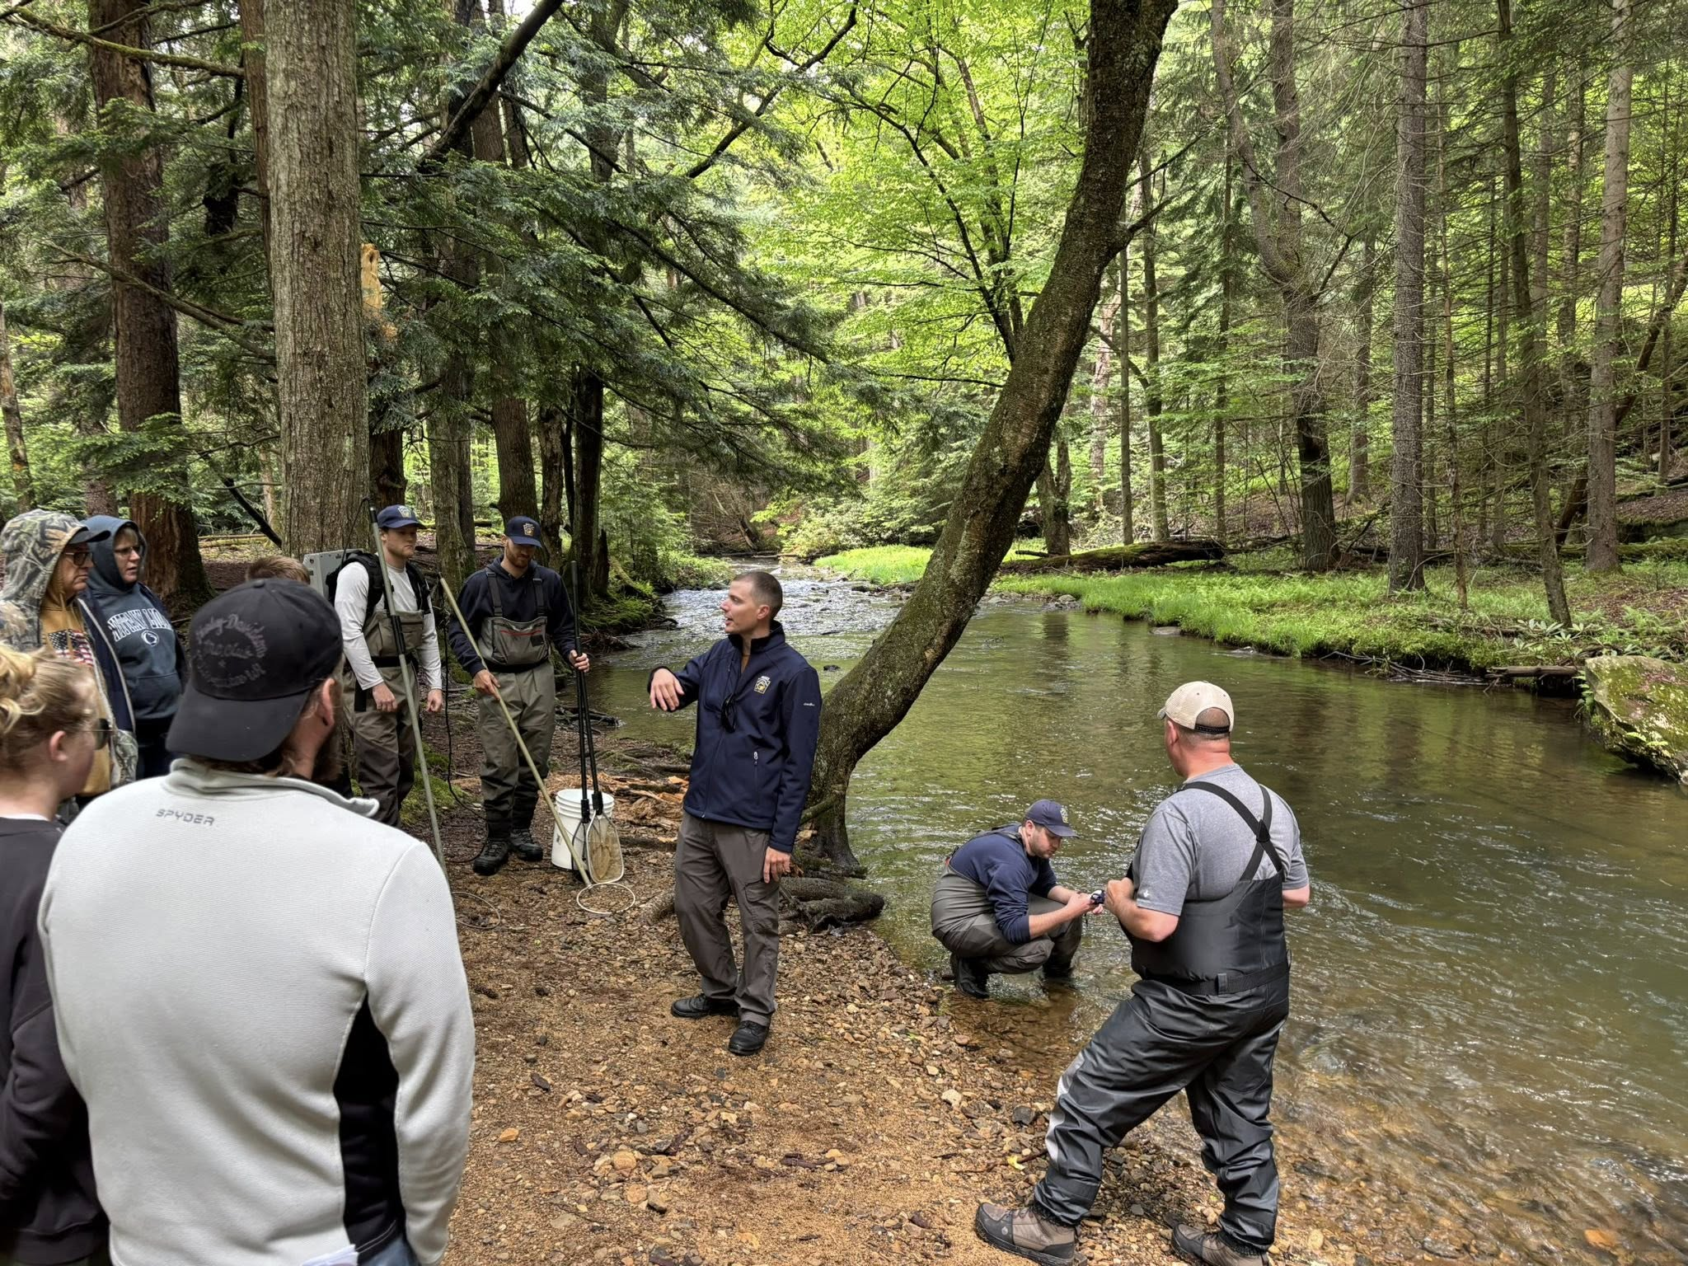
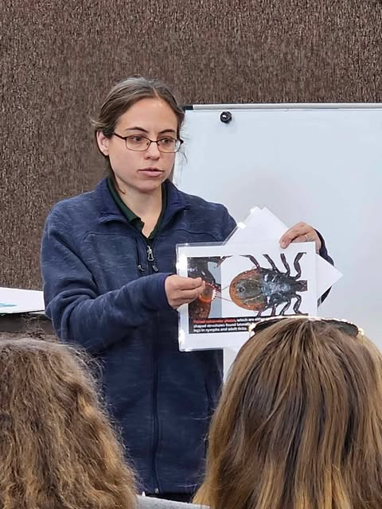
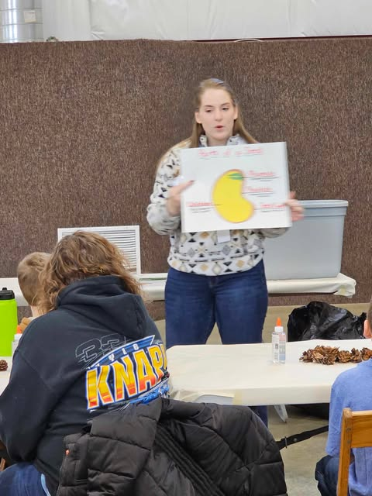
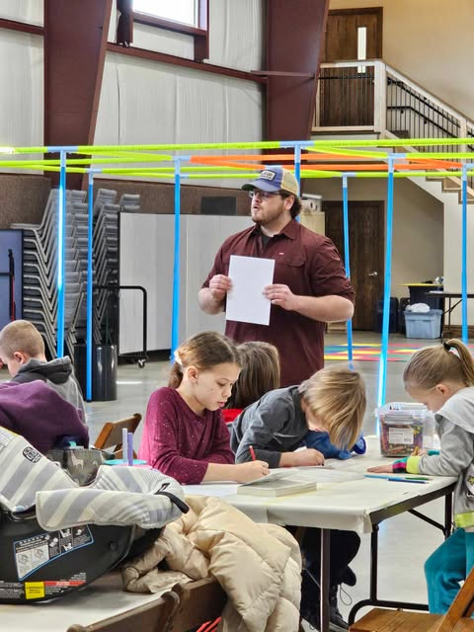
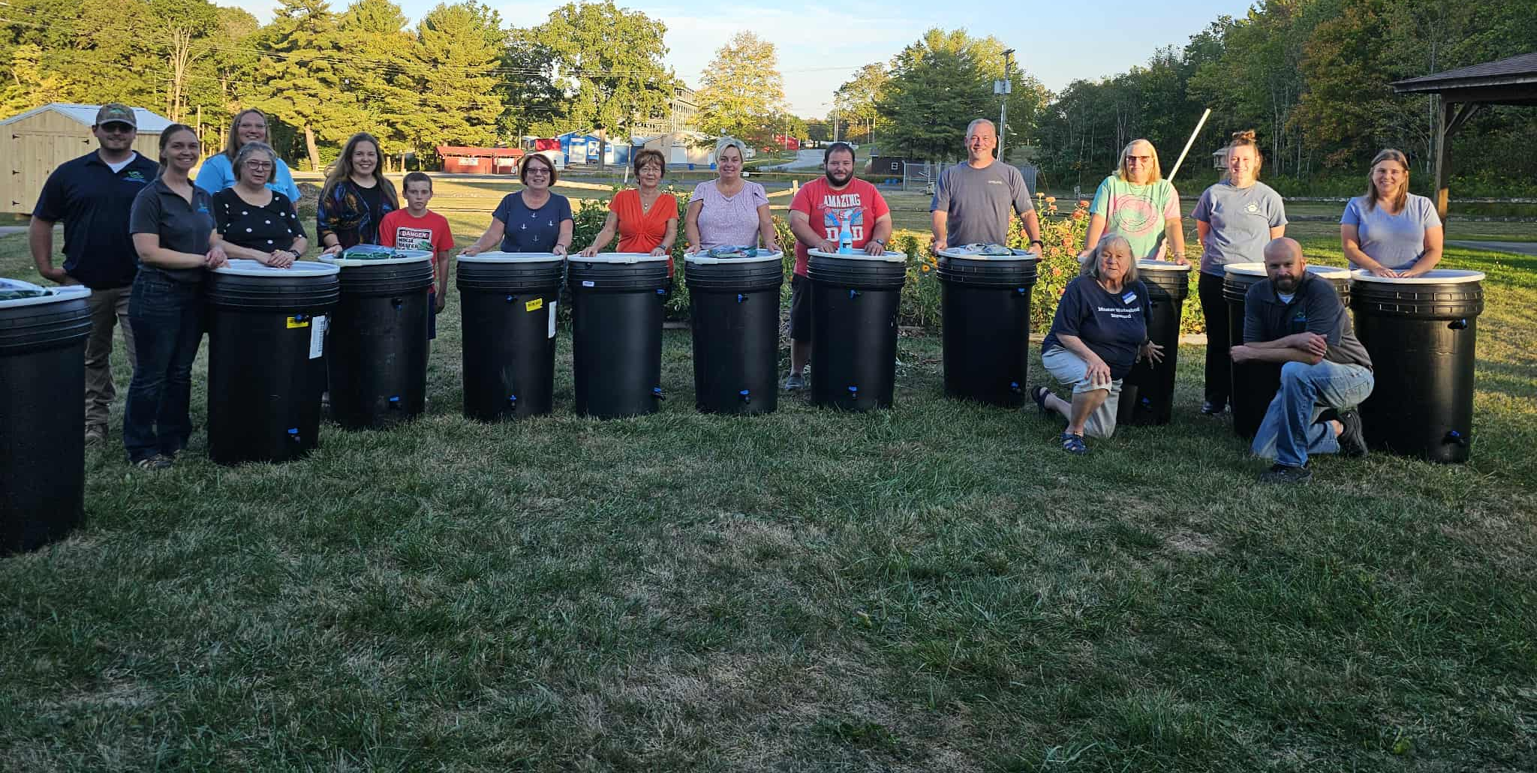
Recruitment, Retention,
Reactivation (R3) Event
Mahaffey Camp
Rain Barrel Workshop

Slide 17
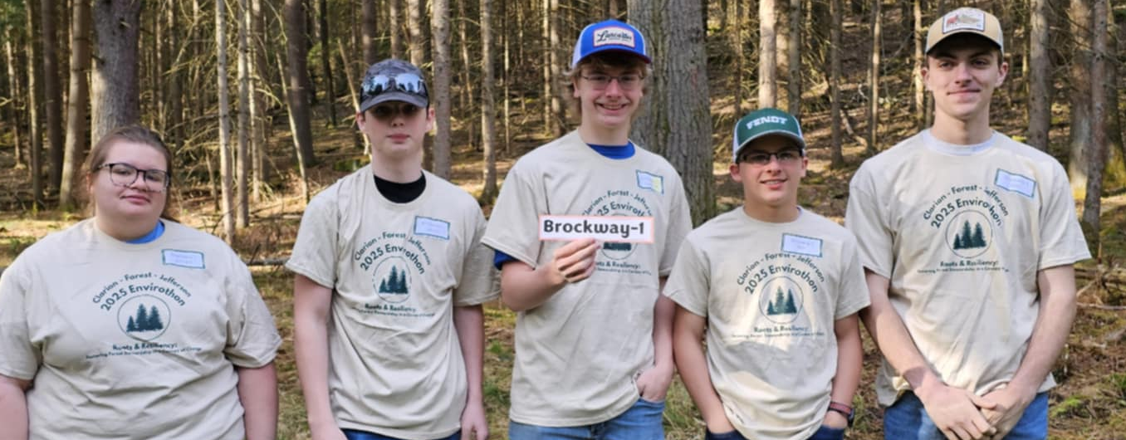
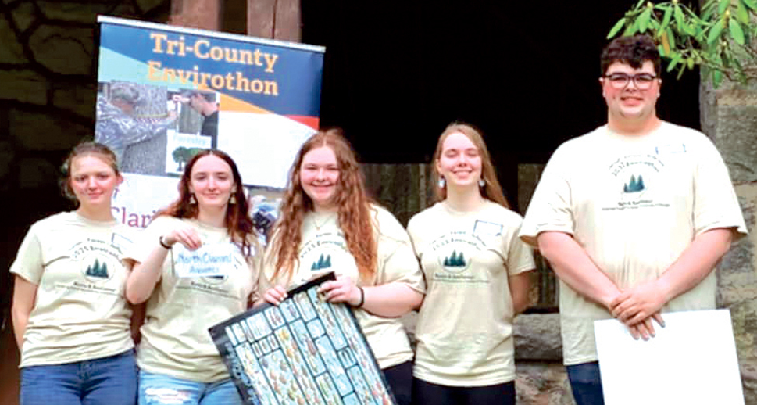


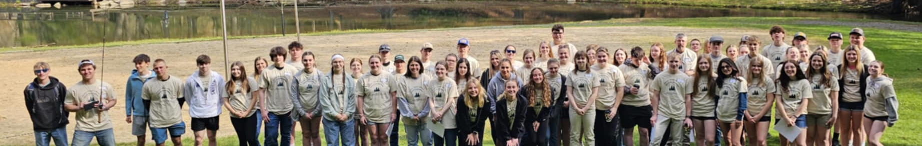
Tri-County Envirothon
Jefferson, Clarion, and Forest Counties
1st place: Brockway 1
2nd place: North Clarion
The Tri-County Envirothon was held on April 29, 2025. This year's event was held at the Clear Creek State Park in Sigel and was sponsored/planned by the Clarion Conservation District, Forest County Conservation District & Planning Department, & Jefferson County Conservation District
Fourteen teams from seven different schools in Clarion, Forest &
Jefferson Counties participated.
The schools at this year's Envirothon included:
Clarion County: Union, Redbank Valley, North Clarion & Keystone
Forest County: West Forest
Jefferson County: Brockway & Brookville
Presenters at this year's event were:
Forestry Station- Department of Conservation & Natural Resources
Aquatics Station- PA Fish & Boat Commission
Wildlife Station- PA Game Commission
Soils Station- Jefferson County Conservation District
Students use study materials provided by the Pennsylvania Envirothon to prepare for the event.

Slide 18
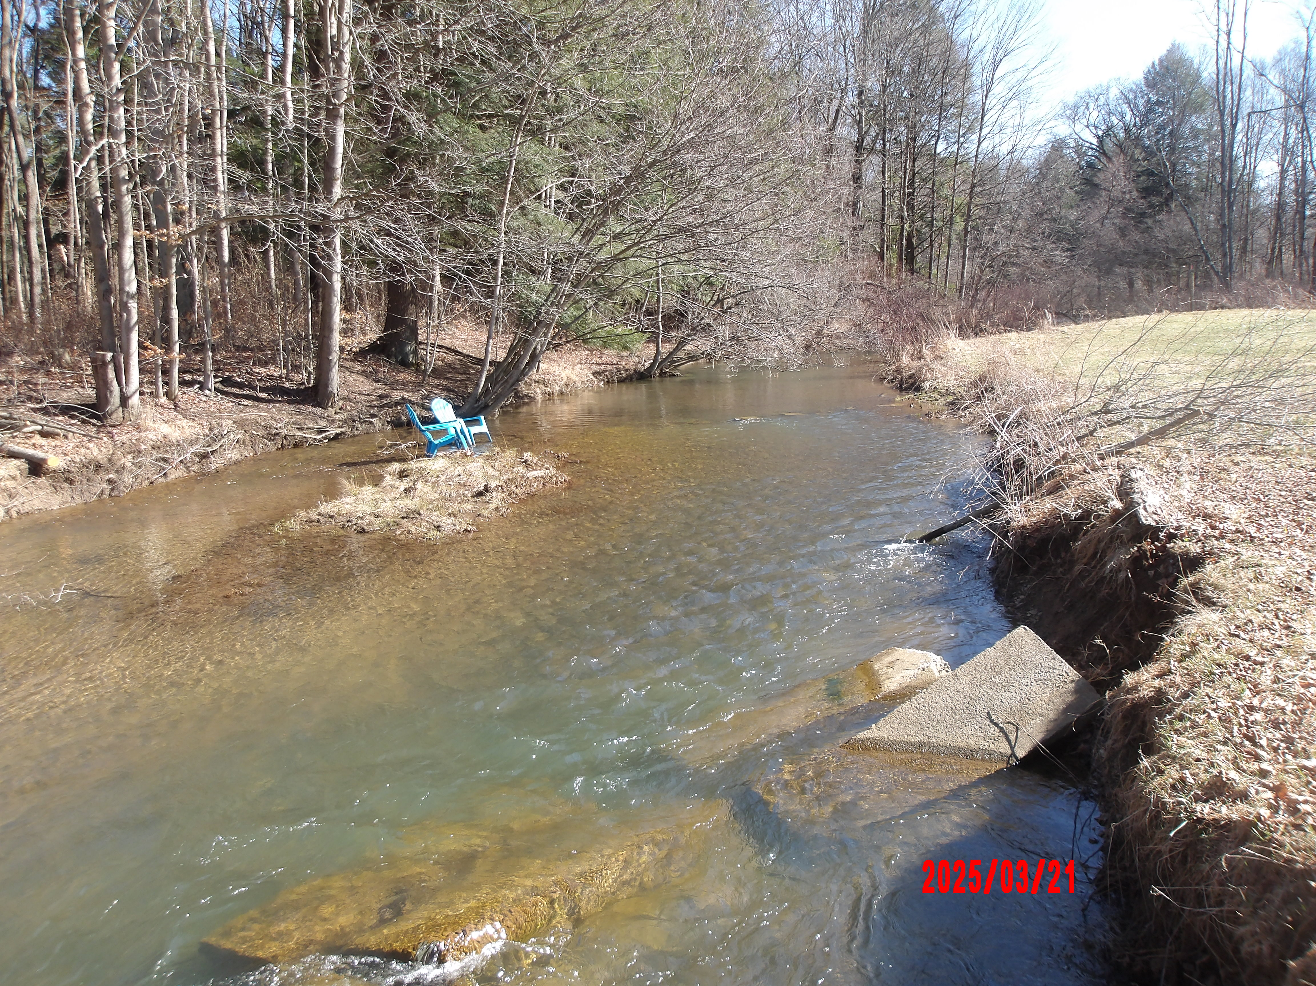
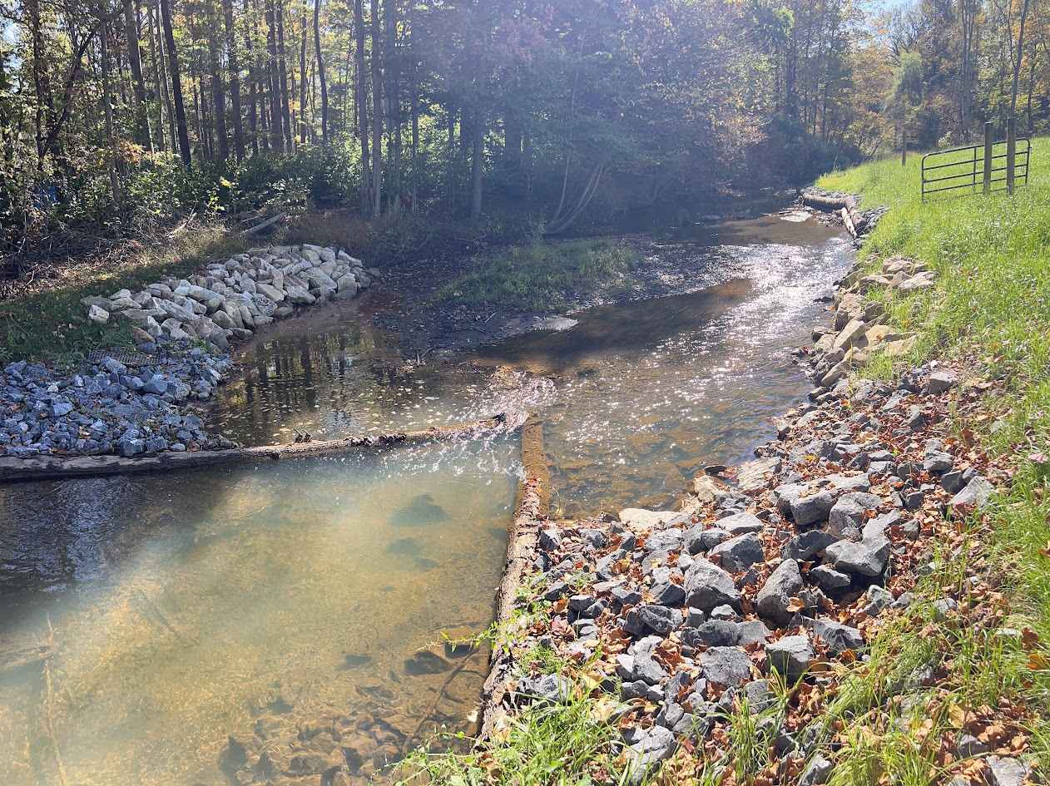
Growing Greener Grant
Rattlesnake Creek
Before
After
In 2022, the Jefferson County Conservation District was awarded a PA DEP Growing Greener Grant to continue the improvement of the Rattlesnake Creek watershed by installing structures to stabilize eroded streambanks and provide fish habitat. Streambank stabilization will help to reduce erosion within the stream channel and prevent scour of the stream bank so property owners will no longer lose property, minimizing risk to nearby structures. Stabilization of streambank erosion through the construction of structures that provide habitat to fish and macroinvertebrates will continue to provide protection to life and improve properties over time. Rattlesnake Creek is a wild and stocked trout stream, and construction of the instream structures will provide a benefit to adjacent property owners by increasing stability of the stream channel and provide a benefit to fish by improving habitat within the stream.
The PA DEP Growing Greener grant allowed for the installation of about 110 streambank stabilization and fish habitat structures along approximately 2100 linear feet of streambank in the Rattlesnake Creek watershed. This PA DEP Growing Greener grant has allowed for great improvement to the Rattlesnake Creek watershed.

Slide 19
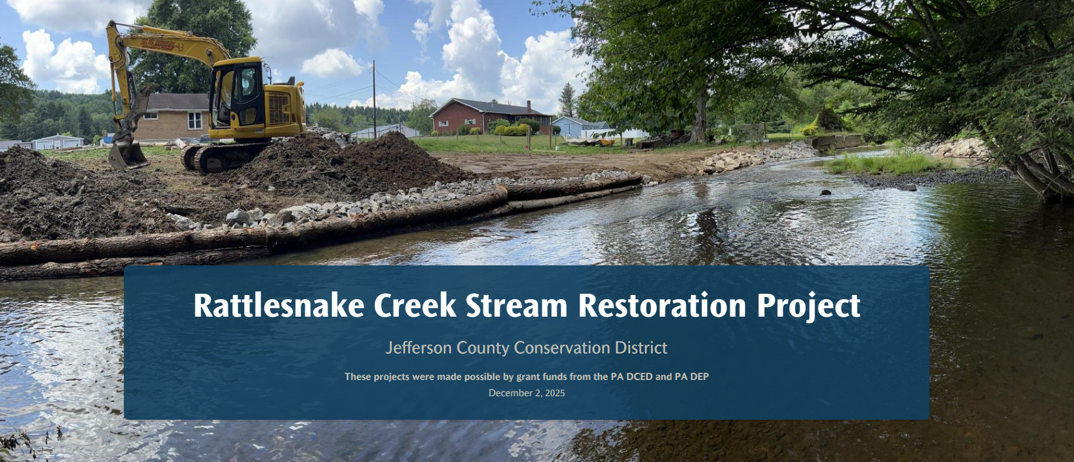
Rattlesnake Creek Stream Restoration Project Story Map
The JCCD has also created a Story Map to showcase the projects in the Rattlesnake Creek watershed. The Rattlesnake Creek Stream Restoration Project Story Map shows the location of each project, as well as the potential environmental benefit of each. The website has interactive maps, links to valuable resources, and clarification on the importance of this type of project.
Check out the Rattlesnake Creek Stream Restoration Project Story Map at: https://storymaps.arcgis.com/stories/3c3aead5e2f24cd8a8e3eb2f6193b6c7

Slide 20
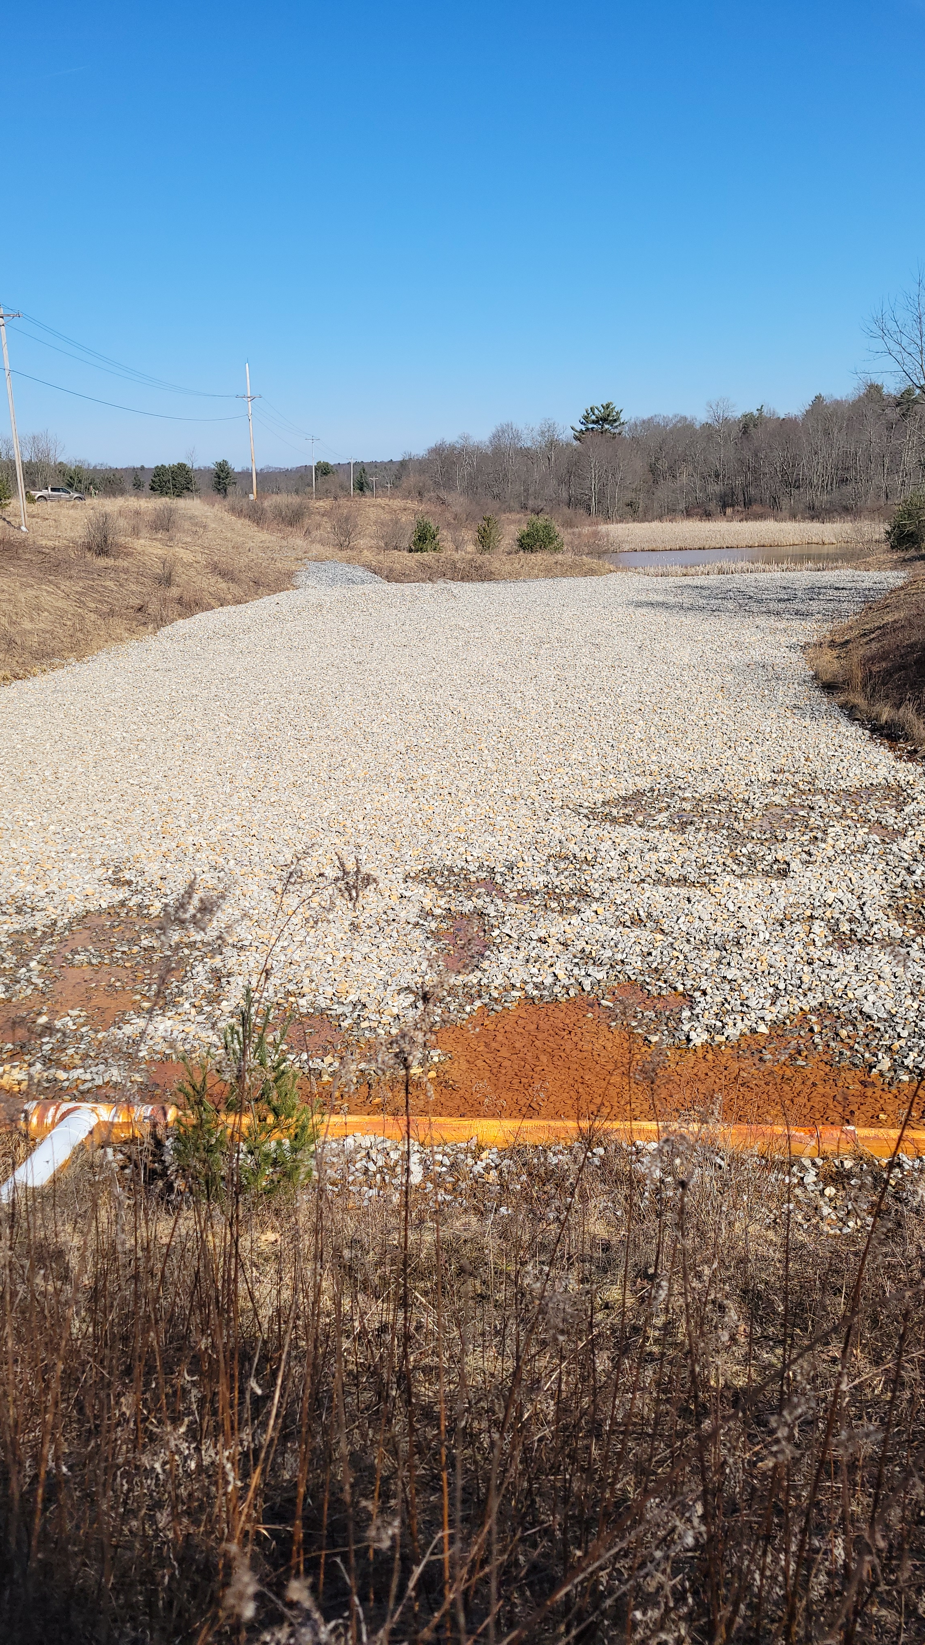
Funding from the Redbank Creek Watershed Trust was used for maintenance of the Conifer East and Conifer West AMD treatment systems in Beaver Township.
Redbank Creek Watershed Trust
Conifer Treatment Systems Maintenance
Conifer West is a passive limestone bed treatment system at an acid mine discharge site located in Conifer, Jefferson County. The treatment system was designed to precipitate (fall out in solid form) and contain iron, aluminum, and manganese solids in a manner that would allow for periodic monitoring and maintenance of the treatment system. When standing water is observed on 75% of the treatment system, it indicates that precipitate has formed over a large portion of the treatment bed and maintenance is needed. This maintenance consists of an excavator scooping and rinsing the stone allowing the precipitated minerals to slough from the stone. Once excess precipitate has been removed from the stone, subsurface treatment is restored. Subsurface treatment provides the maximum surface area of the limestone to interact with the mine discharge, which allows the system to function at its highest level. No maintenance was needed in 2025, and routine sampling was conducted in May and September.

Slide 21
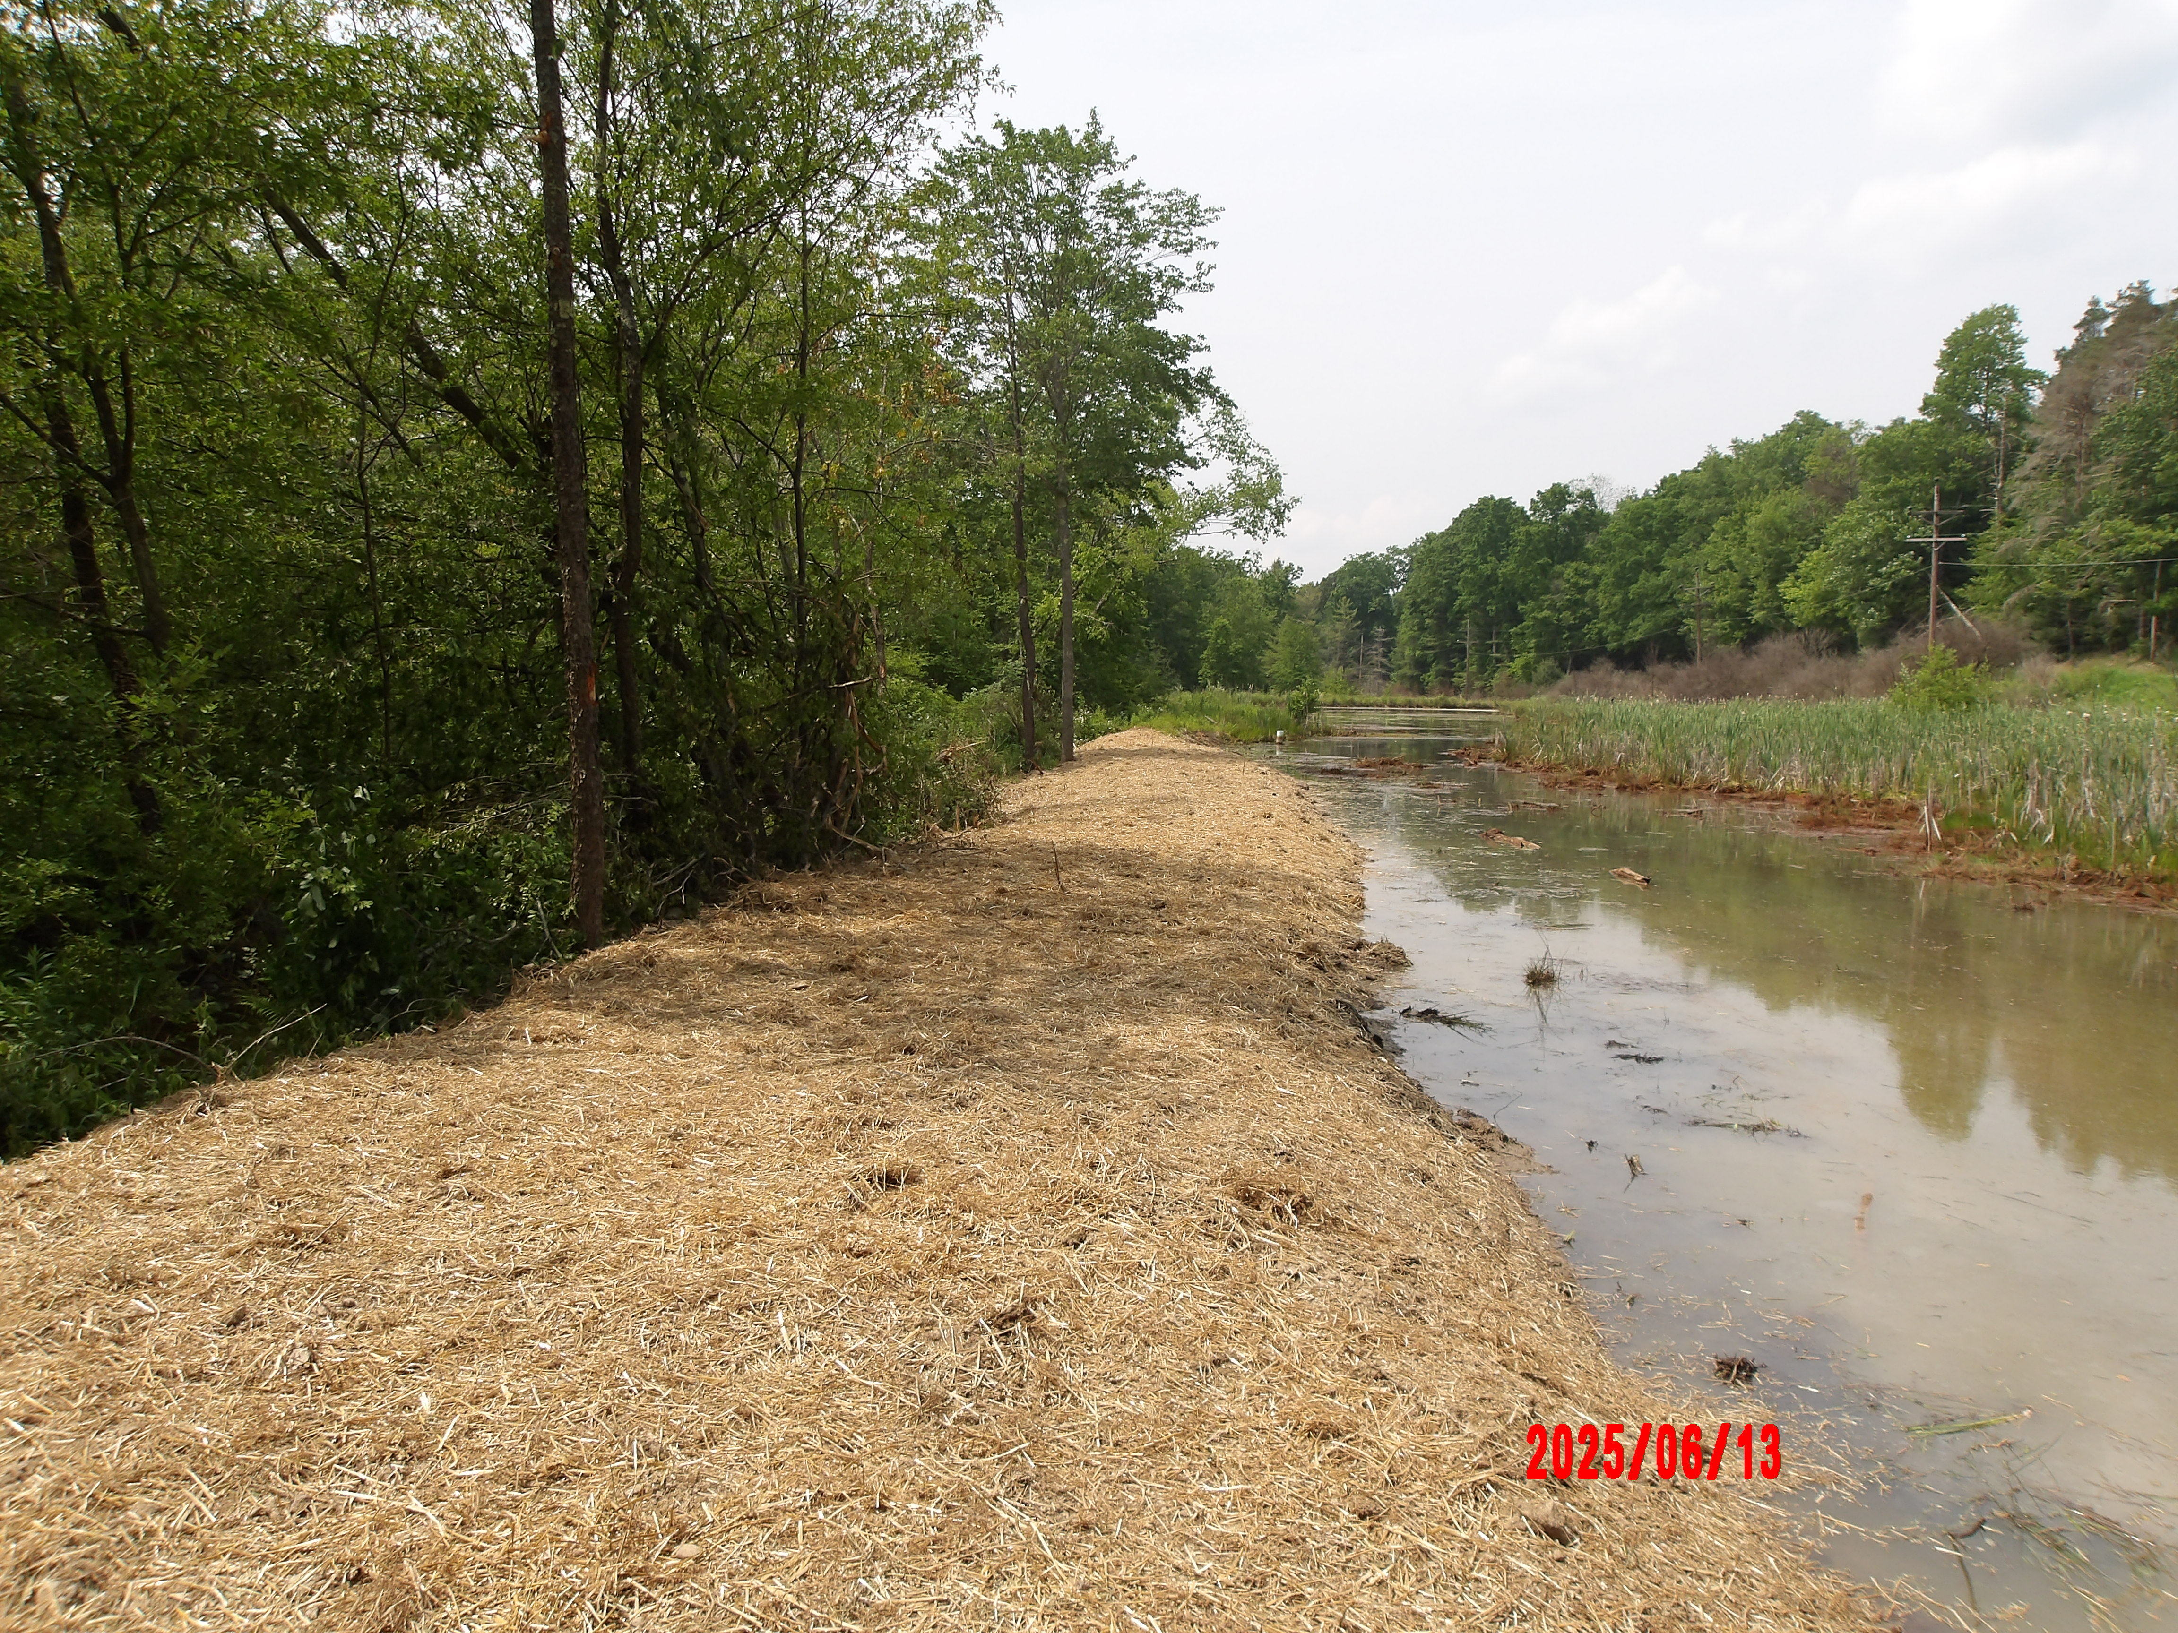
Conifer East is a passive treatment system, consisting of a series of ponds, wetlands and a limestone channel at an acid mine discharge site located in Conifer, Jefferson County. The treatment system was designed to precipitate and contain iron, aluminum, and manganese solids in a manner that would allow for periodic monitoring and maintenance of the treatment system. Routine inspections and water sampling help determine if the system is functioning properly and when maintenance is necessary. Maintenance consists of reshaping the channel and replacing the limestone. The placement of fresh limestone re-establishes subsurface treatment. Subsurface treatment provides the maximum surface area of the limestone to interact with the mine discharge, which allows the system to function at its highest level.
The maintenance conducted in 2025 consisted of rebuilding the berm that had been damaged by muskrats. Sampling was conducted in May and September.
Conifer East berm repair maintenance project in 2025.

Slide 22
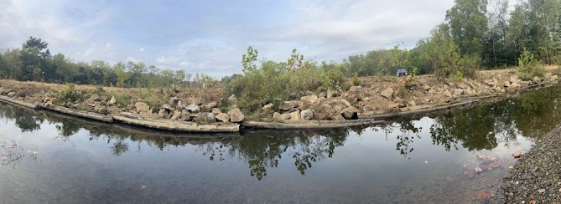
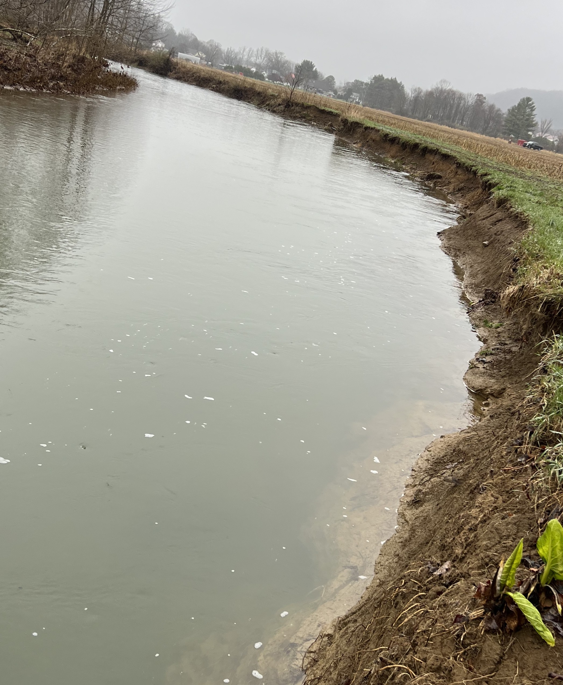
Little Sandy Project
Repair Project
This project aimed to repair the mudsills installed in Worthville along Little Sandy Creek in 2016. Approximately 80 tons of R-6 stone was placed behind the existing mudsills to protect the bank from erosion.
Repair project along Little Sandy Creek
New Project
This project installed 14 modified mudsills and a wing wall along Little Sandy Creek, just downstream from the repair project. This project spanned approximately 300 linear feet and aimed to prevent streambank erosion and provide fish habitat. Live staking will be done in the spring of 2026 to add more riparian flora to the streambank
Before the 2025 project.
After the 2025 project.

Slide 23

Contact Us
Mailing Address:
1514 Route 28,
Brookville PA, 15825
Phone Number:
(814) 849-7463
For more information on the Jefferson County Conservation District, visit our website at:
www.jeffersonconservation.com

